Slide 1

Florida PALM
FLAIR Replacement System Overview & Timelines
Nona McCall
Director of Financial Services

Slide 2
What is PALM?
The Planning, Accounting, Ledger Management System (PALM) will replace FLAIR for:
  Accounting (Disbursements and Revenue)
  Reporting
  Payroll

Slide 3
Project Timeline
Cash Management Wave (CMS) –implemented July 2021
Financials Wave – July 2024
  Central FLAIR functionality
  Departmental FLAIR functionality
  Information Warehouse reporting data

Slide 4
Project Timeline - Continued
Payroll Wave – July 2024
  People First payment data is uploaded to the FLAIR Payroll module for payment processing
  Now implementing with Financial Wave instead of January 2025

Slide 5
Project Timeline - Continued
Expansion Wave – TBD, it will be post-July 2024
All dates are subject to change

Slide 6
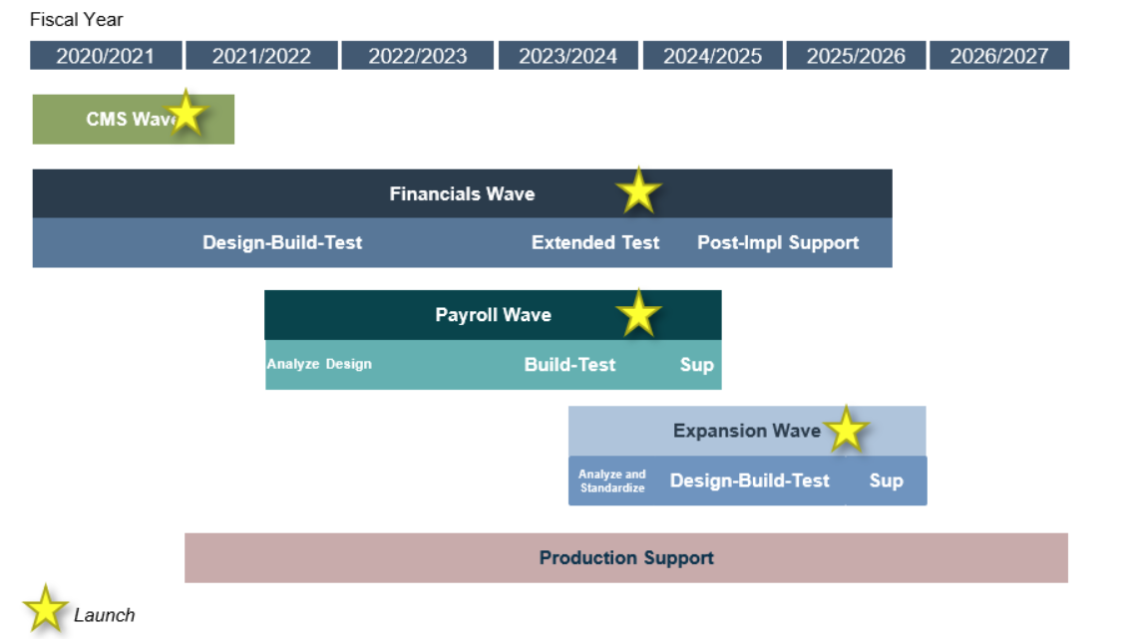
Project Timeline - Continued

Slide 7
What We Know
Cloud/Web based like STMS and PCard
PALM will be different
  Some FLAIR codes will change

Slide 8
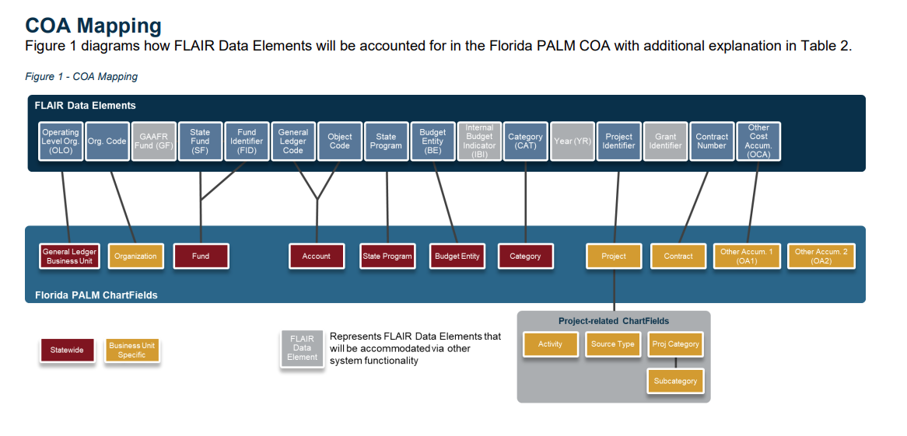
PALM – Chart of Accounts

Slide 9
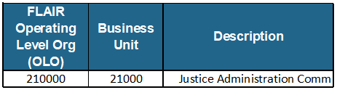
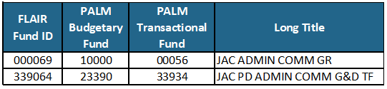
PALM – Chart of Accounts
FLAIR OLO’s name and ID changes slightly
FLAIR Fund ID’s are changing
  PALM Budgetary Fund – unchanged
  PALM Transaction Fund

Slide 10
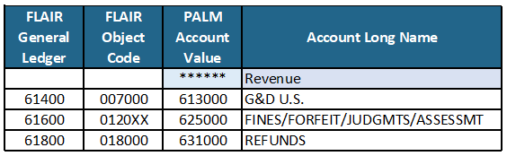
PALM – Chart of Accounts
Object Code and General Ledger will be combined and become Accounts
  Revenue will start with a 6
  Expenditures will start with a 7
(Expenditure example unavailable)

Slide 11
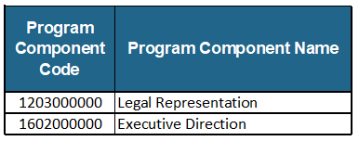
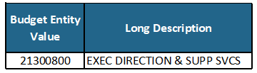
PALM – Chart of Accounts
State Program Codes are the same
Budget Entity is not changing

Slide 12
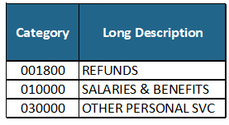
PALM – Chart of Accounts
Category Codes are the same

Slide 13
Changes Coming
Organization (Org) codes structure may change
Expansion Options (EO) and the ORG/EO combination is eliminated
  FLAIR ORG/EO linked all FLAIR critical elements together
  Speed Types – provides a slightly similar linking

Slide 14
Changes Coming
There are 4 other fields for tracking expenditures and revenue:
  Project ID
  Contract
  2 Other Accumulators

Slide 15
JAC’s preparation for July 2024
Attending all of PALM’s workshops and trainings to understand the system and identify changes
CIP is aware of the PALM implementation and can start researching the impact on BOMS and needed changes

Slide 16
Start Next Fiscal Year . . .
Start an ORG code clean up before the PALM transition
Review and collect the Revenue Agreements to aid in ORG code clean up
Study and discuss ORG code structure and possible changes

Slide 17
Takeaway Today
DFS is still developing workflows
Yes, there are changes, but they’re not extreme
JAC is working to make this as smooth as possible for you
JAC will keep you updated as more information becomes available

Slide 18
How Can You Prepare?
Understand the accounting information
  Fully understand FLAIR accounting data, see Handout 1
  Understand the Account Code by Circuit Worksheets
    What is an ORG code
    What is a GR fund or a Trust fund
    What is your Budget Entity

Slide 19
How Can You Prepare?
BOMS users – understand how BOMS ties a Fund Name to the FLAIR accounting data
  JAC has a BOMS Fund named 22-GR3230
Notes:
What FLAIR accounting info does that represent in FLAIR?
What ORG/EO, Fund ID, and Category is tied to that Fund Name?

Slide 20
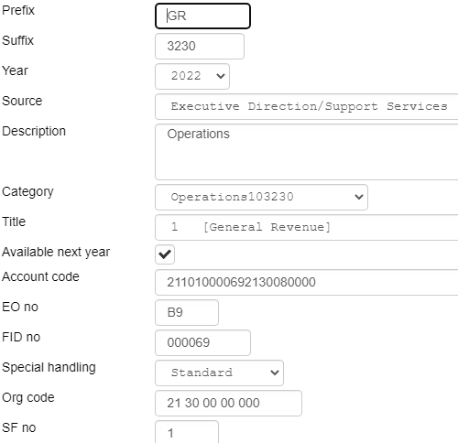
How Can You Prepare?
Notes:
What FLAIR accounting info does that represent in FLAIR?
What ORG/EO, Fund ID, and Category is tied to that Fund Name?

Slide 21
Don’t be Overwhelmed
We have time to plan and be prepared
JAC will support you in learning the new system

Slide 22

Questions
Contact:
  (850) 488-2415
  nona.mccall@justiceadmin.org

