Slide 1
PALM Knowledge Share
Workshop
January 2025

Slide 2
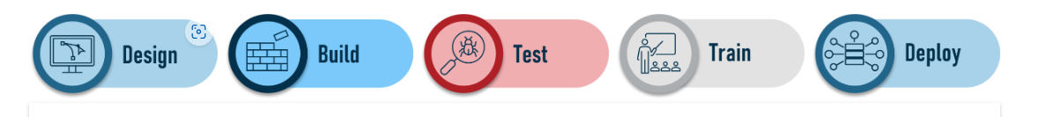
Florida PALM Project Overview
The Project’s solution goals include:
Reduce the state’s risk exposure
Improve state and specific decision making
Improve the state’s financial management capabilities
Increase internal controls by enabling standardization and automation of business processes within and between DFS and agencies.

Slide 3
Florida PALM Project Overview
Financial Management Solution:
A system that allows the State to organize, define, and standardize its financial management business processes and that complies with Sections 215.90 - 215.96, Florida Statutes.

Slide 4
2024 – Design Workshops
  To achieve success with progression of the project, the following initiatives have been completed:
  31 Design Sessions
  Workshops spanned September 2023 through November 2024
  1300 Attendees from 37 State Agencies and the PALM Project

Slide 5
2024 - JAC Activity
  Created 125 Process User Guides (PUGs)
  Published bi-monthly status reports
  Created the Workforce Readiness Plan
  Created a Communications Plan
  Created a Change Management Plan
  Identified and updated a Future End Users
  Performed JAC data cleansing activities

Slide 6
Agency Business Systems (ABS)
Reviewed and began remediating :
  CATTS
  Laserfiche
  And other systems
Selected and tested data exchange interfaces

Slide 7
PALM Development Status
PALM is divided into four segments
  The Segment I & II builds are complete: Build III should be done in February
  Examples of Segment I activities
    Chart of Accounts
    Budget Journals
    Process Vouchers

Slide 8
JAC ChartFields and Configuration
ChartFields and Configurations have been created
Accounting Code Configuration is on-going
  Examples:
    Organization Code
    Location
    Speedkey
    Other Accumulator 1 (OCA will not exist in PALM)
JAC has determined which current data will be converted to PALM at Go-Live

Slide 9
Florida PALM ChartField Vocabulary
Previously, FLAIR data was called ‘data elements’
In the future, PALM will refer to the same data as ‘PALM chartfields’

Slide 10
Florida PALM Chartfield Vocabulary
FLAIR Data Elements
Operating Level Organization (OLO)
Organization Code
GAAFR Fund (GF)
State Fund (SF)
Fund Identifier (FID)
General Ledger Code
Object Code
Budget Entity (BE)
State Program
PALM Chartfields
General Ledger Business Unit
Organization
Value accommodated using an attribute at reporting
Fund ~State Fund value accommodated using an attribute for Transactional Fund~
Account
Budget Entity
State Program

Slide 11
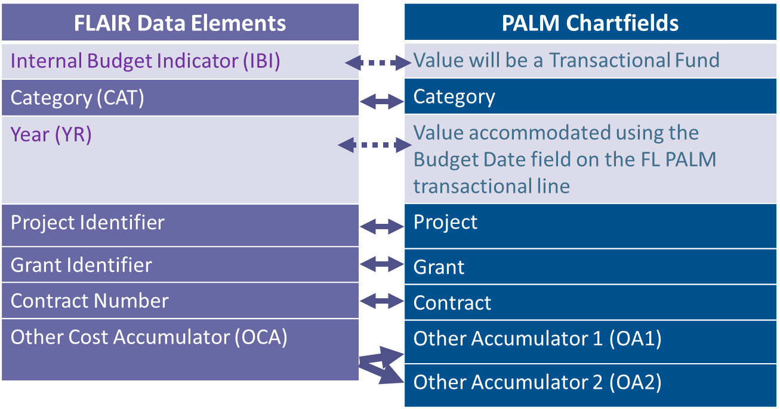
Florida PALM Chartfield Vocabulary

Slide 12
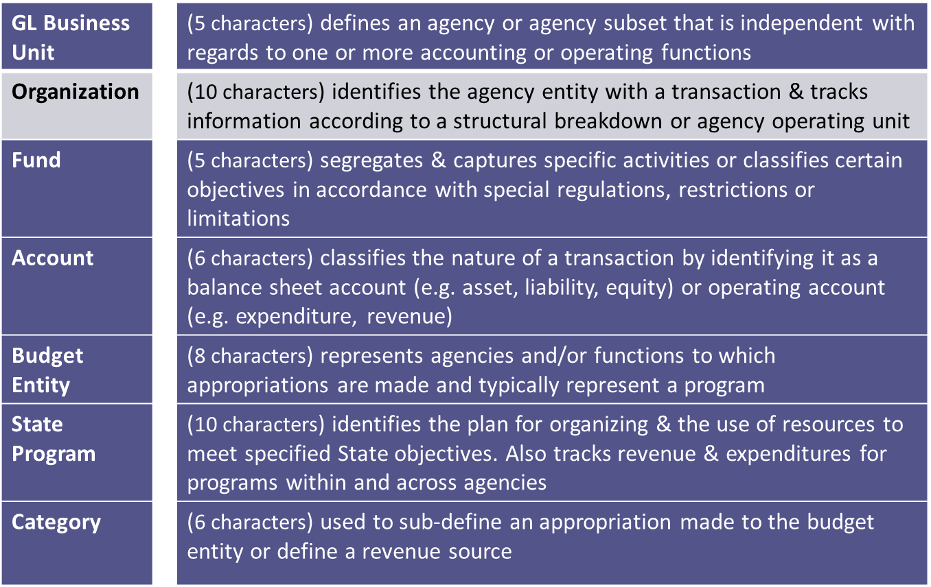
Florida PALM Chartfield Vocabulary

Slide 13
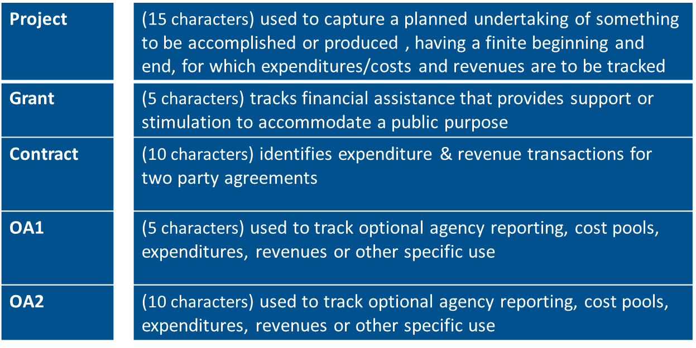
Florida PALM Chartfield Vocabulary

Slide 14
Executive Steering Committee
Breaking News
On January 29, PALM presented Amendment 12 of the Accenture contract to the Executive Steering Committee.
This amendment will increase the scope a tad and delay implementation until July 2026.
The vote was deferred until February 5

Slide 15
2025 Key Dates
Role Mapping – February 3, 2025
User Stories – February 10, 2025
Executive Sponsor Certification of Readiness for User Acceptance Testing – March 14, 2025
UAT to start April 15, 2025 August 11, 2025

Slide 16
2025 Key Dates
User Acceptance Training (UAT)
Phase 1
  Superusers – April 15 thru June 26, 2025
  Data Warehouse available for UAT – June 2025
Phase 2 – All Future Users – July 7, 2025
Phase 3 – Year-End Close – October 2025
UAT will continue until November 2025 (we will use the UAT system as a Sandbox)

Slide 17
2025 Key Dates
PALM Hosted Training
PALM Project Hosted Training - “How to use the system”
UAT Pre-Training (date TBD)
Instructor-Led & Web-Based Training – July 1 start date
End User Manual– Autumn 2025
Learning Management System – Hosted on PeopleFirst

Slide 18
2025 Key Dates
Agency Specific Training
Starts in October 2025
Training will include items specific to JAC

Slide 19
Shut Down and Go-Live
The Executive Steering Committee will decide in November 2025 as to Go-Live readiness
Shut Down will be mid December 2025
Go-Live will be January 6, 2026
  Post Implementation Support –Jan – Sept 2026
  Sandbox will continue after Go-Live
  Florida PALM Solution Center – Customer Portal (currently available ) will serve as a one stop shop for questions.

Slide 20
Roles
PALM end user roles definitions:
Maintainer - an administrative role that manages exceptions, ChartField values, or other configuration data and has access to run and review reports for the related business processes
Processor - adds, reviews, and updates transactions and will typically send transactions to the Approver. A Processor also has access to run and review reports for related business processes
Approver - approves transactions added or updated by a Processor and has access to run and review reports for the related business processes
Reporter - runs and reviews reports
Requester - submits support requests (usually through Florida PALM forms) to other end users

Slide 21
User Stories
What are User Stories?
How do they help prepare for UAT
Scheduled to be released on February 10
Example: “As a Budget Processor, I need to enter Allotments in PALM, so that JROs can see their Allotments.” This can be verified by looking at a PALM report.

Slide 22
User Acceptance Testing (UAT)
Will be different from other UAT at other projects in which you may have participated. PALM considers UAT to be part of User Training.
UAT and Training will run in tandem and provide unique learning opportunities

Slide 23
UAT Phases
Phase 1 – Superusers – April 15 – June 26, 2025
Superuser responsibilities:
  Attend FL PALM – hosted sessions to learn how to use FL PALM
  Test agency transactions completed in FLAIR between Feb 10 – Apr 4, 2025
  Reprocess those transactions in PALM

Slide 24
UAT Phases
Phase 2 – All other end-users – July 7, 2025
End-user responsibilities:
  Superusers who have participated in Phase 1 will host Agency-led UAT sessions with other users
  Reprocess transactions from April 7 - June 30, 2025

Slide 25
UAT Phases
Phase 3 – Year End Close– October 2025
Selected users will focus on completing year-end activities in the UAT environment
UAT may continue until November 2025 (we will use the UAT system as a Sandbox)

Slide 26
Next Workshops
  How to Write User Stories
  PALM’s 13 Business Process Groupings
  JAC’s Chart of Accounts and what you need to know
  Knowledge Center and other PALM resources

