Slide 1

PALM Information Exchange Meeting at CCRC-Middle, Temple Terrace, FL
January 24 and 25, 2024
Welcome!

Slide 2

Launching in 1 Year,
11 Months and 13 Days

Slide 3
Florida PALM
Planning, Accounting and Ledger Management
What we know about PALM today
But first…..

Slide 4
First - Our caveats
Our current knowledge is VERY limited
We have attended numerous workshops but have only seen sample screen shots of most modules
We have a list of anticipated reports; we have seen a few samples but no actual reports
We learn more almost every day

Slide 5
What we do know
The PALM Go-Live date is 01-06-2026
We receive focused snips of information at various workshops.
We have 158 tasks assigned to us and another 25 that we have created internally.
FLAIR end of life is June 30, 2026
We can’t do this without YOU.

Slide 6
Impact on the JROs
PALM is web-based
A single password for any PALM module. (If you have STMS on 01/05/2026, your PALM PW will be the same.)
Different data elements in the Chart of Accounts; more functionality, fewer codes.
Report and file formats will be different
Training will begin in mid-2025.

Slide 7
What the JAC is doing today
Understanding & Documenting:
  How the JAC and the JROs use FLAIR
  The FLAIR data elements we use and why
  Our agency business systems; what and why we need them, how we use them, the data outputs and inputs

Slide 8
What the JAC is doing today
Understanding and Documenting (continued):
  The reports we use that contain FLAIR data elements
  Our business processes
  Change impacts
Reviewing data quality and planning for cleaning up old or unused records

Slide 9
What we are asking JROs to do today
Understand what you do in FLAIR (or BOMS) and why
Document and understand both your data sources and reports that you generate
Work in tandem with JAC staff to make good decisions that will affect the future
Be curious and learn more about Florida PALM

Slide 10
Roundtable #1
  Interactive discussion – How the JROs process information, from the receipt of invoices to vouchering

Slide 11
Roundtable #2
  Interactive discussion – Reports and Data
  What FLAIR Reports Used
  What data is received/used
  What’s generated

Slide 12
Florida PALM website
Access the website
  Home (myfloridacfo.com) or
  www.myfloridacfo.com/floridapalm

Slide 13
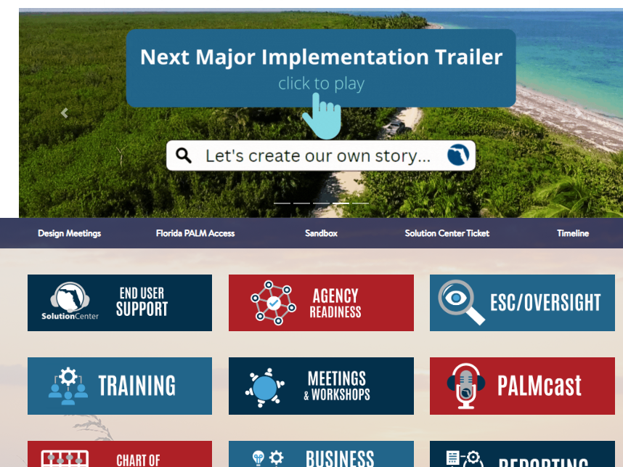
Florida PALM website

Slide 14
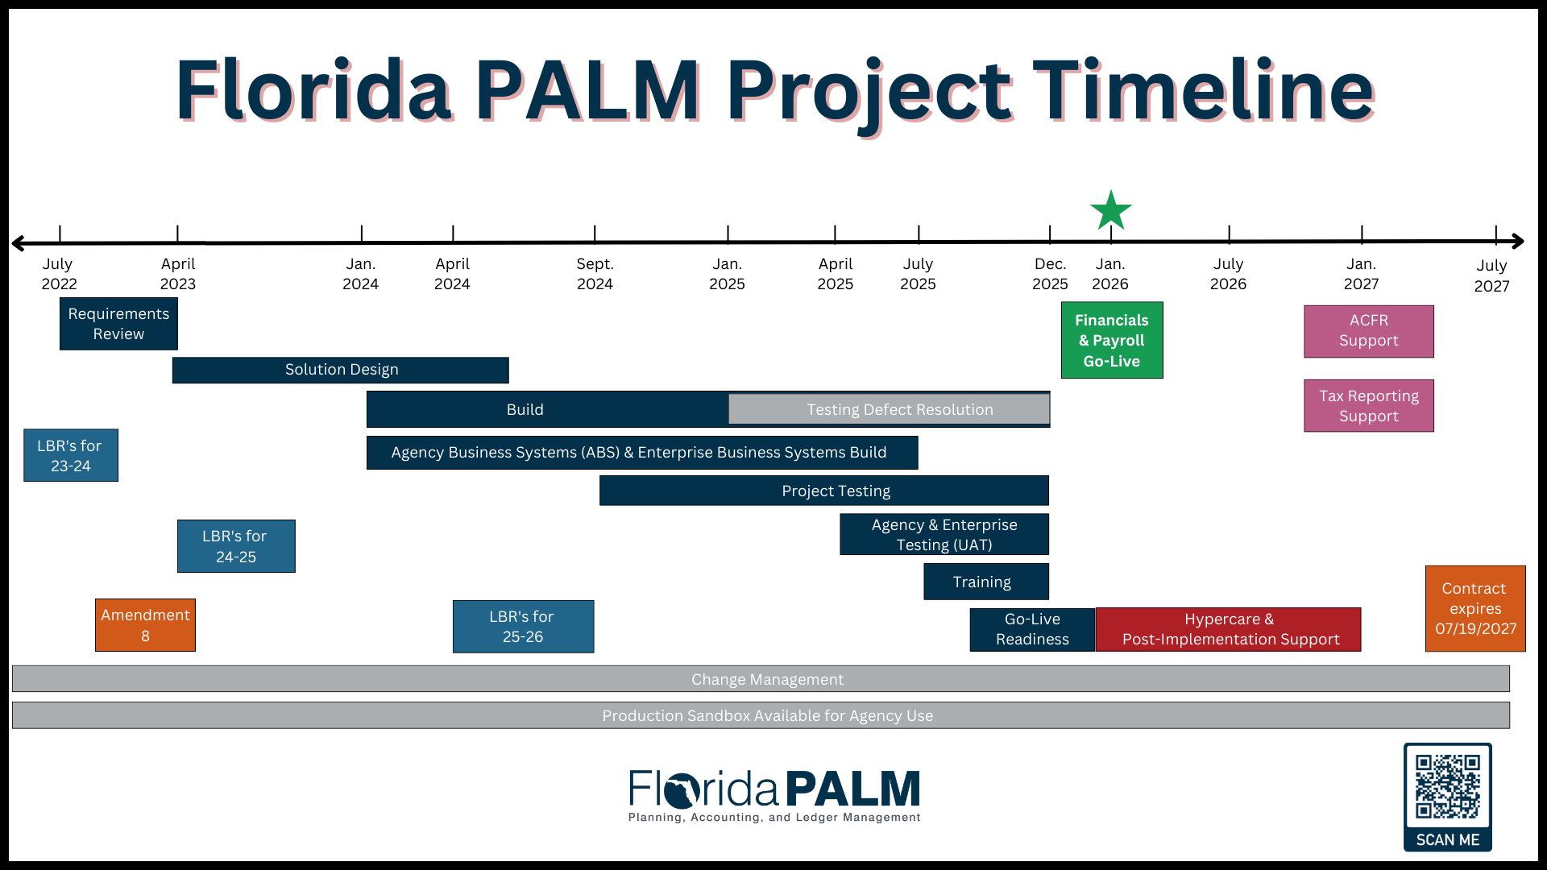
Readiness Timeline

Slide 15
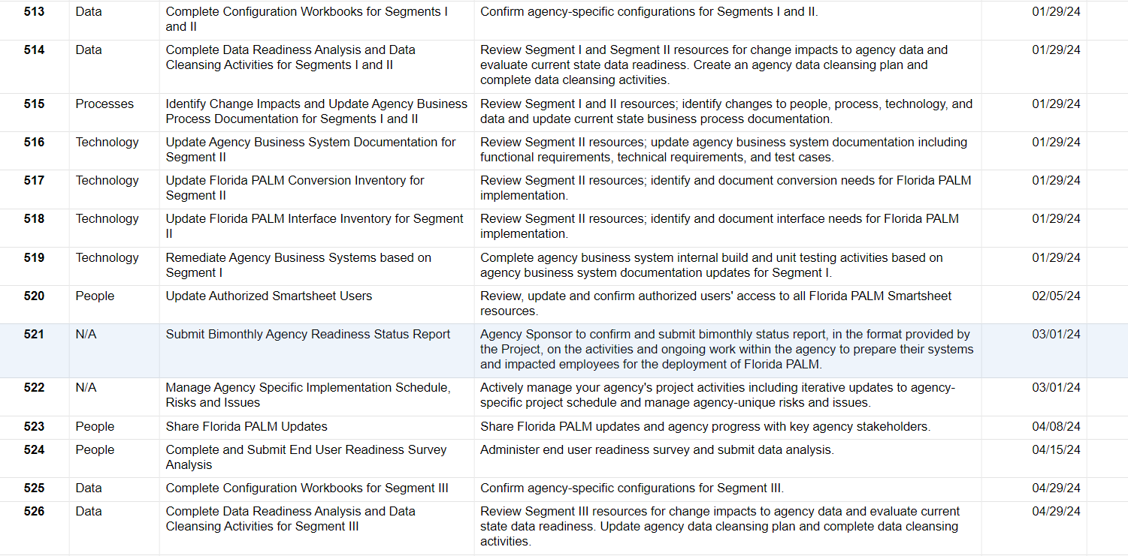
Readiness Tasks

Slide 16
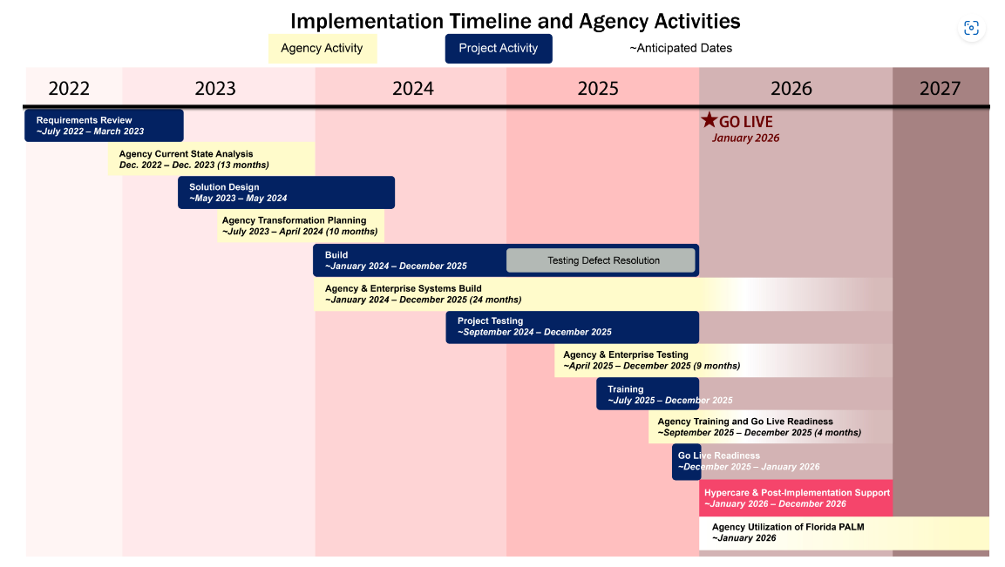
Implementation Timeline -
PALM team and Agencies

Slide 17
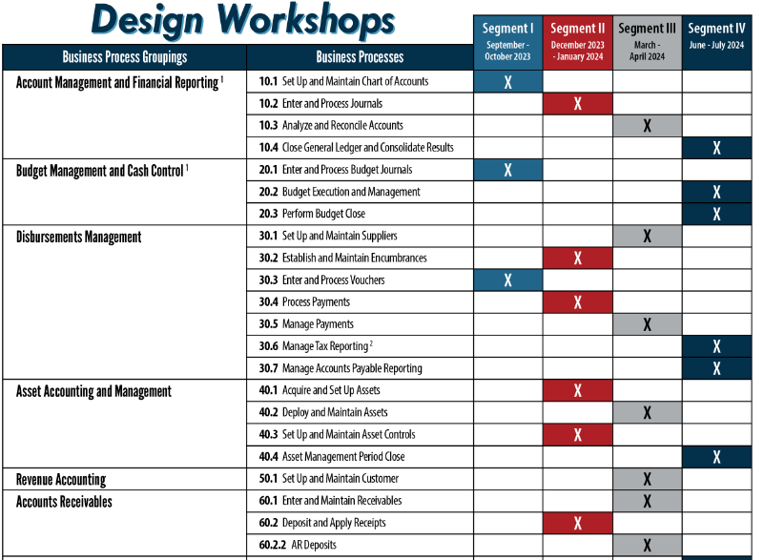
Design Segments
LINK

Slide 18
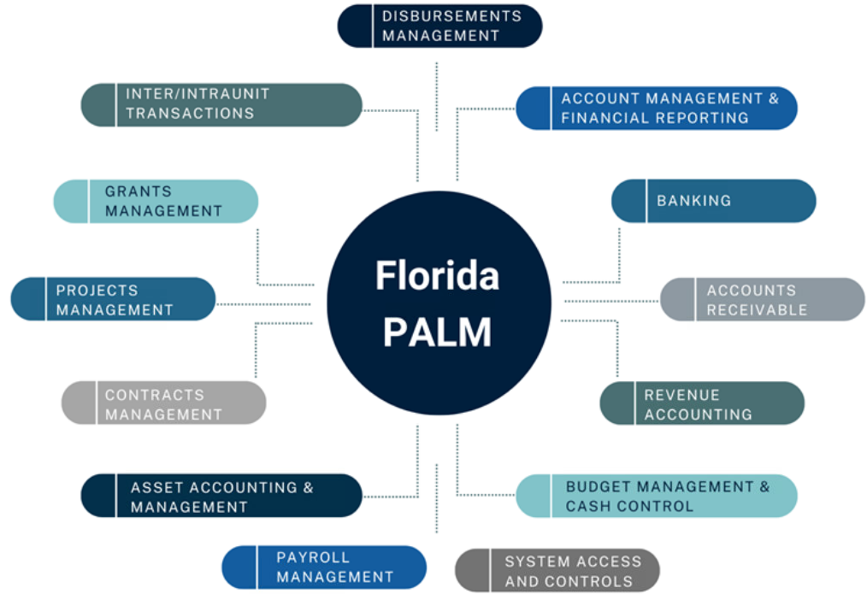
Business Processes

Slide 19
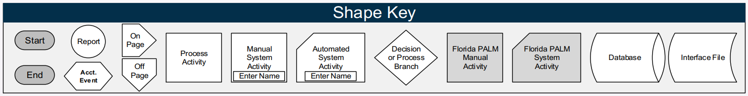
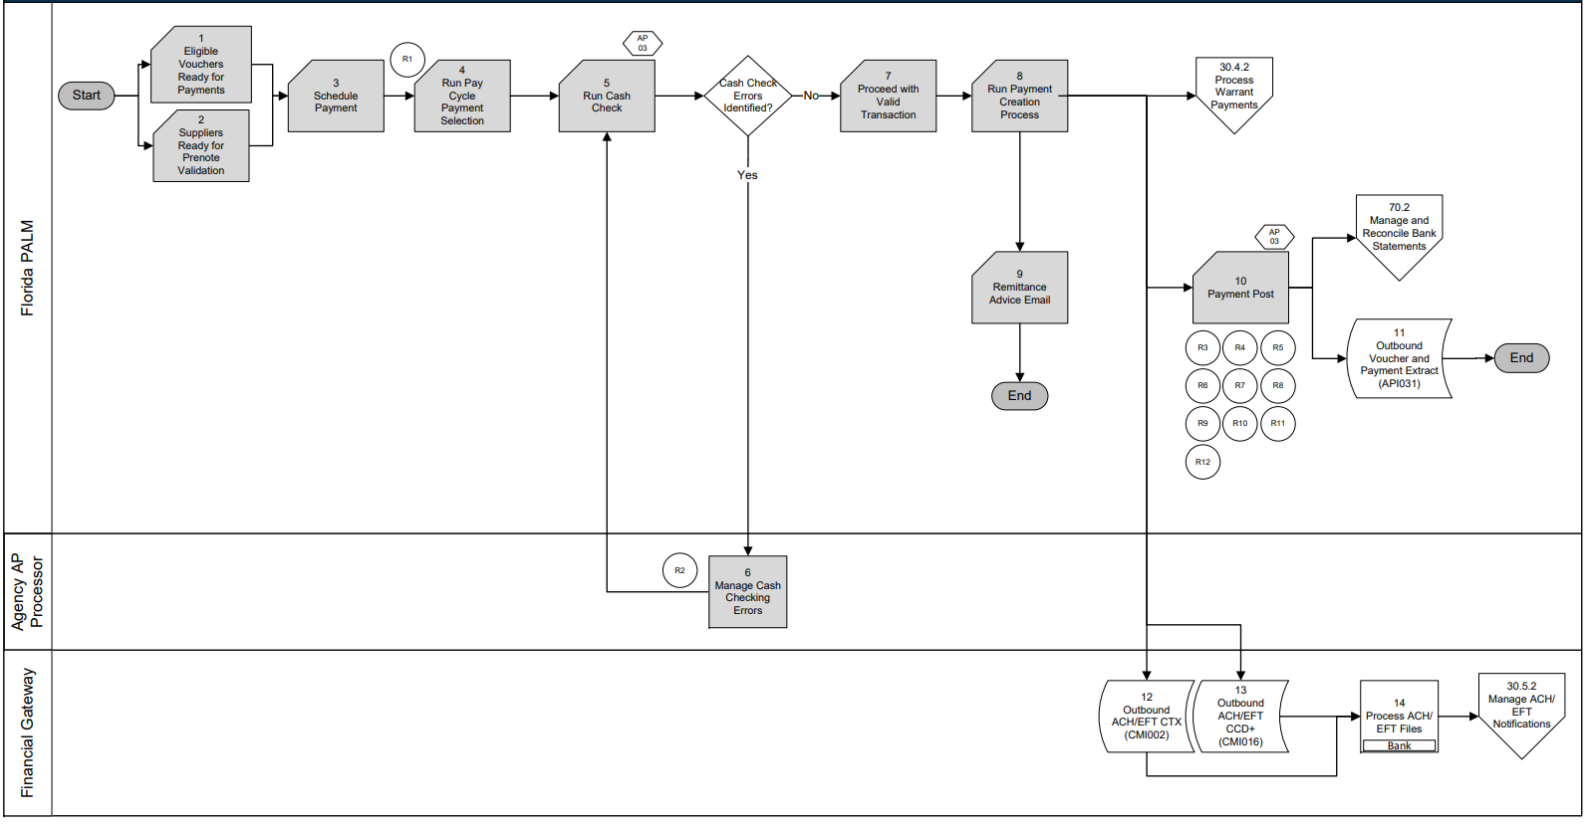
Business Processes
FLOW SHAPE KEY

Slide 20
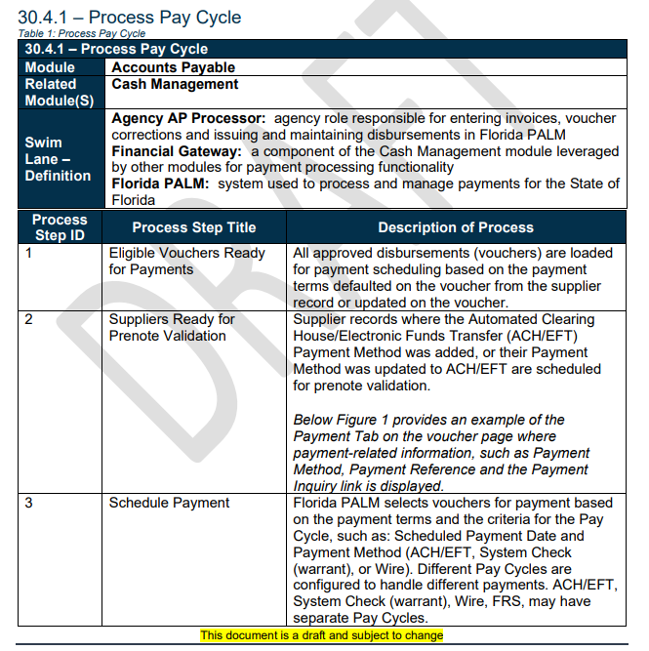
Business Processes

Slide 21
Roundtable #3
  Interactive discussion – Accounting Data Elements
  Chartfields
  Fund IDs
  Revenue & Expense
  ORGS
  Tracking Projects

Slide 22
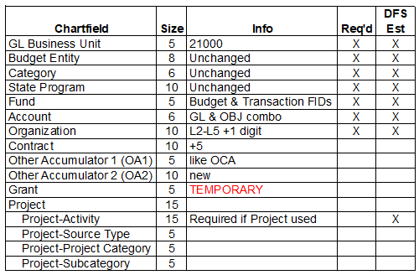
ChartFields
Interactive COA

Slide 23
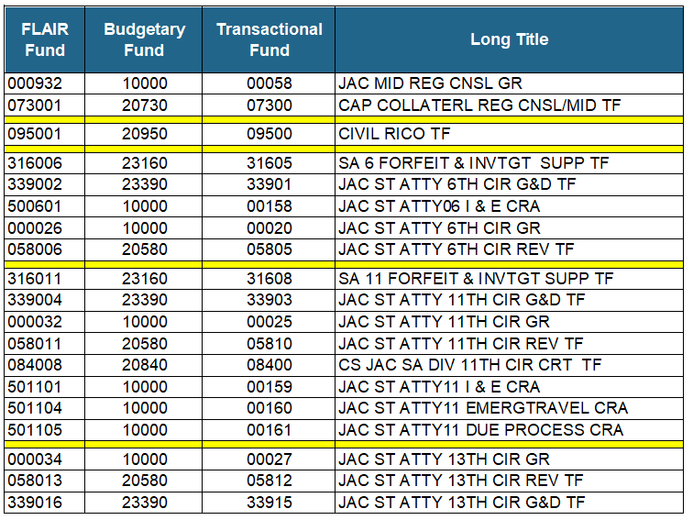
Fund ChartField

Slide 24
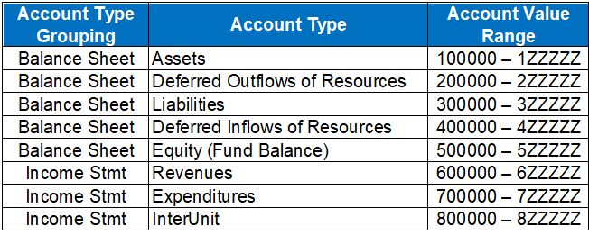
Account Tree ChartField
The Account Type Groupings numbers are similar to the FLAIR GL groupings.
All JTs will occur completely separate from the Disbursements Module

Slide 25
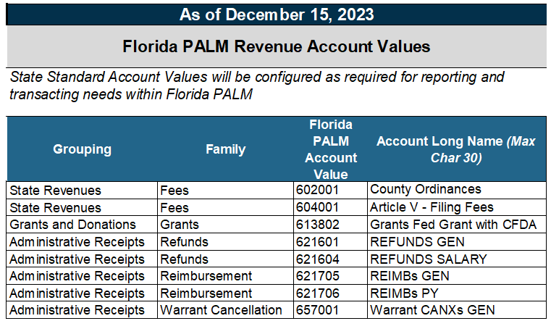
Account ChartField

Slide 26
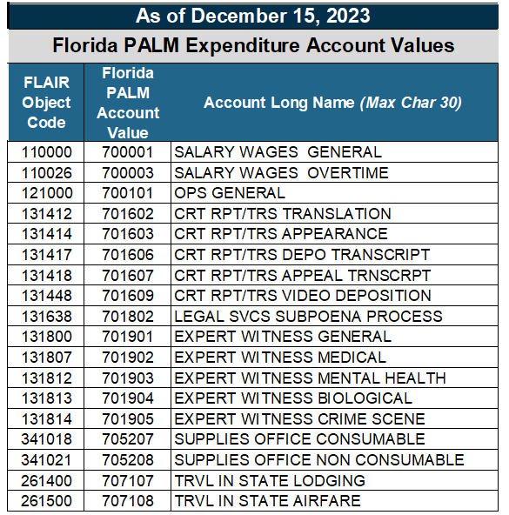
Account ChartField

Slide 27
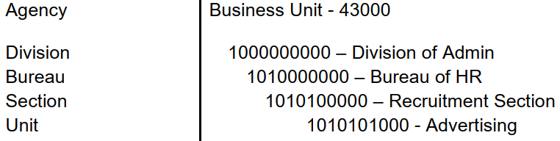
ORG ChartField
Organization ChartField tracks information according to a structural breakdown (i.e., division, bureau, section) or operating unit of the agency.

Slide 28
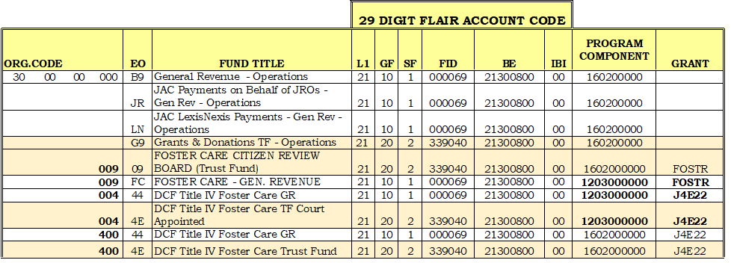
ORG ChartField
Example of JAC’s Account Code worksheet

Slide 29
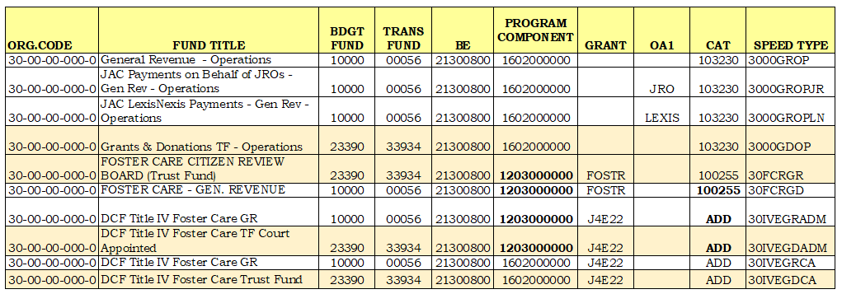
ORG ChartField
Example of JAC’s PALM Account Code worksheet

Slide 30
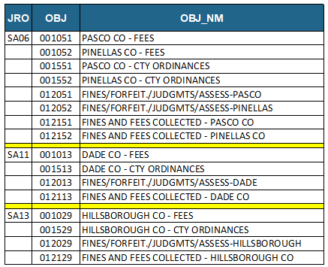
ORG ChartField
In FLAIR, revenue OBJs identify the counties that send the SAs certain revenue

Slide 31
ORG ChartField
Those OBJs are gone in PALM
Do you want this info in PALM?
  Of the 3 SAs - only SA6 has more than 1 county
    Only 5 circuits have only 1 county
  For PALM we can created an ORG for each county like Pasco 50-06-51-000-0 and Pinellas 50-06-52-000-1
  These ORGs can be used for just revenue, if desired
  CCRCM – do you have a need for more than 1 ORG?

Slide 32
Grant ChartField
This field was created just for this wave of implementation in PALM
It’s a temporary field until the full Project functionality is available
  The Project field is available.
  The Optional Services wave will be completed after Go Live that will greatly increase Project functionality.

