Slide 1
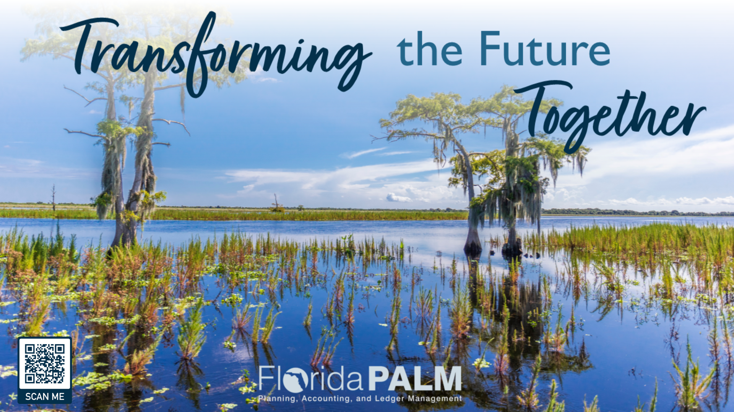

Slide 2
What is Happening?
The Florida Planning, Accounting, and Ledger Management (PALM) Project is replacing the State of Florida’s current accounting and cash management systems with an integrated, enterprise financial management solution that will allow the State to organize, define, and standardize its financial management processes.
The Project Vision is to implement a statewide accounting system that enforces standardization, acts as a scalable foundation to evolve as business needs change, and positions Florida for future innovation as it considers a true enterprise-wide solution.

Slide 3
History of the Florida PALM Project
SAMAS was first implemented in the late 1970’s. It is over 40 years old and is built on an antiquated programming language (Natural.)
In a lead-up to Y2K, SAMAS was minorly altered and renamed FLAIR.
In the early 2000’s a project named “ASPIRE” was implemented to replace FLAIR. There were some major issues with ASPIRE and development ceased in 2007.
For the next six years, many studies were completed with a goal of determining how to better deal with the many issues of this aging system.

Slide 4
History of the Florida PALM Project
In 2013, the Legislature authorized a study to either recommend enhancing for replacing FLAIR. The vendor doing the study highlighted 20 major Limitations and Challenges to retaining FLAIR. The recommendation was to replace FLAIR.
In 2014, a Project was created with the goal of modernizing the state’s financial management processes and system. The project subsequently was named “Florida PALM.”
In July 2018, DFS and Accenture executed a contract to design, build, and implement Florida PALM.
The first implementation wave went live in July 2021 with cash management functionality.
The next major implementation is currently underway.

Slide 5
What is happening today
DFS and the vendor signed Amendment #8 on April 26.
Since then, all agencies have been engaged in various tasks.
For the most part, JAC staff have been performing the functions to complete the tasks; we know that we need to start engaging JRO staff
We are developing a website for communication
We are documenting what we know TODAY in preparation for the future
We are preparing for the estimated 150 Tasks between now and Go-Live

Slide 6
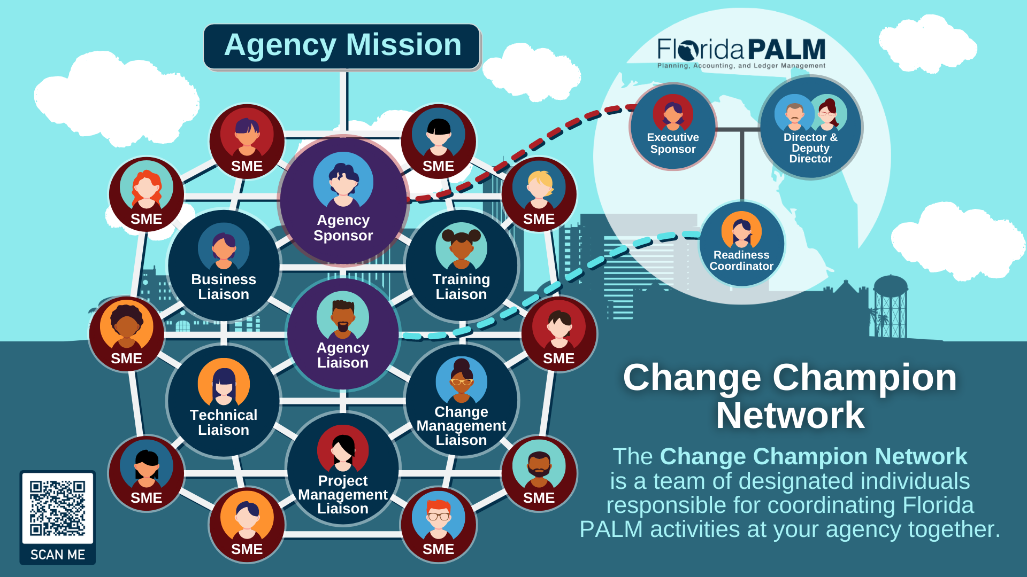
What is happening today?

Slide 7
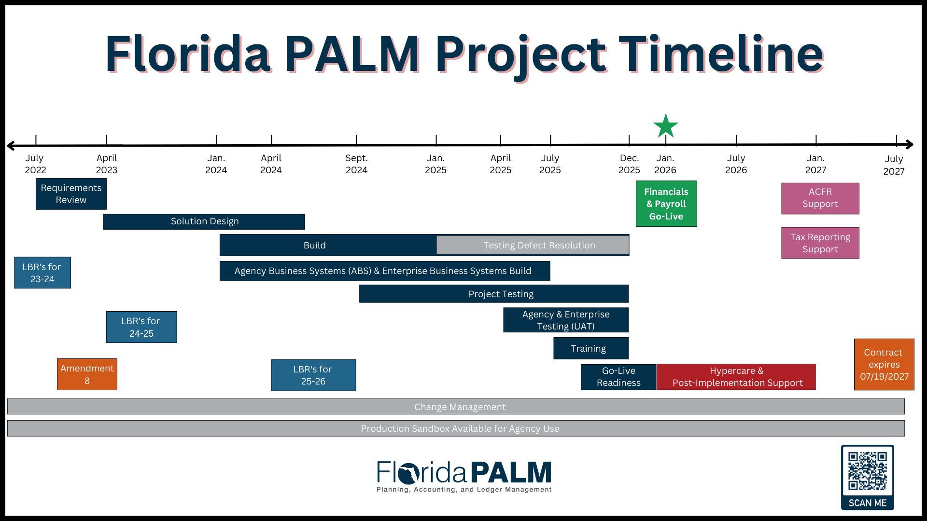
What is happening today?

Slide 8

Steps to Go-Live
May 2023 – May 2024
Functional and technical designs are updated or created and shared with impacted stakeholders across four segments. All designs will be finalized by May 2024.

Slide 9

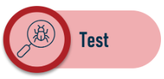
Steps to Go-Live
January 2024 – December 2024
The system will be configured, and reports, interfaces, conversions, extensions, forms, and workflows will be built by the Project team.
September 2024 – November 2025
Includes several types of testing, including system testing, user acceptance testing, parallel testing, and regression testing, and a cadence to refine the system build where appropriate. Testing will be performed by the Project team, enterprise partners, and agencies. User Acceptance Testing, performed by agencies, will begin in April 2025.

Slide 10
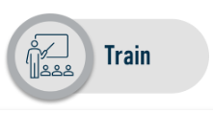

Steps to Go-Live
July 2025 – November 2025
Training will be available in various forms and across several months prior to go live. State Project team members will develop and conduct Florida PALM-specific training and agencies will be responsible for agency-specific training.
November 2025 – December 2025
Deployment is a short time frame right before implementation when all testing and readiness activities have been completed and enterprise partners and agencies ensure they are ready to transition to Florida PALM.

Slide 11
End User Activities
Understand the FLAIR data and processes that you use today
Participate in various activities
  Planned meeting in late October to discuss a Reports Inventory
  Planned meeting mid-November to discuss the new Chart of Accounts
  Planned (tentatively) meeting(s) in December to engage those users that input data directly into FLAIR
  User acceptance testing (date TBD)
PALM Website
  https://myfloridacfo.com/floridapalm

