Slide 1

Benefits
Kelsey Leckinger
Human Resources Coordinator

Slide 2
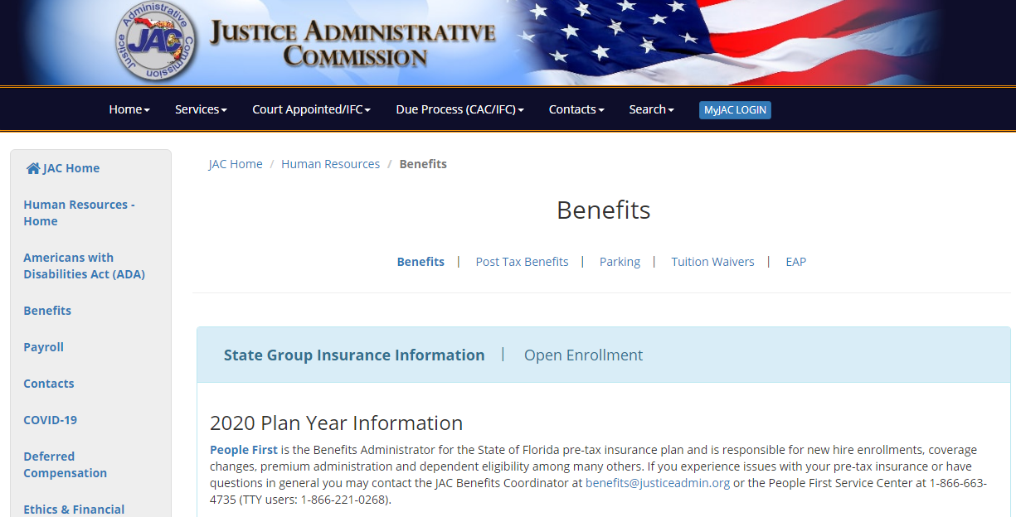
JAC Website - Benefits
www.justiceadmin.org

Slide 3

My Benefits Website
Benefits Guide
Learn about changes
Read about plans
Use Cost Estimators
Insurance Company Contact Info
http://mybenefits.myflorida.com/

Slide 4

People First
How employees will receive information
Employees MUST verify mailing and home address in People First
Employees MUST enter Notification Email in People First
Benefits summary will be mailed and available online
Confirmation statements will be mailed and available online
New hire letter
https://peoplefirst.myflorida.com/peoplefirst
Phone Number: 866-663-4735

Slide 5

State Group Insurance
Health
Life
Dental
Vision
Supplemental Plans
Savings and Spending Accounts
Premiums and plan details can be found at www.mybenefits.myflorida.com under the health tab.

Slide 6

Who is Eligible?
Salaried Employees
OPS Employees who work 30+ hours
Eligible Dependents
https://www.mybenefits.myflorida.com/health/eligibility_and_enrollment/dependents

Slide 7
Employer Paid Insurance
Health
  Employer premium is based on the type of coverage (single/family) and the employees classification code.
  Premium Rate Chart
Life
  Employer monthly premium is $3.58.
Disability
  Only available to select employees.
  Monthly premium is based on employees salary.

Slide 8
When Can Employees Enroll in Benefits?
As a New Hire
During Open Enrollment
Because of a Qualifying Status Change (QSC) Event

Slide 9
New Hire
Newly-hired, eligible employees, have 60 days from the date hired to enroll in State Group Insurance benefits.
Coverage begins on the first day of the month after the month in which the state deducts a full month’s premium. Coverage always begins on the first day of a month and continues for the rest of the calendar year, as long as you pay premiums on time and you remain eligible.
If an employee enrolls in insurance after monthly payroll is processed, they may elect an early effective date for health insurance only.

Slide 10
Marketplace Exchange Notice
Employers are required to provide a health insurance marketplace exchange notice to all newly hired employees.
  2023 Marketplace Exchange Notice

Slide 11

Open Enrollment
Held annually in the fall.
Open Enrollment gives you the opportunity to review available benefit plan options and make any changes you want for the next plan year.
All elections will start January 1st and go through December 31st.
Any changes you make remain in effect for the entire calendar year, unless you make changes because of a QSC event.

Slide 12
Qualifying Status Change (QSC) Event
A QSC event is an event that results in a gain or loss of eligibility for coverage. (e.g., birth, marriage, death)
QSC Matrix
Documentation of certain events is required.
You have 60 days (unless otherwise noted) from the date of the event to make changes to your benefits.

Slide 13
Dependent Eligibility Verification Process
All enrollees who add new dependents during QSC events will receive the documentation request.
If you fail to send sufficient documents in a timely manner, or if you submit documents that do not prove dependent eligibility, People First will terminate dependent coverage prospectively (i.e., the first day of the month following ineligibility determination).
For a full list of eligible dependents and what documents need to be submitted to prove dependent eligibility please visit www.mybenefits.myflorida.com/health/dependent_eligibility_verification

Slide 14
Leave Without Pay (LWOP)

Slide 15
Leave Without Pay (LWOP)
Types of LWOP:
  Family Medical Leave Act (FMLA)
  Military Leave
  Authorized Leave/Suspension
When employees are on LWOP and not receiving a paycheck, the state premiums must be manually paid through a voucher processed at JAC. This includes health, life, and disability if applicable.
Due to guidelines in the Affordable Care Act any employee on leave is entitled to affordable insurance. This means the employee will only be responsible for their portion of the health insurance premium when on any type of leave.
Employees are also responsible for paying for any supplemental insurance plans.

Slide 16

Where to send Premium Payments
While an employee is on LWOP they will need to mail a check for their monthly pre-tax insurance premiums.
Please make check or money order out to DSGI, put PF ID# on the check and mail it directly to:
  People First Payments
  P.O. Box 863477
  Orlando, FL 32886-3477

Slide 17
Measurement Matrix

Slide 18
Measurement Period
 | New Hire Measurement Period | Open Enrollment Measurement Period (OEMP)
A measurement period is defined a period of 12 consecutive months
WHO | OPS and Part-time FTE employees working less than an average of 30 hours per week at the point of initial hire. | All salaried FTE employees and all OPS Employees who have worked 12 months.
WHEN | Starting the first day of the month following the initial hire date and ending the last day of the twelfth month. | October 3 through the following October 2 of each year.

Slide 19
Stability Period
Federal guidelines state that we must provide affordable coverage for the period of one year.
If an employee is hired at a 1.0 FTE but moves to a .25 or OPS, they will pay the same premium for the remainder of the year.
For Example, an employee’s effective date is October 1 and in January they move to a .25 FTE or an OPS position they will pay the same premium for the remainder of the stability period.

Slide 20
Break in Service
A Break in Service occurs when:
  An employee moves from One salaried FTE position to another salaried FTE position (includes part-time salaried FTE) AND termination of employment lasts one full calendar month.
  For all other position changes: termination of employment that lasts at least 13 consecutive weeks; or a break between four weeks and 13 weeks if the period of service prior to the break is less than the period of the break.
If a Break in Service does not occur and the employee was enrolled in benefits before termination, upon reemployment benefits will automatically reinstate.

Slide 21
Under/Overpayment
Benefits Report

Slide 22
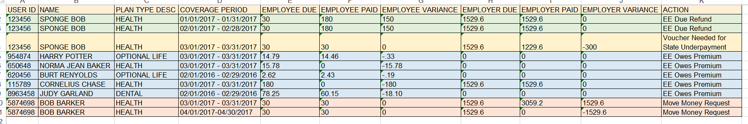
What is the Under/Overpayment Benefits Report?
The report identifies employees and employers whose benefits are either underpaid or overpaid for the requested coverage period.

Slide 23
What Does the Under/Overpayment Report Show?
Employee Due: Employee contribution due for the insurance plan for the coverage month.
Employee Paid: Employee contribution paid for the insurance plan for the coverage month.
Employee Variance: Employee underpayment or overpayment amount for the insurance and coverage month.
Employer Due: Employer contribution due for the insurance plan for the coverage month
Employer Paid: Employer contribution paid for the insurance plan for the coverage month
Employer Variance: Employer underpayment or overpayment amount for the insurance plan and coverage month

Slide 24
What am I supposed to do with the report?
JRO
JAC
Review Under/Overpayment Report.
Inform employees of underpayments.
Inform employees of refunds due to them.
Request all overpayment refunds from People First for both employee and employer paid premiums.
Create JT backup documentation and voucher underpaid employer portion.
Submit Move Money Request to People First.

Slide 25
What Causes Under/Overpayments?
Pay Increase
Position Changes
QSC Events
New Hire/Payroll Cutoff
LWOP
Termination
People First
Warrant Cancellation/On-demand
Personal Payment- Employee
Voucher
Age/Date of Birth

Slide 26

Contact Information
JAC Contacts
  State Attorney Offices
    Call Kelsey Leckinger at 850-488-2415 or email at benefits@justiceadmin.org
  Public Defender Offices, Guardian Ad Litem Offices, Capital Collateral Regional Offices, and Criminal Conflict and Civil Regional Offices
    Call Amy Maros at 850-488-2415 or email at benefits@justiceadmin.org
People First
  Call at 866-663-4735
  https://peoplefirst.myflorida.com/peoplefirst

