Slide 1
Introducing PCard Works
Justice Administrative Commission
Summer 2019

Slide 2
Why is this important to me?
What is PCard Works?

Slide 3
PCard Works - Introduction
is a web-based application from Bank of America
replaces current FLAIR PCard processing procedures
goes live for our agency September 6th
provides 24/7 access to accountholders and approvers from any device with an internet connection including a smart phone

Slide 4
PCard Works - Benefits
allows accountholders and approvers to reset their own passwords as long as they have access to their work email when requesting a reset
provides reporting tools, such as automated daily email notifications of charges awaiting approval
uses statewide merchant code groups so users will see fewer declines for their charges

Slide 5
PCard Works - Changes
changes to terminology from the old FLAIR terms
only three levels of users in PCard Works. All 3 must approve charges in the system:
      Accountholders (Cardholders)
      Approvers (Mid-Level Approvers/ Supervisors)
      Accountants (Level 008 Approvers)

Slide 6
accountholders want to know
How does it change my life?

Slide 7
Accountholder Features
Accountholders can see various items in the system, like current charges, scanned documents, and closed charges. They can only run and print reports on their charges.
Accountholders can change the information on a charge, split a charge amongst multiple travelers, and add documentation to a charge once it appears on their charge queue.

Slide 8
Accountholder Benefits
FLAIR network access is not required to use PCard Works. Any device with an internet connection will access an accountholder user account.
Receipts will be uploaded to PCard Works. This can be done from a mobile phone while traveling. No need wait until the accountholder returns to the office. The supported file formats for upload are: .pdf, .png, .jpg, .gif and .jpeg

Slide 9
Accountholder Benefits
Accountholders sign/approve their own charges electronically in the system. This step represents documented approval from the accountholder so no need to sign and date the receipts.

Slide 10
Accountholder Documentation
Remember that the documentation from accountholders is used for any audits that DFS may conduct on charges.
Florida has a very broad public records law. Please know that anything you upload to this system could become available for inspection as a public record, unless it is confidential or exempt.

Slide 11
Accountholder Documentation
You know your cases and information better than anyone else. Please do not upload confidential/ exempt/sensitive information. Redact as necessary to protect your client/victim/witness information.
Follow your agency’s records retention policy for un-redacted documentation.

Slide 12
User Account Dashboard
Accountholders can see their credit limit, current balance, available spend, and available credit on their Account Dashboard.
Accountholders can also see the Authorization Log from their Account Dashboard. This is a list of all transactions on their account, including any declined charges. If a charge is declined, the system will show the reason.

Slide 13
Accountholder Duties
Accountholders will complete and verify all of the financial details of a charge before they submit it to the approver.
These details are called General Ledger (GL) Values in PCard Works. The accountholder will allocate GL values to the charge.
GL values include the accounting data necessary to process the payment successfully through FLAIR.

Slide 14
Accountholder Duties
Don’t freak out! We don’t expect you to be FLAIR experts! Most fields will be pre-populated or have a drop-down menu.
ALL GL values must be populated before the accountholder signs off on the charge (sends it for approval) to the approver.

Slide 15
Approvers want to know
How will it make my job easier?

Slide 16
Approvers
An approver is the second level of user to review charges. They must be someone who is:
    the accountholder’s supervisor,
    in the accountholder’s direct line of supervision, or
    a manager with direct knowledge of charges and purchases and who can approve in PCard Works

Slide 17
Approvers – General Overview
Accountholders will be placed in user groups. Each user group should have primary and a backup approver.
There must be at least one accountholder and one approver in each user group.
Approvers cannot be accountholders and approvers in the same user group.
Approvers do not need to be accountholders.

Slide 18
Approvers Account Dashboard
Approvers can see real-time accountholder activity:
  who has charges that need supporting documentation
  who has not signed off on their charges
  how long charges have been pending
  what information is missing from a charge (e.g., Vendor ID)

Slide 19
Approvers - Duties
Approvers will review all of the documentation and ensure that the GL value information is correct before signing off the charge to the accountant.
Approvers have the ability to either flag a charge (return it to the accountholder) or to edit the incorrect GL values themselves.

Slide 20
A quick look for accountants and ScopeD administrators
How will my role change in the new system?

Slide 21
Accountants - Overview
PCard Works designates the accountant role as the third and final level of user to review charges before they are sent to FLAIR for batch processing.
The process for the accountant is similar to the approver – attest that the accountholder documentation and GL values on the charge is correct.

Slide 22
Accountants - Duties
The accountant completes his or her review of the charge, and then closes the charge, allowing it to be submitted to FLAIR for payment in the Ready to Batch queue.
Accountants also manage any flagged charges returned by FLAIR. These charges will remain in queue until the error is corrected and resubmitted for payment.

Slide 23
Scoped Administrators
Scoped Administrators are Merry and Aleah
Scoped Administrators can see all transactions, run reports, and add/maintain users. We cannot touch any transactions!
We can make immediate limit increases with the new system. With the current system, a limit increase is an overnight FLAIR process, which delays an accountholder’s ability to make purchases.

Slide 24
Well, it’s not that simple in Pcard works…
What about delegating someone to sign-off on charges for my agency head?

Slide 25
Secondary Accountholders
Secondary Accountholders are users who act on behalf of an accountholder to review, edit, and sign-off on charges.
Permission for secondary accountholders can only be granted by the DFS Statewide Administrator. The requests will be considered on a case-by-case basis.

Slide 26
Secondary Accountholders
DFS provided a form to request a secondary accountholder. Each request requires justification.
Please include a strong justification to sell the need for the delegation.
The form is located on My JAC

Slide 27
We are glad you asked!
Are there any other types of users?

Slide 28
Auditors - Overview
Auditors are system users who have access to review charges and reports but they do not have the ability to modify or process charges.
This role may be useful to agencies with large groups of accountholders who want to monitor activity for reporting functions, but not necessarily for approval purposes.
Approvers can run reports only if they are given the auditor role in PCard Works.

Slide 29
Please, please tell us now!
Any other significant changes we need to know?

Slide 30
CH-CH-CH-CH-CHANGES
We will work with DFS over the next couple of months to get our user data ready to upload into the new system.
There are a few tasks for your offices to complete that are needed to meet the DFS deadlines.
We understand the year-end stresses at this time of the year.

Slide 31
Task 1- User Groups due 7/03/2019
Review user groups. Do the FLAIR user groups (e.g., PD1, GAL STO, DPSA13) continue to work with the new requirements?
Consider how your agency functions and if you need to re-define your groups to meet the approver requirements.
Having more groups is fine.
Your approvers do not need to be accountholders.

Slide 32
Task 1- User Groups due 7/03/2019
Remember:
  each group must have at least one approver and one accountholder
  the approver cannot be a member of the group as an accountholder
  the approver must be the accountholder’s supervisor, in their direct line of supervision, or be a manager with direct knowledge of the purchase and Works approval permissions
  think about who you want as primary and back-up approvers

Slide 33
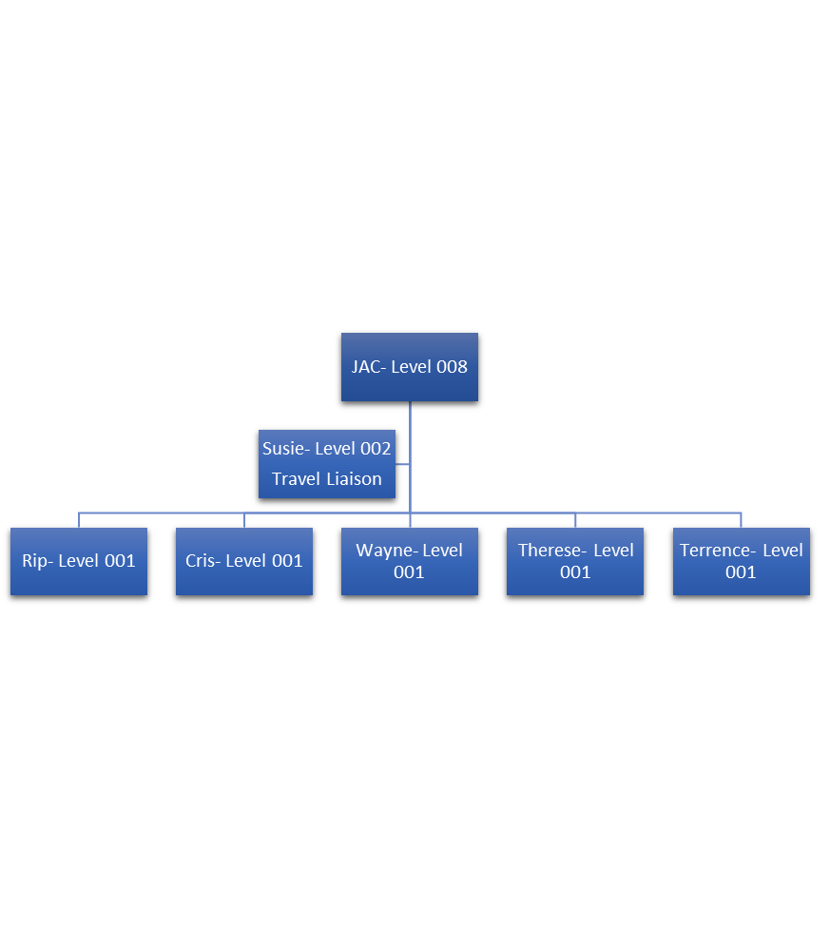
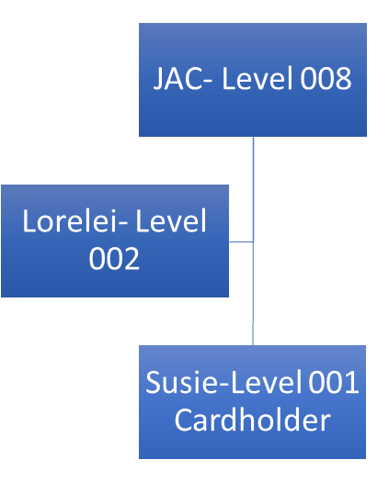
Current System- JAC Example
Group 1: Cardholder
Group 2: Level 002 Approver

Slide 34
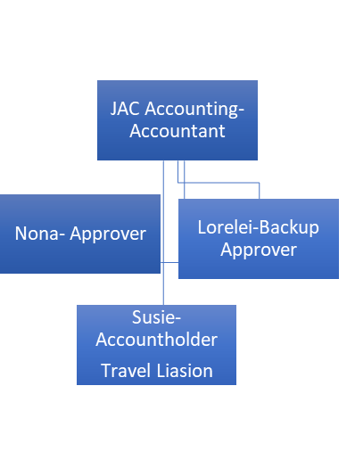
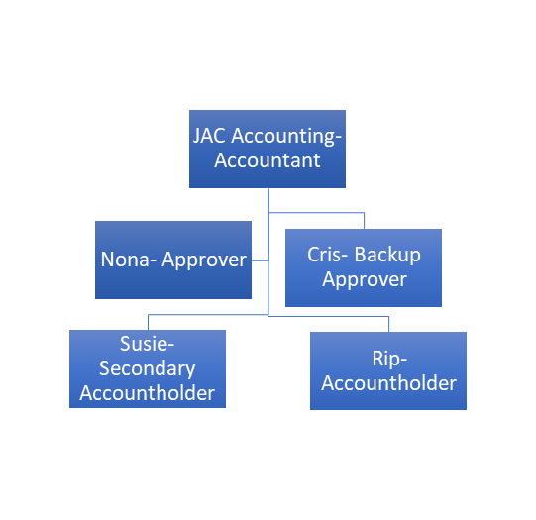
PCard Works - JAC Example
2100 JAC HQ Travel
2100 JAC HQ Exec

Slide 35
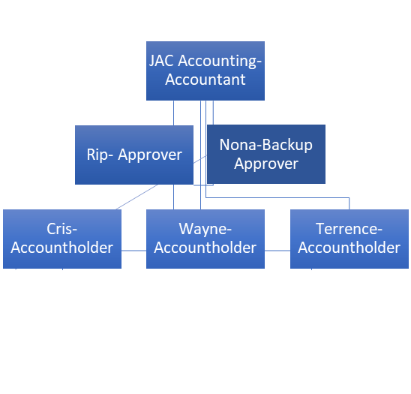
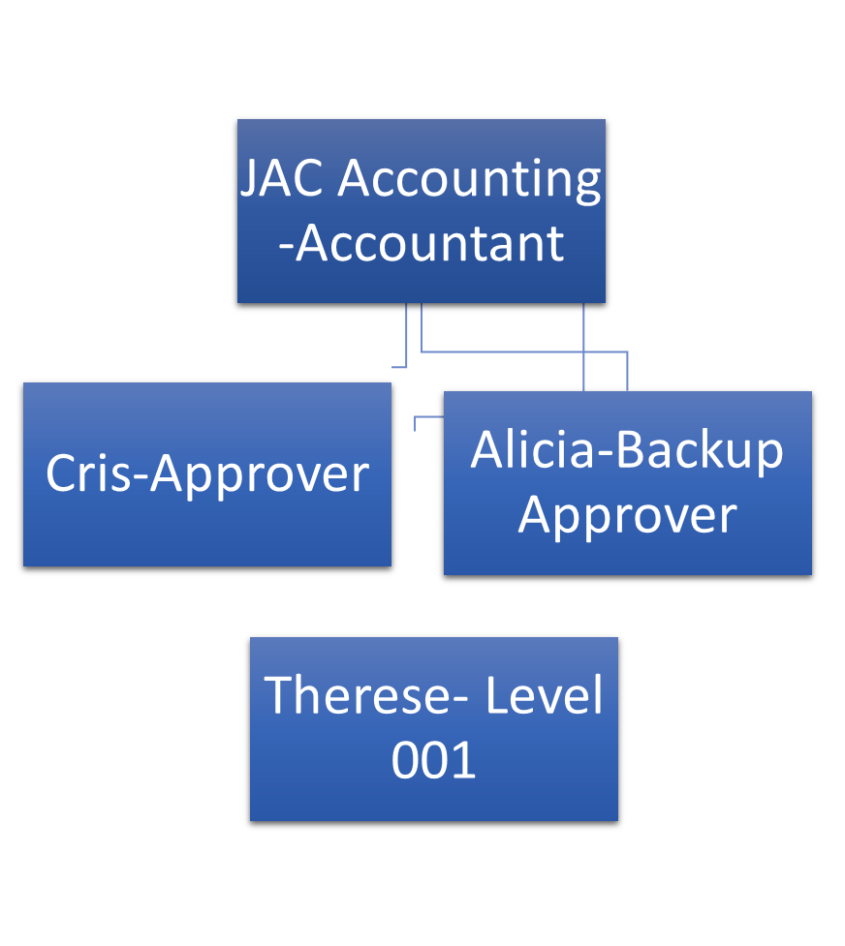
PCard Works - JAC Example
2100 JAC HQ Ops
2100 JAC HQ CA

Slide 36
Task 2- User Lists due 7/12/2019
DFS wants us to verify user information
We will send a spreadsheet for you to fill out to help us meet this task ahead of our due date
  Please check your list of all of your authorized users.
  Verify your users still require a PCard. Make a note of any underutilized cards and question whether they need to be in the new system.
  Make sure their names are spelled correctly.
  Please check phone numbers and email addresses. This information does not currently appear in FLAIR!

Slide 37
TASK 2 ½- SPEND PROFILES
The daily transaction limits and the PCard credit limits have been revamped as the statewide standardized spend profiles. The profiles identify what the accountholder can buy and how much they can spend.
Spend profiles replace the old Class ABC system of Commodities, Travel, or Commodities and Travel charge permissions.

Slide 38
TASK 2 ½- SPEND PROFILES
The transaction limits and credit limits are now fixed; you will have to pick what levels you want the accountholders to have.
There is still a requirement for justification for the base amount over $1,500.

Slide 39
New PCard State
Standardized Spend Profiles
X | Transaction | Limit
PCard Credit Limit | 1,500 | 5,000 | 10,000 | 20,000 | 35,000
Travel and Commodity Purchases Examples | X | X | X | X | X
2,500 | X
5,000 | X
10,000 | X | X
20,000 | X | X | X
35,000 | X | X | X | X
65,000 | X | X | X | X | X
100,000 | X | X | X | X | X
Grand Total | X | X | X | X | X

Slide 40
TASK 3- Works User Agreement Forms due 7/31/2019
ALL users MUST sign the DFS user agreement form before they are granted access to the system.
There are specific sections to check and sign based on your role in the system - accountholder, approver, accountant, or auditor.
DFS will not authorize Bank of America to send your verification email to set up your account and password information without this form!

Slide 41
TASK 3- Works User Agreement Forms due 7/31/2019
We are starting to collect these forms early, so there will be no problems when we go live on September 6th
The form can be found on My JAC

Slide 42
What do we need to do to get ready?
What happens now?

Slide 43
COMING EVENTS
There are also new DFS forms required to add or change user information – the new forms will be added to My JAC
Status updates will be provided to the JAC PCard Administration page on My JAC throughout the process, so that access to training materials and information are available to everyone.

Slide 44
COMING EVENTS
We will start posting forms and this PowerPoint presentation immediately. Other documentation is forthcoming.
We will develop training for all users, however DFS has videos and manuals available now at: https://myfloridacfo.com/Division/AA/WorksTrainingMaterials.htm

Slide 45
850-488-2415
PCARD@justiceadmin.org
Questions?

