Slide 1
PCard Works for Accountholders
Justice Administrative Commission
August 2019

Slide 2
What do users need to remember about PCard Works?

Slide 3
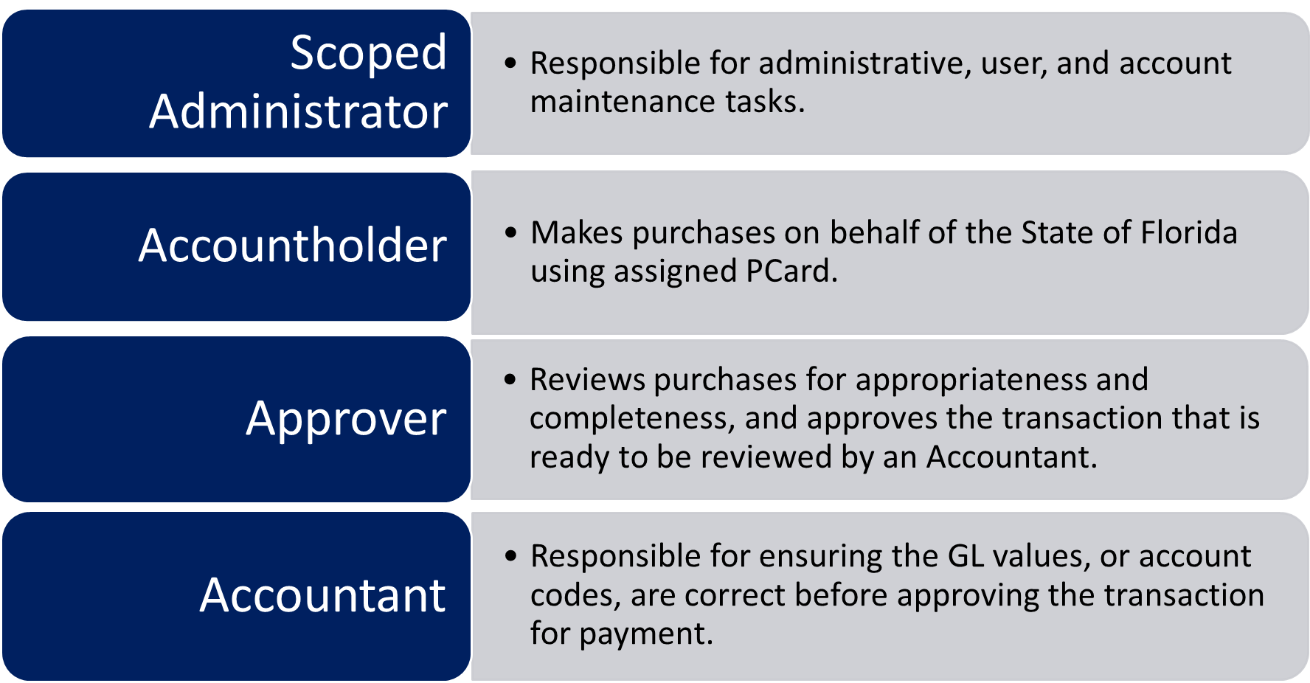
User Roles Review

Slide 4
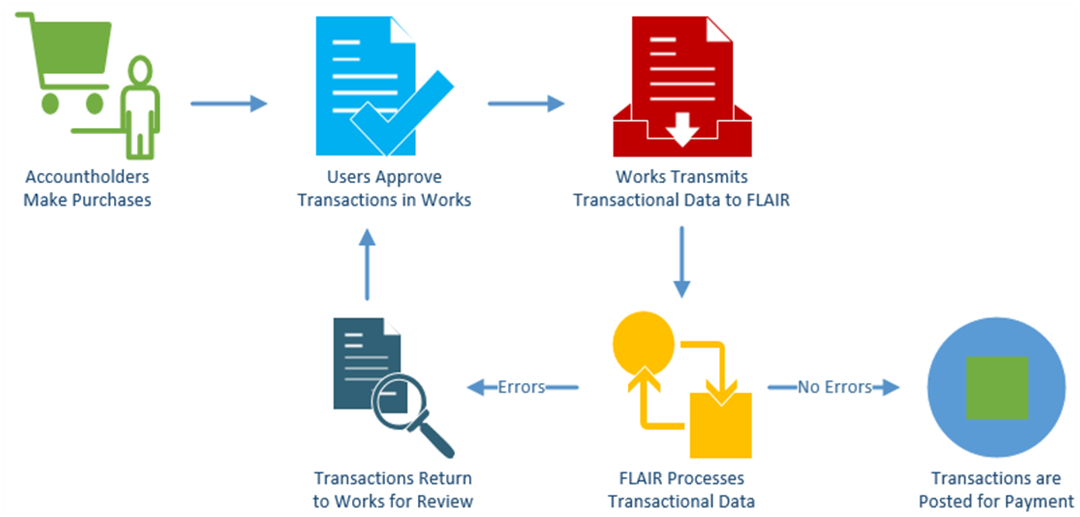
PCard Works – Program Overview

Slide 5
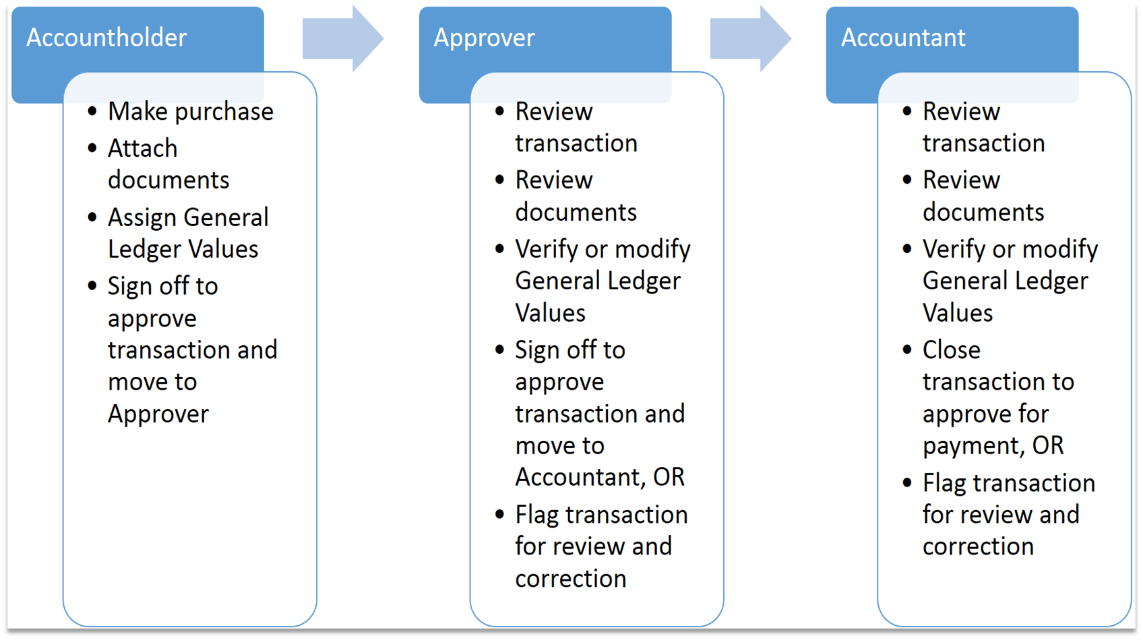
PCard Works – Approval Flow

Slide 6

Access from Any Internet Device

Slide 7

Real-Time Updates

Slide 8




Recommended Browsers

Slide 9
Things to Remember- WARNING
There are some buttons and functionalities in this system that the State of Florida does not use.
Bank of America will not turn off or gray-out these functionalities.
This training will point out which ones are not usable for transaction processing and highlight them in red.
It is up to the individual user to be diligent about which buttons are clicked in the system. Some mistakes are user-correctable, some are not.

Slide 10
What are the first steps in PCard Works?

Slide 11
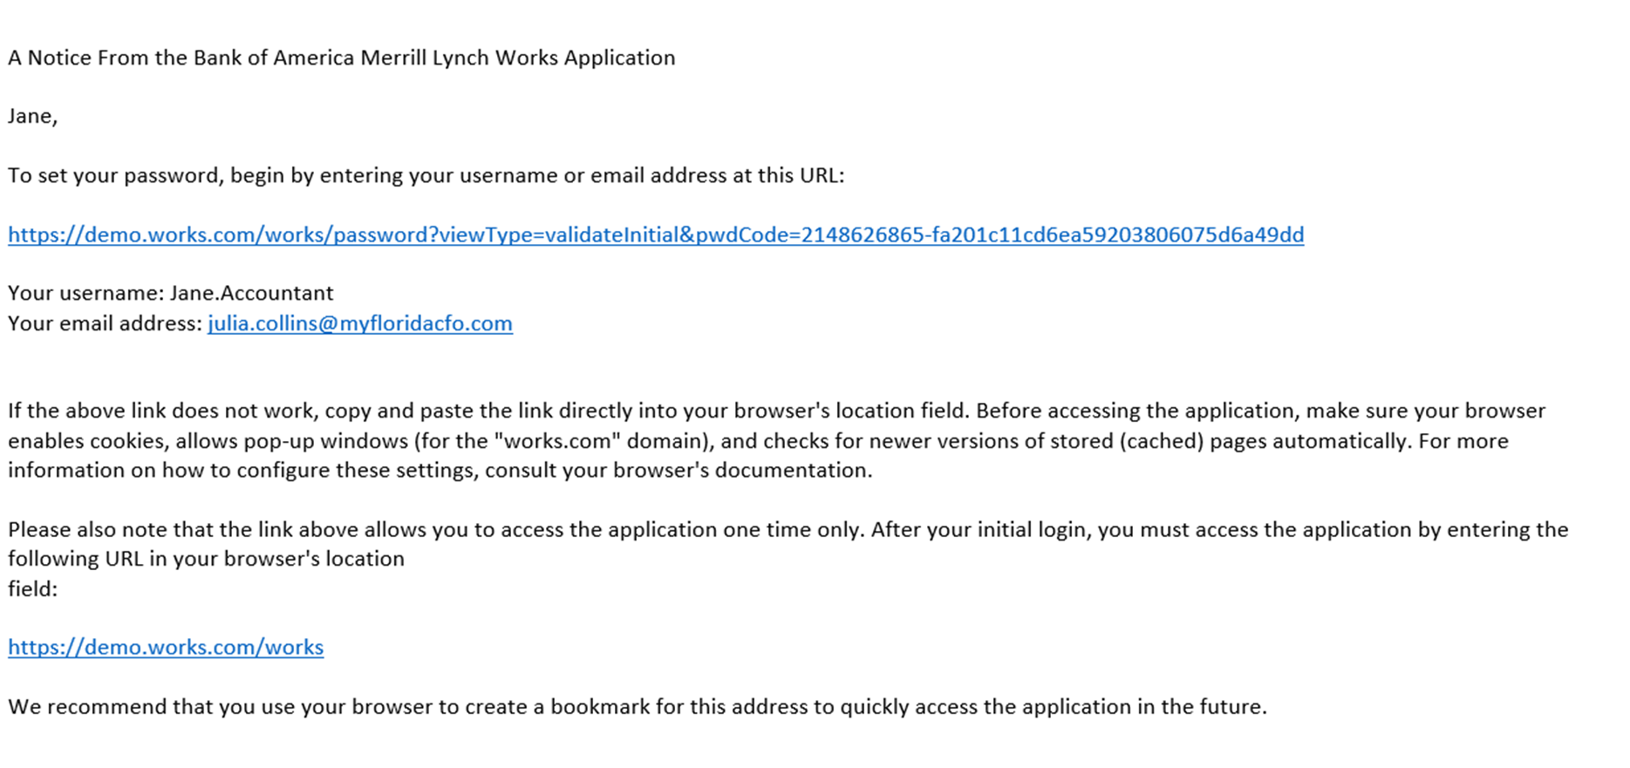
Welcome Email

Slide 12
Welcome Email
Bank of America will send the welcome emails to all new users on September 3rd
This email is only good for three days
There is a link to set up a user ID and password
There is also a link at the bottom of the page to bookmark for the PCard Works website- www.BankofAmerica.com/worksonline.

Slide 13
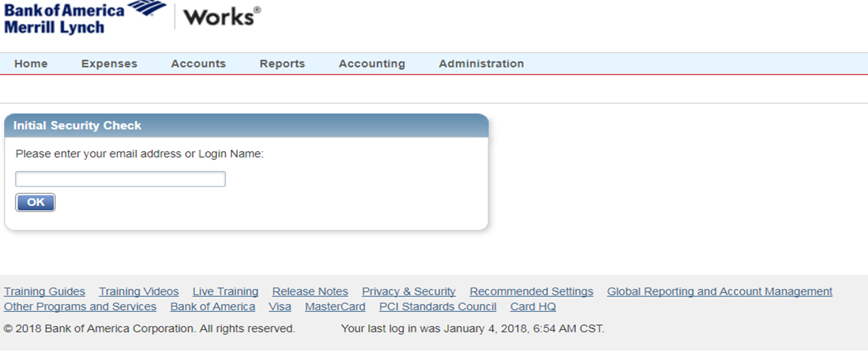
Initial Security Check

Slide 14
Initial Security Check
This is the first screen users will see on the Works website
The username is the email address provided to us when we set up the account
The username (email address) is not case sensitive
Users will be directed to set up a password on the next screen

Slide 15
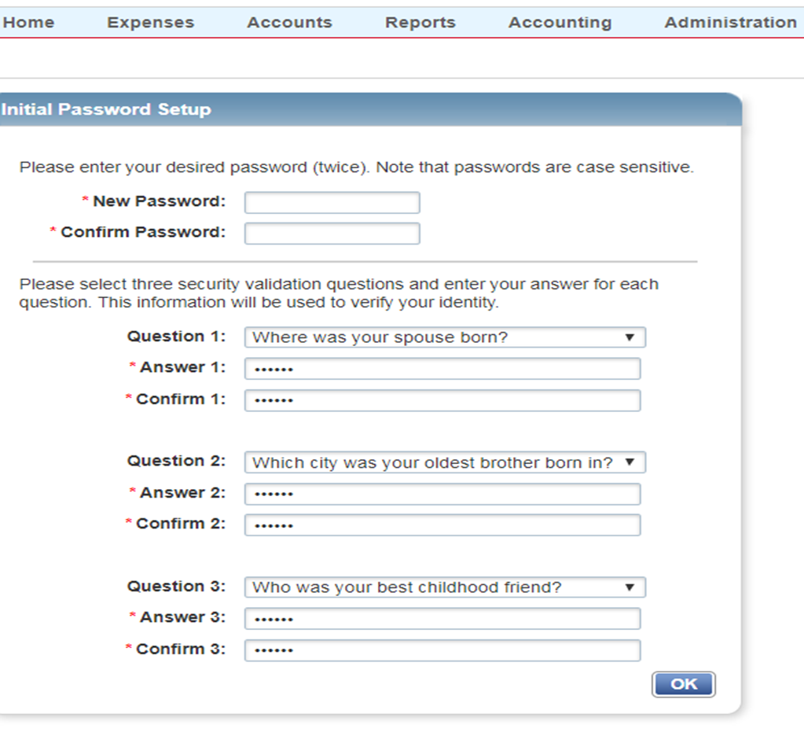
Initial Set Up for Passwords

Slide 16
Initial Set Up for Passwords
Passwords must be 8 characters in length, with at least one alpha and one numeric character
Passwords are case-sensitive and cannot be one of the 8 previously used passwords
Passwords reset every 90 days
Users have six attempts to remember a password before they are locked out of the system. Users must wait 20 minutes to retry or reset.

Slide 17
Initial Set Up for Passwords
Users can reset their own passwords or email us to reset it for them.
The system will not alert that an account is locked, so contact us if there is an issue accessing Works.
DFS reminds users that they should not share usernames and passwords with other individuals. Please protect any access information to this system.

Slide 18
Initial Set Up for Security Questions
Users can select from a variety of security questions on your profile
These questions will help users to reset their own passwords
User must choose three different questions with three different answers.
The answers to the security questions are not case-sensitive

Slide 19
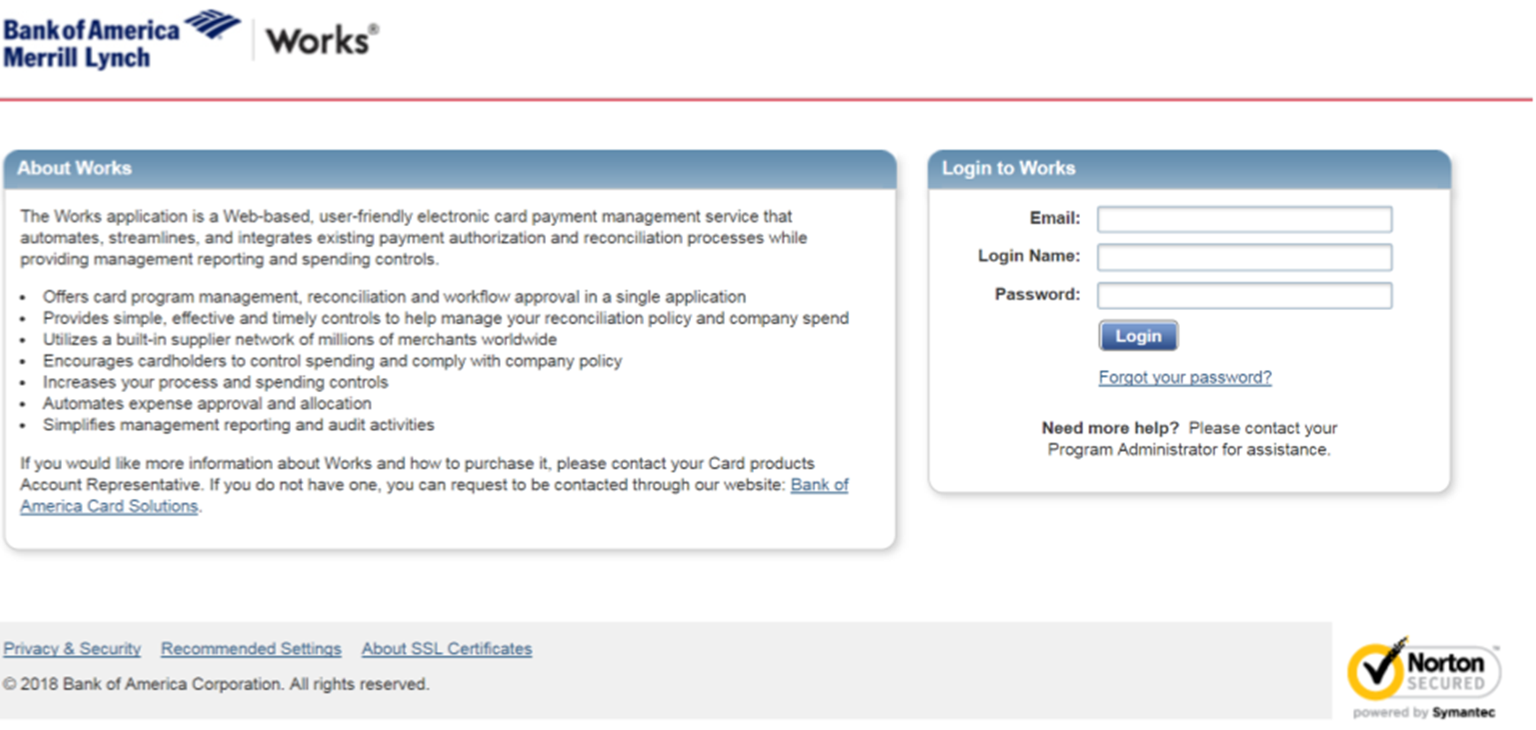
Initial System and New Device Log-In

Slide 20
Initial System and New Device Log-In
Users will need to go back and access Works through the link from the bottom of the Welcome Email, or a saved shortcut on a web browser
Users will log-in with their new password
Users will enter their email address, Login Name (email address again), and password

Slide 21
Initial System and New Device Log-In
Users will perform this three-part log-in every time they access any new devices
Users only have to log-in like this the first time they access their accounts on a device
The regular log-in will just be a user’s Login Name (email address) and password

Slide 22
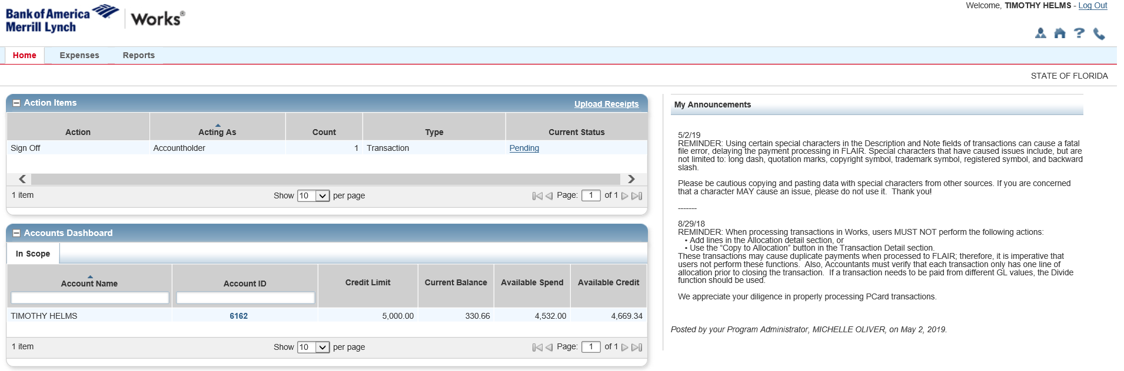
System Log-Out

Slide 23
System Log-Out
Works will automatically log users out after fifteen minutes of inactivity, such as the last click or mouse movement.
Works notifies users of the pending time out and gives the option to “Continue Working”. If a user is timed out, their last action in Works will be saved and accessible when they log back in
User can log out of Works from any screen by clicking the “Log Out” button located in the top, right-hand corner of the screen.

Slide 24
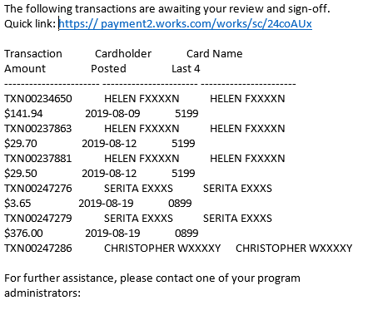
Daily System Emails

Slide 25
Daily System Emails
Works will send automated emails to users who have NEW pending items in their work queues.
Emails will contain a list of transactions that the user needs to sign off, any flagged transactions, or any scheduled reports that are ready for review.
Each new item will only be included on that day’s email. Once a transaction is signed off from one level, it will be included on the daily system email for other users in the approval chain.

Slide 26
Daily System Emails
The system generated emails will be sent every afternoon and will include a system-wide sweep of all pending transactions at that time in Works.
Transactions approved after the daily system sweep of pending transactions will still be included in the email that afternoon.

Slide 27
accountholders want to know
What is on the Accountholder Home Screen in PCard Works?

Slide 28
Accountholder Home Screen

Slide 29
Home Screen - Action Items
The Home Screen includes: Action Items, Accounts Dashboard, Alerts, and My Announcements.
Action Items are tasks that are assigned to the user and need attention
Action Items show the last 100 days of actions only
There are 5 columns in this section: Action, Acting As, Count, Type, and Current Status.

Slide 30
Home Screen - Action Items
Column 1: “Action” indicates the action that needs to be taken for the task.
Column 2: “Acting As” indicates the user role for the task assigned. If a user is both an Accountholder and an Approver, for example, this column indicates which user role needs to complete the action. Users will also be able to sort actions by “Acting As”.

Slide 31
Home Screen - Action Items
Column 3: “Count” is the number of individual actions listed under a specific type of action.
Column 4: “Type” indicates the kind of item that requires action (e.g. transaction or report).
Column 5: “Current Status” tells users where the charges are in the approval process. The status is a hyperlink that will take users directly to the charge.

Slide 32
Home Screen - Account Dashboard
All users have an Accounts Dashboard that lists the accounts that they are authorized to review.
There are 6 columns for this section: Account Name, Account ID, Credit Limit, Current Balance, Available Spend, and Available Credit.
Column 1: “Account Name” lists all of the accounts that are available for a user to see. Users can sort accounts by name by clicking the arrow directly above “Account Name”.

Slide 33
Home Screen - Account Dashboard
Column 2: “Account ID” is the last 4 numbers of the card.
Users can also click on the Account ID to view additional information such as:
  the account address
  the Spend Control Profile description
  any Secondary Accountholder on the account
View “Full Details” to see more information regarding a user’s profile. Users can also see their Charge Authorization Log.

Slide 34
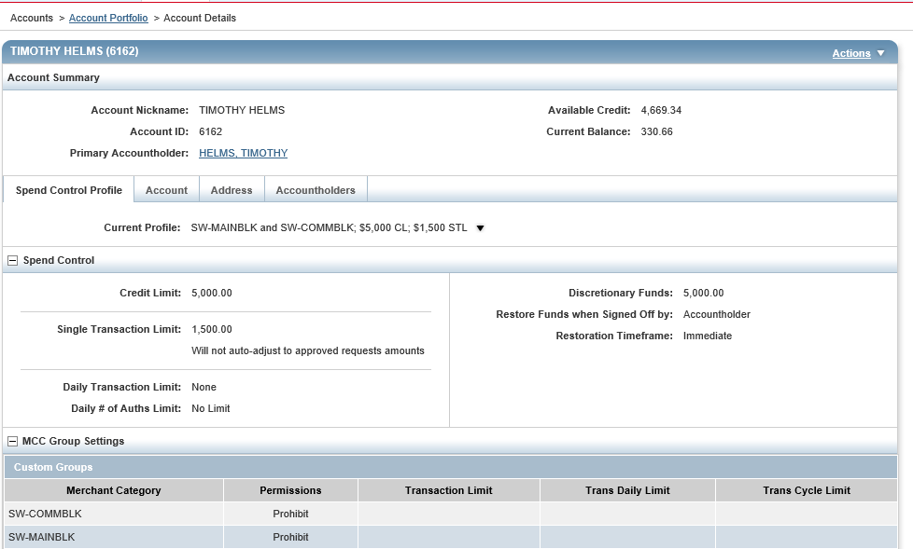
Full Details Screen

Slide 35
Home Screen - Account Dashboard
Column 3: “Credit Limit” is the overall limit on the card.
Column 4: “Current Balance” is the amount of outstanding charges on the card.
Column 5: “Available Spend” is the Credit Limit less the Current Balance. This number will increase once charges are approved.

Slide 36
Home Screen - Account Dashboard
Column 6: “Available Credit” is a tricky number. It can be negative. It shows the transactions over monthly cycles. If users don’t sign-off on charges before the cycle resets, there can be a crazy amount in this field.
Available Credit is not real time, but can change throughout the day. For instance, if a user just made a purchase, the amount available will not reflect that transaction until it has been reported by the merchant.

Slide 37
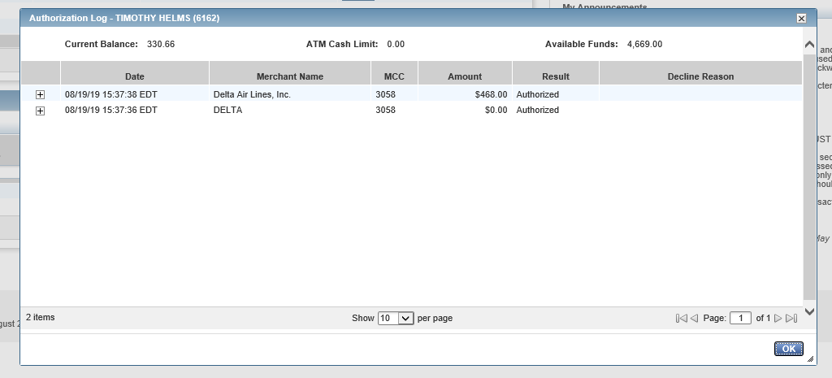
Authorization Log

Slide 38
Authorization Log
The Authorization Log shows the action of every transaction whether accepted or declined.
This is helpful when users are attempting to make a purchase, and their card has been declined.
Users can access this Authorization Log to see the Decline Reason without having to call the Bank or JAC.
Declined Charges due the Daily Transaction Limit can be rectified immediately with agency justification and notification to JAC.

Slide 39
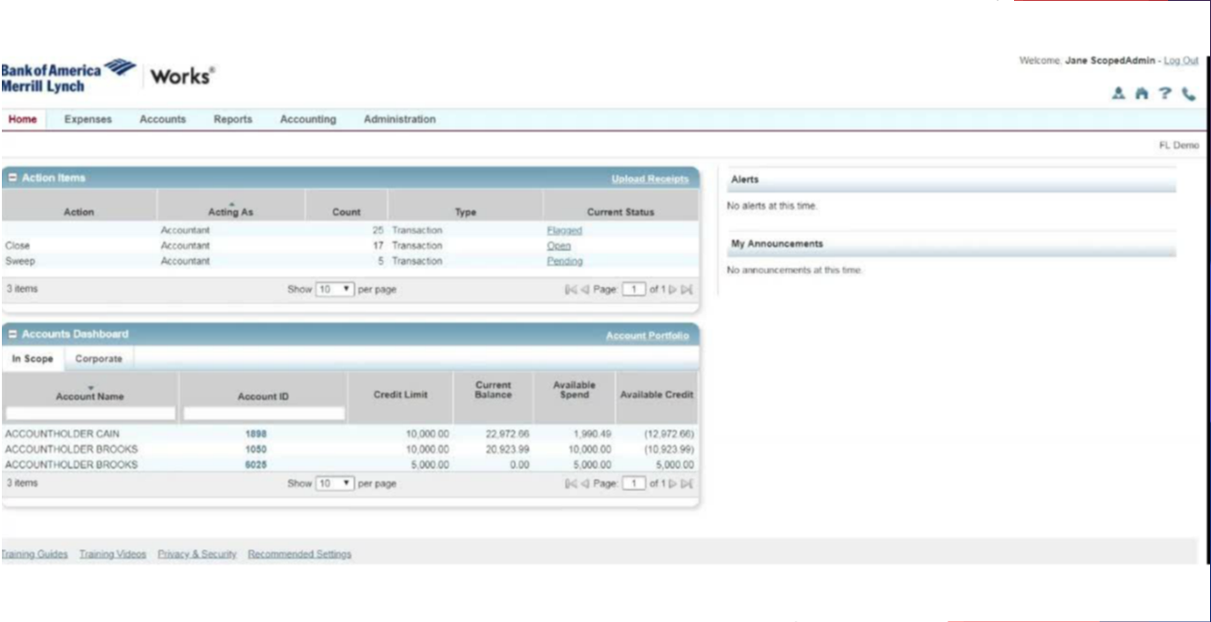
Alerts and My Announcements

Slide 40
Alerts and My Announcements
Alerts and My Announcements are located on the right side of the screen.
Alerts will show users BOA announcements about system updates or password expirations.
My Announcements will include news or remarks about the PCard program made by the DFS.

Slide 41
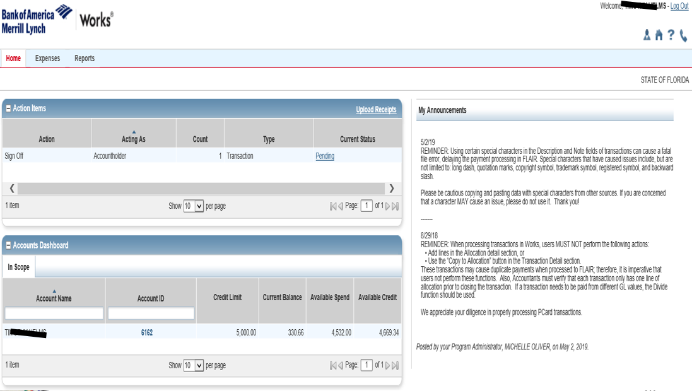
Shortcuts

Slide 42
Shortcuts
There are 4 shortcuts on the top right of the screen: My Profile, Home, Help, and Contact Us.
My Profile will take users to their personal information. This is where users can update passwords and review their user information.
Home will return users to the home screen from any screen in the application.

Slide 43
Shortcuts
Help gives users access to online help for functions and features for that specific screen. This tool guides users to the subject in the user manual.
This is Works system-specific tool, and does not provide details to Florida policies and procedures.
Contact Us gives users access information for Accountholder Support Services, including Customer Service and Card Activation assistance.

Slide 44
Shortcuts
Each user who contacts Bank of America will have to provide their Verification ID, which is our 4 digit Agency ID and your PeopleFirst ID. (e.g. 2100123456 or 21001234567).
Users can always call us if they need help instead of going through the Bank. This information is important to know for after business hours, on weekends, or during holidays or emergencies.

Slide 45
Please tell us!
What is the Navigation Bar and why do I want to use it?

Slide 46
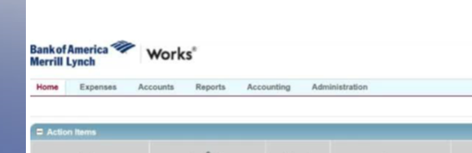
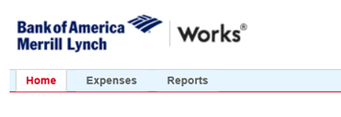
Navigation Bar

Slide 47
Navigation Bar
The Navigation Bar is located at the top left of the screen. This tool bar allows users to move within Works for major activities.
To use the Navigation Bar, simply hover over the menu tabs and click on an option from the drop down menus. Some items in the drop down menu will contain a sub menu.
There are 6 tabs on the Navigation Bar: Home, Expenses, Accounts, Reports, Accounting, and Administration.

Slide 48
Navigation Bar
All roles will have access to the Home, Expenses, and Reports tabs.
Accountants and Scoped Administrators have access to the Accounts and Accounting tabs.
Only Scoped Administrators will access to the Administration tab.

Slide 49
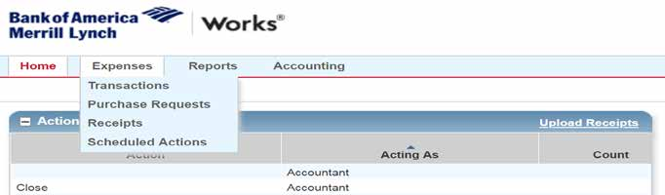
Expense Tab

Slide 50
Expense Tab
A majority of the functionalities Accountholders need is on the Expense Tab. All user roles are able to view, manage, and sign off on charges under the Transactions option from this tab.
Users can also upload and manage receipts from this tab using the Receipts option.
Only Scoped Administrators will be able to view the Scheduled Actions queue.

Slide 51
Expense Tab - WARNING
Under the Expense menu you will also see “Purchase Requests.” The State of Florida will not be using this function.
If a user clicks this button by mistake, simply go back to the Expense Menu or click on the Home shortcut at the top right of the screen.

Slide 52
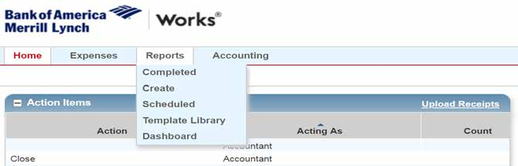
Reports Tab

Slide 53
Report Tab
The Reports Menu is accessible by all users. Users can create, schedule, and view custom Works reports.
Once a report has been created, click on the Home Tab or any other tab.
Please reference the DFS Works End User Manual for all of the various types of report options.

Slide 54
Navigation Tools - General

Slide 55
Navigation Tools - General
Works also offers other navigating tools to make the application easier to use
A simple click is sufficient to select an item - there is no need for double clicking.
Works does not use the Enter key, so moving between GL Values will require the use of the tab key or a mouse to navigate.

Slide 56
Navigation Tools - General
On some screens, there are hyperlinks to click that give users more information regarding that particular action item.
Many functionalities in Works include an expansion button. Simply click the button and Works will show the user additional information that is related to that item.
If you need information on optimal system requirements, click on the “Recommended Settings” at the bottom of the screen application.

Slide 57
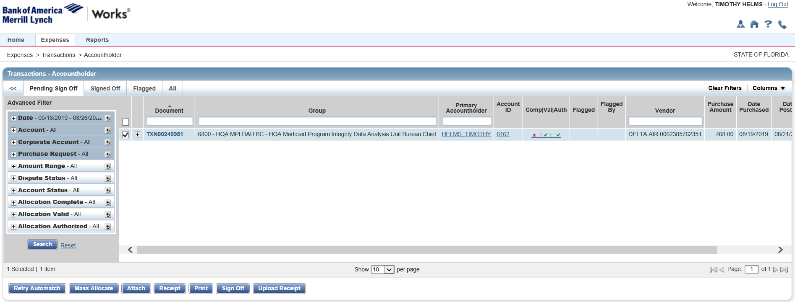
Navigation Tools – Breadcrumb Trails

Slide 58
Navigation Tools – Breadcrumb Trails
After clicking on a hyperlink, and located directly below the Navigation Bar, Works provides Breadcrumb Trails that show the series of options that users have selected to reach the current screen.
The Breadcrumbs Trails are view only, so they cannot be used to navigate to another screen. If users have access to more than one role, the Breadcrumb Trail will show them which role they are using in the system.

Slide 59
What do I need to do?
How do I open a charge transaction in PCard Works?

Slide 60
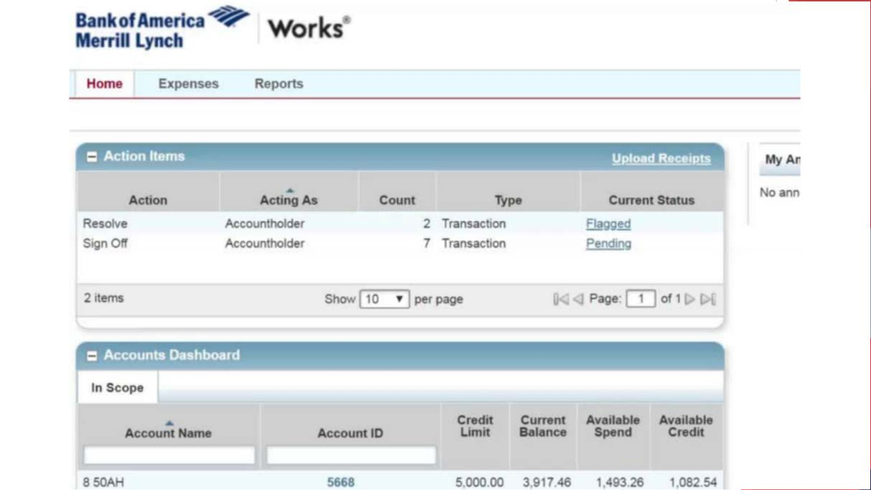
Accessing Transactions

Slide 61
Accessing Transactions
Users can access the main transaction screen two different ways:
  Use the Expenses tab on the Navigation Bar. Be sure to select the correct user role for the transactions.
  Users can also access pending transactions from the “Action Items” from the Home Screen. Users can click the hyperlink in the “Current Status” column to access the transactions for processing. Transactions are grouped together depending on the action needed and the user role assigned.

Slide 62
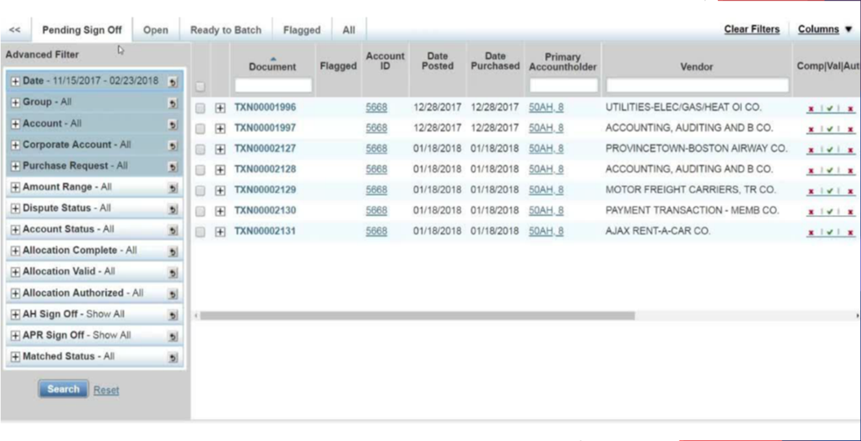
Transaction Navigation

Slide 63
Transaction Navigation – Display Options
Users can access, search for, and approve transactions on the Transaction Screen.
There are 5 tabs on the transaction screen: Pending Sign Off, Open, Ready to Batch, Flagged, and All. The available transactions depend on the queue selected.
Users can set personal preferences for the transaction data appearance by moving the columns on any of the tabs.

Slide 64
Transaction Navigation – Display Options
Users can add or remove columns by clicking on the “Columns” drop down sub- menu in the upper right hand corner.
Users can also drag columns to move them right or left to place them in a particular order.
Once you have set up your queue, save the column preference by selecting “Save” located at the bottom of the “Column” drop down sub-menu.

Slide 65
Transaction Navigation – Display Options
Once the columns are set, they will remain in this order with these data fields, within this queue, until updated again.
The column changes are only relevant for each individual queue. For example, updating the Pending Sign Off Queue, will only reflect those changes and the other queues will not automatically be updated.

Slide 66
Transaction Screen Overview
The Transaction Screen will show:
  The transaction number listed under the “Document” column
  if the transactions has been flagged
  the account ID
  the posted and the purchasing dates of the transaction
  primary accountholder
  who the vendor is

Slide 67
Transaction Screen Overview
  the Complete/Validated/Authorized field, shown as Comp/Val/Auth
  the GL Value allocation codes
  the amount of the transaction
  if a receipt has been uploaded
  who flagged the transaction
  the name of the group where Accountholder is assigned

Slide 68
Transaction Screen - Advanced Filter
The Advanced Filter, located on the left of the screen, allows users to specify which transactions they want to view. For example:
The Date filter automatically shows the transactions from the past 100 days, but you can search transactions up to 24 months.
Users can adjust the number of transactions per page incrementally up-to 500 transactions per page. However, the system will be really slow.

Slide 69
Transaction Screen - Check Boxes
Click the empty box in the gray area of the transaction screen to SELECT ALL transactions, even transactions that are not in current view.
If users use this option to select all they should be ready sign off on all transactions.
The number of items selected is shown on the “Select/Items” count at the bottom of the advanced filter.
Users always have the ability to select a single transaction to sign off or close the transaction.

Slide 70
Transaction Screen - Check Boxes
Click the empty box in the gray area of the transaction screen to SELECT ALL transactions, even transactions that are not in current view.
If users use this option to select all they should be ready sign off on all transactions.
The number of items selected is shown on the “Select/Items” count at the bottom of the advanced filter.
Users always have the ability to select a single transaction to sign off or close the transaction.

Slide 71
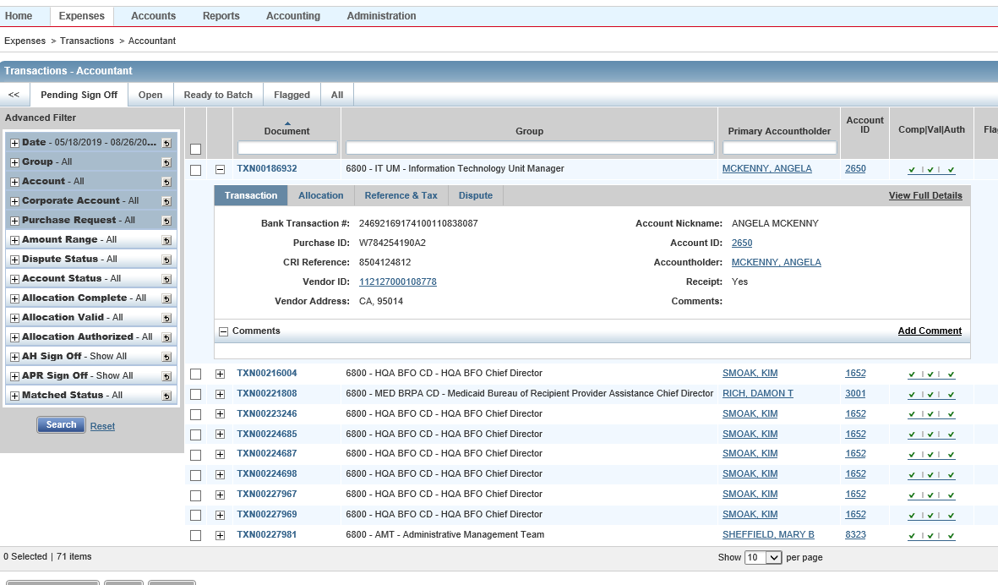
Expansion Button

Slide 72

Transaction Screen – Expansion Button and Column Search
Users can open a summary window by clicking the Expansion Button ( ) to the right of the transaction.
From this window, users can see and add comments, view all GL allocation codes, view notes about a disputed transaction or view full details of the transaction.
Users can search some of the Column fields using search words, can sort all Column information alphabetically and chronologically.

Slide 73
Transaction Screen – Comp/Val/Auth Field
Users select a transaction to: edit the transaction, close or dispute the transaction, divide the transaction into different amounts and codes, manage receipts, or print the transaction.
The system has a series of checkmarks to show a user’s progress with a charge. It is called the Comp/Val/Auth Field which indicates items that still need to be completed in order to sign off on the charge.

Slide 74
Transaction Screen – Comp/Val/Auth Field
This field does not indicate that a charge is coded correctly- it only indicates that the GL Values selected are active on the FLAIR title file!
Comp represents the Completion of values, which means that all required GL fields for FLAIR and Works processing have been completed. All fields are required to be completed before a transaction can be signed off.

Slide 75
Transaction Screen - Comp/Val/Auth Field
Val represents Validation of values. Works does not validate the values entered for GL segments. However, FLAIR will validate these values once the Accountant closes the transaction, and it is sent to FLAIR for processing. Therefore, there is always a green check for Val. It is very important that GL values are verified and double checked in all stages of the approval flow, as FLAIR will reject invalid GL values, the transaction will be flagged and returned to Works to be corrected.

Slide 76
Transaction Screen - Comp/Val/Auth Field
Auth represents Authorization of values. When the values in the GL fields, authorized by the agency’s profile are complete, the green check appears for Auth. The GL values authorized by Profile are specific to each agency.

Slide 77
The good stuff
What are GL Values again?

Slide 78
GL Values
The Accountholder has to code the GL Values correctly and attach required documentation before signing off on the transaction.
The following table is a reference point for the 13 GL Value fields that are required for a transaction to process correctly through FLAIR.
Please review the DFS Works User Manual or the Cheat Sheet provided by JAC for a more detailed explanation of GL Values

Slide 79
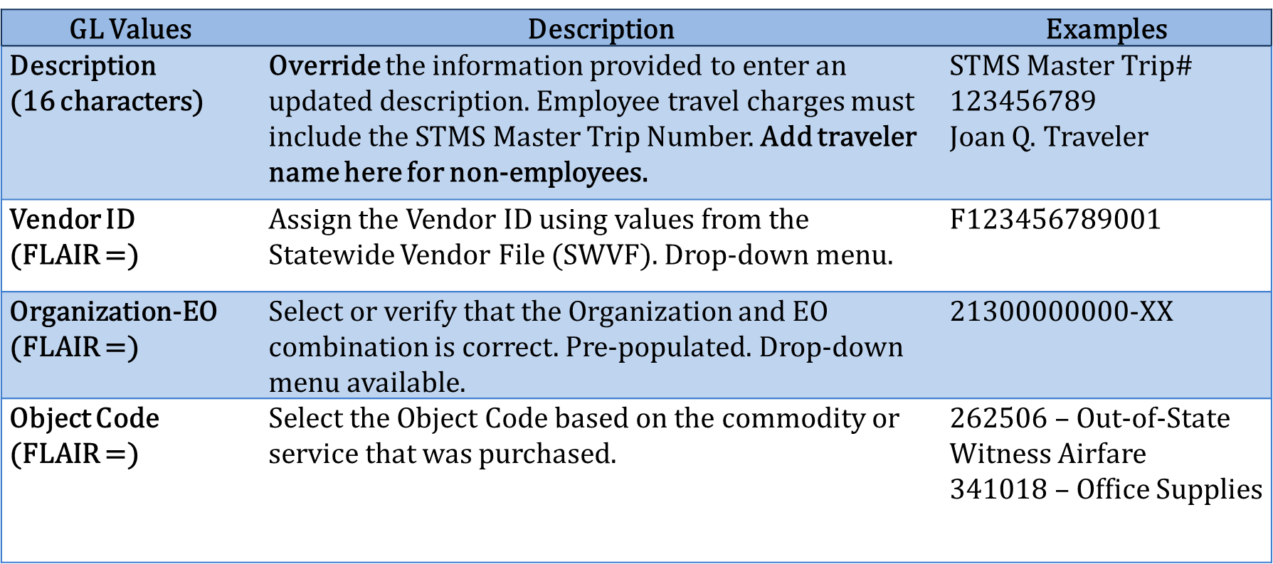
General Ledger Values - Review

Slide 80
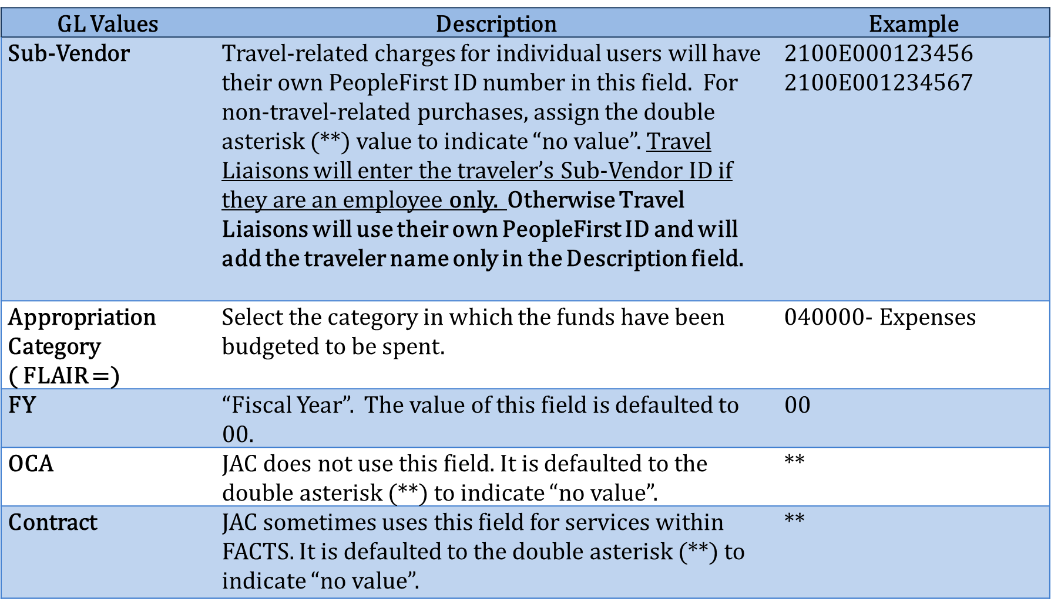
General Ledger Values

Slide 81
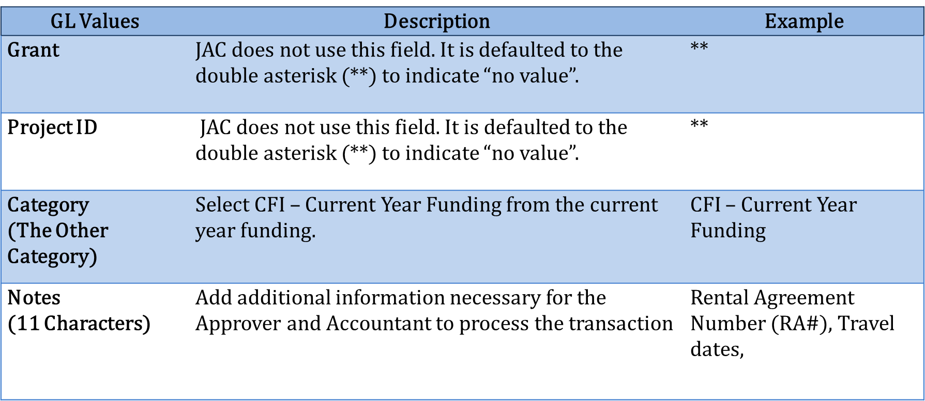
General Ledger Values

Slide 82
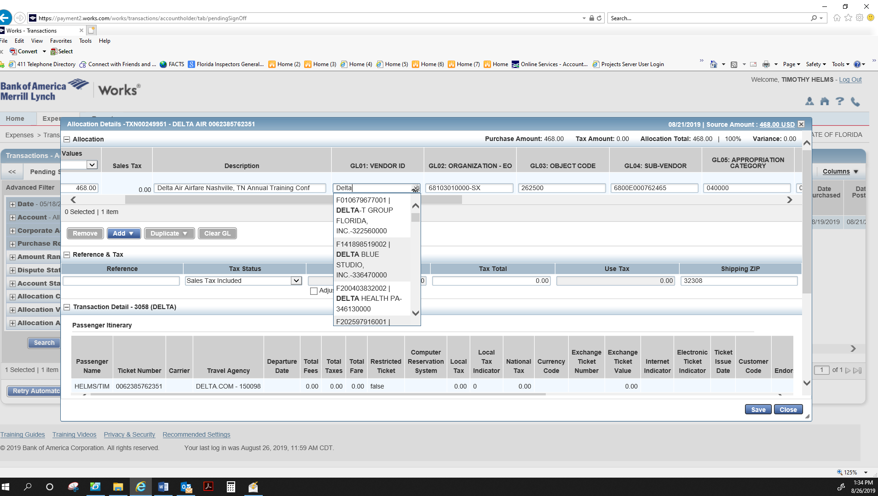
See More Option Vendor ID

Slide 83
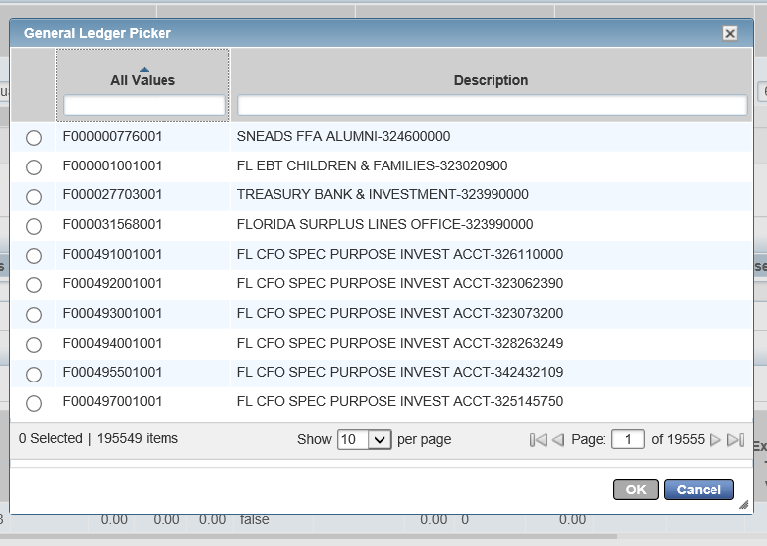
See More Option-Vendor ID

Slide 84
Sending the charge through to the next level
Are we ready to process a transaction?

Slide 85
Processing Transactions- Overview
We are now ready to process a charge, attach relevant documentation, verify the GL Values coding is correct, and sign-off on the charge to move it to the Approver level.
The actual coding of the transaction should be relatively quick and painless for users.
There are two sections to Transaction Screen:
  We are going to code data into the Allocation section of the transaction screen.
  The Reference and Tax section is where you will see if sales tax was charged (reference only).

Slide 86
Processing Transactions – Access a Transaction
Works offers two ways to access a transaction:
  (Single-Action) Click on a single transaction number (TXN number found in the Document column), then click “Allocate/ Edit”.
  Click on the expansion button ( ) to the left of the transaction and click “View Details” to open the transaction.
User preference on which method to use to process a transaction.

Slide 87
Processing Transactions – Access a Transaction
The Single-Action Menu has multiple functions that are helpful:
  Allocate/Edit –allows the user to open the transaction to assign or edit GL values, as well as view transaction information and comments.
  Sign Off – allows the user to sign off on a transaction.
  View Full Details – allows the user to open the transaction to view all details. Under this action, the user will have the ability to edit and review the details of a transaction.

Slide 88
Processing Transactions – Access a Transaction
  Divide –allows a user to divide a transaction to allocate different GL values to new transaction lines.
  Mark Receipt Status – mark the status of a receipt as, “No Receipt” or “Yes, I have the receipt”. This status will update automatically when supporting documentation has been added.
  Manage Receipt – allows the user to manage the receipts of the transaction. The user can add supporting documentation from the user’s Stored receipt folder or add new supporting documentation directly to the transaction, as well as remove any documentation.

Slide 89
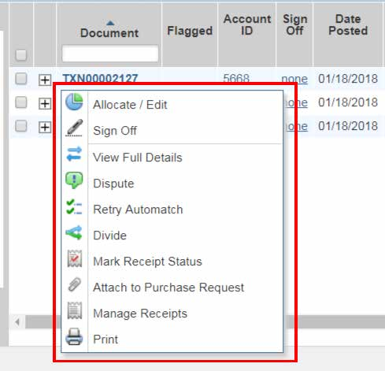
Processing Transactions – Single-Action Process Transaction- WARNING

Slide 90
Processing Transactions – Single- Action Process Transaction- WARNING
Some of the functions on the Single-Action menu are not available for use:
  Dispute
  Retry Automatch
  Attach to Purchase Request
Nothing is supposed to happen if you click these buttons accidentally.

Slide 91
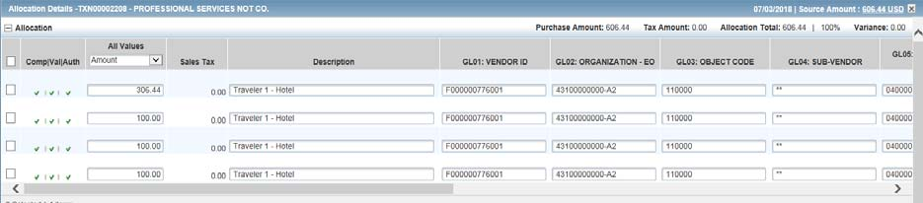
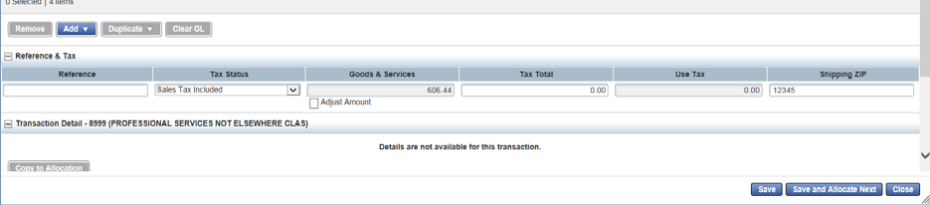
Processing Transactions – Access a Transaction- WARNING

Slide 92
Processing Transactions – Access a Transaction- WARNING
Once your transaction opens, there are three buttons at the bottom that you should NOT USE:
  Add
  Duplicate
  Copy Allocation
If users accidentally choose these functionalities, remove the row by clicking on the box to the right of the unwanted row and click “Remove”, or close out of the transaction window without saving.

Slide 93
Processing Transactions – Access a Transaction- WARNING
There is also a “Clear GL” button located next to the Duplicate button. This button will erase all GL values that were entered, including default GL values. Best practice would be to manually clear the desired fields.
Be careful when cutting and pasting information into the Description or Notes fields. If you are pulling information from the Internet, drop it into Word first, and then transfer it to Works. This will debug any coding issues and allow the data to be picked up for FLAIR.

Slide 94
Processing Transactions – Steps to Success
Step 1: Make sure it is yours and that the amount is correct!
Step 2: Add your GL Values- see last section for details and descriptions of what goes where
Step 3: Click the “Save,” “Save and Allocate Next,” or “Close” button located at the bottom right of the Allocation screen.

Slide 95
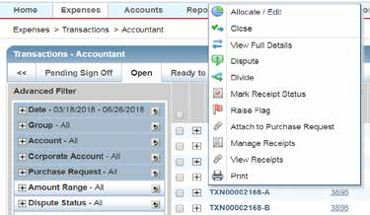
Processing Transactions – Dividing a Transaction

Slide 96
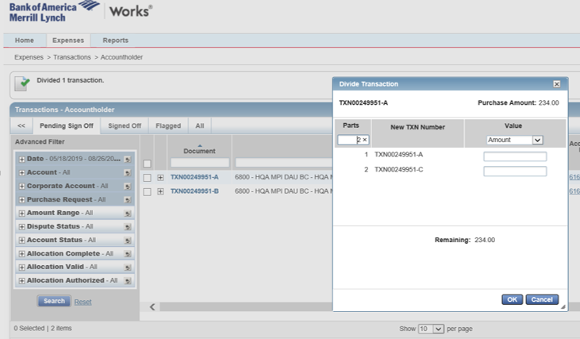
Processing Transactions – Dividing a Transaction

Slide 97
Processing Transactions – Dividing a Transaction
Use the “Divide” function to divide a transaction. Lines can be divided up to 99 times in the new system. Each line will have a TXN number, followed by a letter (e.g. TXN00001701-A)
Divides are used to separate different parts of a charge for a specific purpose.
Examples include:
  Splitting hotel charges between two employees
  Separating out merchandise and freight charges
Only Accountholders and Accountants can divide.

Slide 98
Processing Transactions – Divide Steps
Step 1: Allocate all GL Values to the charge before it is divided.
Step 2: Divides are done from the Pending Sign Off Tab. Click on the Divide button.
Step 3: A pop-up will appear to have the user decide how to divide the charge:
  “Parts” is the number of times the charge should be divided
  “Value” is a choice between selecting a specific amount or allocating a percentage.

Slide 99
Processing Transactions – Divide Steps
Step 4: Click OK to return to the Pending Sign Off Tab.
Step 5: Users can re-allocate GL Values on the Pending Sign Off Tab. Make sure that all divided lines have the correct GL Values.
What happens if a user divides on accident?
  You have to process the lines you divided.
  Once the second line is created Works and given a TXN number, it has to be processed.
  The original transaction can be divided however, but the amount on a single line cannot be $0.00.

Slide 100
How much should be redacted?
What documentation should go into the system ?

Slide 101
Accountholder Documentation Review
Remember that the documentation from users is available for any audits that DFS may conduct on charges.
Florida has a very broad public records law. Please know that anything uploaded to this system could become available for inspection as a public record, unless it is confidential or exempt.

Slide 102
Accountholder Documentation Review
Currently, DFS has notified of us that this will be the new published policy regarding Public Records Requests in the revised SPCA Policy Manual:
G. Public Records Requests (excerpt)
Public Records Requests for PCard data stored in Works that pertain to accounts issued to any state agency employee other than DFS will be referred to that agency’s Public Records Custodian.

Slide 103
Accountholder Documentation Review
DFS has also stated the following on documentation requirements for an audit review:
  All supporting documentation required by the Reference Guide for State Expenditures and other policies must be attached to the transaction in Works.
  The STMS Master Trip number and rental vehicle authorization number are also required for related purchases.
  If a transaction is supported by a specific statute, DFS suggests including that reference with the transaction.

Slide 104
Accountholder Documentation Review
Users know their cases and information better than anyone else. Please do not upload confidential/exempt/sensitive information. Redact and document statute references as necessary to protect all client/victim/ witness information.
Follow your agency’s records retention policy for un-redacted documentation.
Add only what is necessary to process a charge

Slide 105
How do I attach it to a charge?
How do I add documentation to the system?

Slide 106
DFS Documentation Policy
One of the new changes to the PCard process is that receipts and supporting documentation be provided on the front end of the process.
This is now a statewide policy to attach all receipts and supporting documentation to each transaction.
The types of required documentation is not changing. The only thing changing is when the documentation is being required.
Yes, there is a form for lost receipts!

Slide 107
Supporting Documentation In Works
Documentation can be attached at any point prior to the transaction being closed by the Accountant.
Accountholders must add supporting documentation before they can sign off on the transaction. Any other user within the approval flow can also upload documentation.

Slide 108
Supporting Documentation In Works
Users can upload supporting documentation from any electronic internet connected device.
Naming conventions for documents should include identifying information such as the date, vendor name, invoice number, and/or invoiced amount.
Users and JROs need to ensure public record requirements and their internal records policy are followed for the paper receipts and the use of personal devices to upload directly to Works.

Slide 109
Supporting Documentation In Works
Receipt images can be uploaded, and image uploads must be performed one at a time.
The following file formats are supported for the upload process:.pdf,.png,.jpg,.gif and.jpeg.
Each PDF type receipt image must be less than 1MB to upload.
For non-PDF type receipt images (.png, .gif, and .jpeg.) the uploaded file size may be up to 10MB.

Slide 110
Supporting Documentation In Works
DFS has provided a single page Job Aid outlining how to attach documentation.
Files must be less than 1MB when compressed.
Each JRO is considered the primary data owner and is responsible for maintaining original receipts.
Receipts can be uploaded directly to a transaction or receipts can be added in the Receipts section.

Slide 111
Uploading Documentation – Single-Action Process Transaction

Slide 112
Uploading Supporting Documentation
To upload and attach a receipt directly to the transaction:
Go to: Expenses > Transactions.
Click the TXN number for the transaction matching the receipt. The single-action menu displays.
Select Manage Receipts. The Receipts window displays.
Click Add.

Slide 113
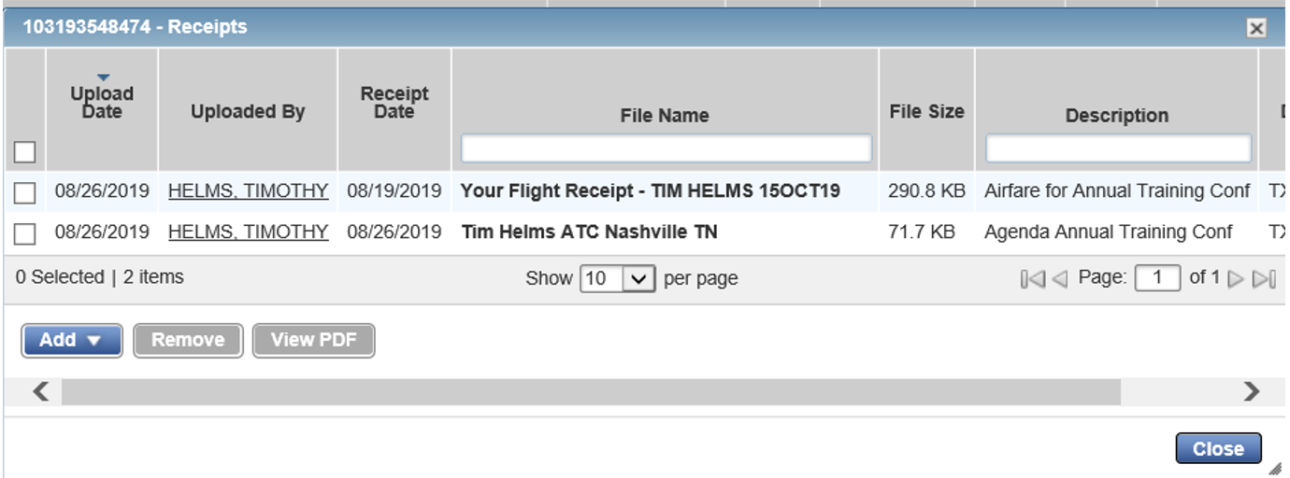
Uploading Documentation – Receipts Window
When the drop-down menu for Add displays, select New Receipt or Stored Receipt. Follow the prompts and locate/select the document.

Slide 114
Upload Supporting Documentation
DFS’s Job Aid identifies ways to add or remove items from the Stored Receipts section
It also identifies how to upload 1 receipt to multiple charges.
Please refer to DFS’s document for additional guidance.

Slide 115
Are we done yet?
How do I sign-off on a charge?

Slide 116
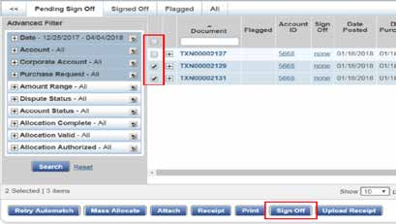
Sign Off on a Transaction

Slide 117
Sign Off on a Transaction
Once all GL Values are entered correctly and the documentation is attached, it is time to sign off on the charge to send it to the Approver level.
Expenses > Transactions> Accountholder. The Transaction screen will display.
Click the Pending Sign Off Tab.
Click the check box for the charge to sign off.
Click Sign Off.
Click OK. A confirmation message displays.

Slide 118
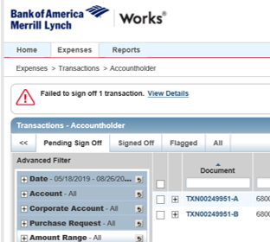
Error Message for a Sign Off Transaction

Slide 119
Error Message for a Sign Off Transaction
Common errors include:
  GL Values left blank
  Description Field not updated
  No supporting documentation attached
There is a hyperlink for View Details for each transaction that has an error.
If an error message appears, the user must resolve the errors before they can attempt to sign off on the transaction again.

Slide 120
Comment Box
When a user signs off on a transaction, the Comment Box will pop-up and ask for additional comments to be passed to the Approver or Accountant in order to process the charge.
The system will not queue the sign-off transaction without a comment.
It is an individual agency-directed policy decision on what will appear in this box at the Accountholder level. Suggestions include initials and date, or a statement or attestation of satisfactorily completion of services.

Slide 121
What are my options?
What if I need to print?

Slide 122
Printing a Transaction
It is possible to print from different screens with various types of information
It is also possible to print a transaction with the attached documentation
Printing a transaction is optional, but it is an individual agency-directed policy decision on the procedure for documenting transaction completion and records retention.

Slide 123
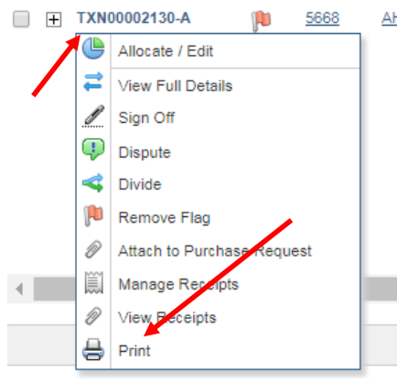
Printing a Transaction
DFS has provided a single page Job Aid outlining how to print documents.
Steps:
Select the TXN Id for the
purchase to be printed
Then select Print

Slide 124
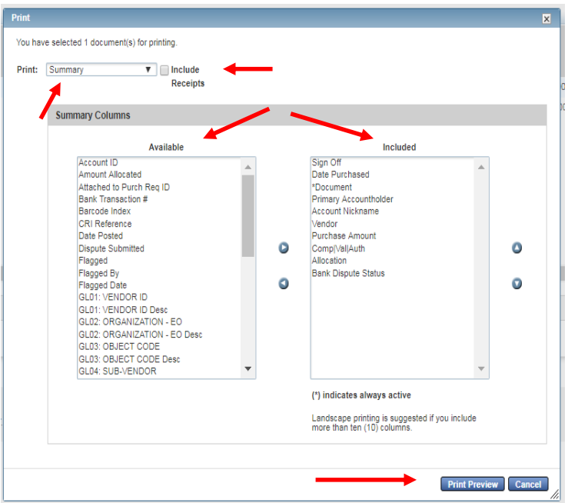
Printing a Transaction
On the Print menu select one of the following:
  Summary – only prints info from selected columns
  Details – prints all available details
  Details & Summary – prints both of the above

Slide 125
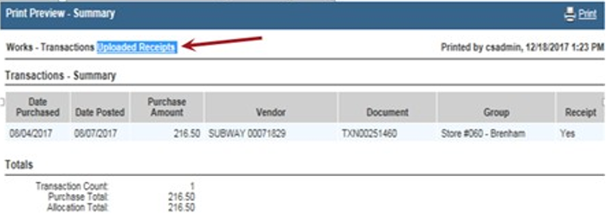
Printing a Transaction - Summary
Click Print Preview.
Click Print in the right corner of the Print Preview window.
Click Print.
If you selected “Include Receipts” on the Print menu, select the Uploaded Receipts.
Click Print to print the receipts.

Slide 126
References
(2019) Welcome to Works for Change Champions. Florida Department of Financial Services. Limited Access PowerPoint Presentation.
(2019) Works® User Manual. Florida Department of Financial Services. Access available at https://myfloridacfo.com/Division/AA/WorksTrainingMaterials.htm
(2019) Works for Scoped Administrators. Florida Department of Financial Services. Limited Access PowerPoint Presentation.

Slide 127
850-488-2415
PCARD@justiceadmin.org
Questions?

