Slide 1
PCard Works for Approvers and Accountants
Justice Administrative Commission
August 2019

Slide 2
What do users need to remember about PCard Works?

Slide 3
Notes on This Presentation
This presentation is for the specifics of the Approver and Accountant Roles in PCard Works
This is a companion presentation to the PCard Works for Accountholders presentation
Discussion on the basic functionalities of the system will not be duplicated in this presentation
Please refer to the other presentation or the DFS Works User Manual for more information
“User” will be generic throughout the presentation, unless referring to a specific user role

Slide 4
Notes on This Presentation
Please refer to the PCard Works for Accountholders presentation for the following information:
Browser information
Initial Log-In
Setting-Up passwords and security questions
Logging-in and logging-out of the system
Attaching Documentation
Detailed GL Values Discussion
Printing Documentation

Slide 5
User Roles Review

Slide 6
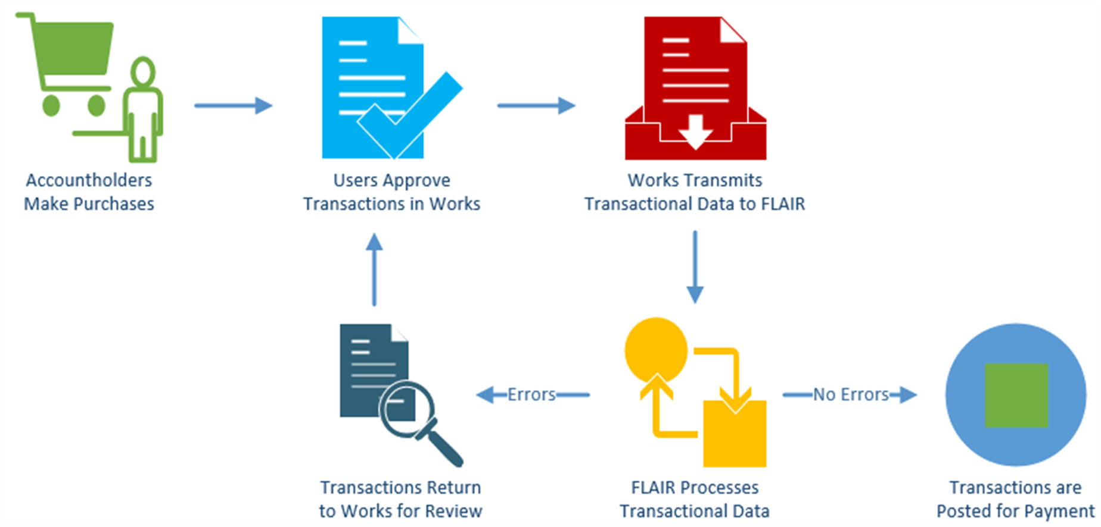
PCard Works – Program Overview

Slide 7
PCard Works – Approval Flow

Slide 8
Things to Remember- WARNING
There are some buttons and functionalities in this system that the State of Florida does not use.
Bank of America will not turn off or gray-out these functionalities.
This training will point out which ones are not usable for transaction processing and highlight them in red.
It is up to the individual user to be diligent about which buttons are clicked in the system. Some mistakes are user-correctable, some are not.

Slide 9
What are the first steps in PCard Works?

Slide 10
User Daily System Emails

Slide 11
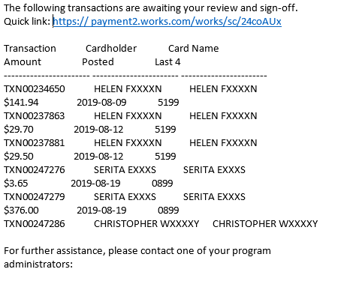
Daily System Emails

Slide 12
Daily System Emails
Works will send automated emails to users who have NEW pending items in their work queues.
Emails will contain a list of transactions that the user needs to sign off or close, any flagged transactions, or any scheduled reports that are ready for review.
The emails will not divide information between user groups. Every Accountant or Approver who is assigned to the User group will receive information regarding the charges for that day.

Slide 13
Daily System Emails
The system generated emails will be sent every afternoon and will include a system-wide sweep of all pending transactions at that time in Works.
Transactions approved after the daily system sweep of pending transactions will still be included in the email that afternoon.
Remember that the emails are notification for pending charges. They are not detailed on purpose, but just a snapshot for activity that requires attention.

Slide 14
We want to know
What is on the Approver and Accountant Home Screen in PCard Works?

Slide 15
Home Screen

Slide 16
Home Screen - Action Items
The Home Screen includes: Action Items, Accounts Dashboard, Alerts, and My Announcements.
Action Items are tasks that are assigned to the user and need attention
Action Items show the last 100 days of actions
There are 5 columns in this section: Action, Acting As, Count, Type, and Current Status.
Please refer to the PCard Works for Accountholders presentation for a detailed explanation of this section

Slide 17
Home Screen - Account Dashboard
All users have an Accounts Dashboard that lists the accounts that they are authorized to review.
There are 6 columns for this section: Account Name, Account ID, Credit Limit, Current Balance, Available Spend, and Available Credit.
Please refer to the PCard Works for Accountholders presentation for a detailed explanation of this section

Slide 18
Alerts and My Announcements

Slide 19
Alerts and My Announcements
Alerts and My Announcements are located on the right side of the screen.
Alerts will show users BOA announcements about system updates or password expirations.
My Announcements will include news or remarks about the PCard program made by the DFS.

Slide 20
Please tell us!
What is the Navigation Bar and why do I want to use it?

Slide 21
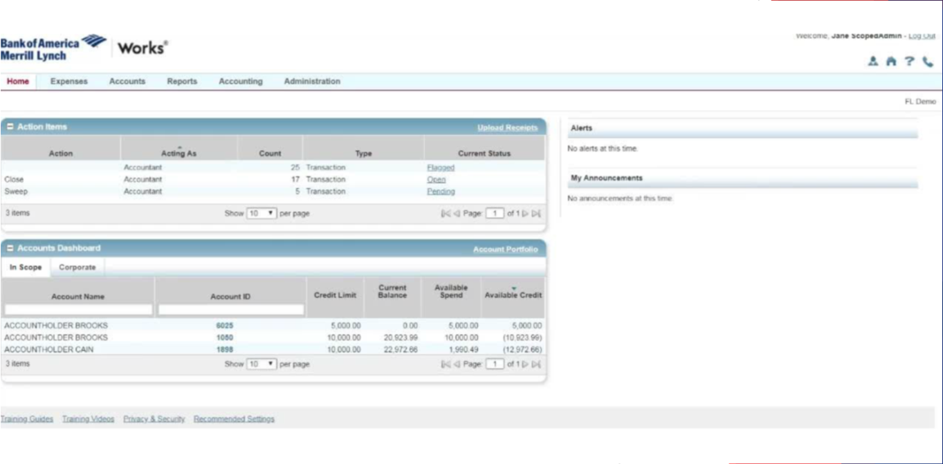
Navigation Bar

Slide 22
Navigation Bar
The Navigation Bar is located at the top left of the screen. This tool bar allows users to move within Works for major activities.
To use the Navigation Bar, simply hover over the menu tabs and click on an option from the drop down menus. Some items in the drop down menu will contain a sub menu.
There are 6 tabs on the Navigation Bar: Home, Expenses, Accounts, Reports, Accounting, and Administration.

Slide 23
Navigation Bar
All roles will have access to the Home, Expenses, and Reports tabs.
Accountants and Scoped Administrators have access to the Accounts and Accounting tabs.
Only Scoped Administrators will access to the Administration tab.

Slide 24
Expense Tab

Slide 25
Expense Tab
A majority of the functionalities users need is on the Expense Tab. All user roles are able to view, manage, and sign off or close charges under the Transactions option from this tab.
Users can also upload and manage receipts from this tab using the Receipts option.
Only Scoped Administrators will be able to view the Scheduled Actions queue.

Slide 26
Expense Tab - WARNING
Under the Expense menu you will also see “Purchase Requests.” The State of Florida will not be using this function.
If a user clicks this button by mistake, simply go back to the Expense Menu or click on the Home shortcut at the top right of the screen.

Slide 27
Reports Tab

Slide 28
Report Tab
The Reports Menu is accessible by all users. Users can create, schedule, and view custom Works reports.
Once a report has been created, click on the Home Tab or any other tab.
Please reference the DFS Works End User Manual for all of the various types of report options.

Slide 29
Navigation Tools – Breadcrumb Trails

Slide 30
Navigation Tools – Breadcrumb Trails
After clicking on a hyperlink, and located directly below the Navigation Bar, Works provides Breadcrumb Trails that show the series of options that users have selected to reach the current screen.
The Breadcrumbs Trails are view only, so they cannot be used to navigate to another screen. If users have access to more than one role, the Breadcrumb Trail will show them which role they are using in the system.

Slide 31
What do I need to do?
How do I open a charge transaction in PCard Works?

Slide 32
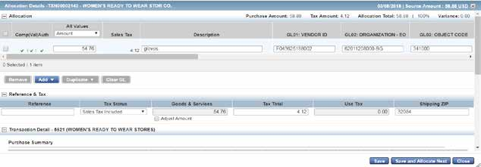
Accessing Transactions

Slide 33
Accessing Transactions
Users can access the main transaction screen two different ways:
Use the Expenses tab on the Navigation Bar. Be sure to select the correct user role for the transactions.
Users can also access pending transactions from the “Action Items” from the Home Screen. Users can click the hyperlink in the “Current Status” column to access the transactions for processing. Transactions are grouped together depending on the action needed and the user role assigned.

Slide 34
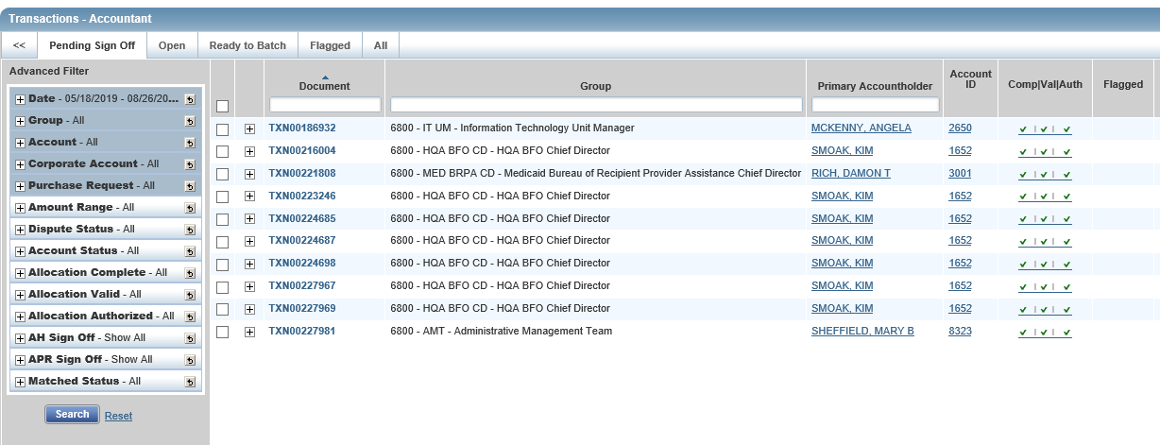
Transaction Navigation

Slide 35
Transaction Navigation – Display Options
Users can access, search for, and approve transactions on the Transaction Screen.
There are 5 tabs on the transaction screen: Pending Sign Off, Open, Ready to Batch, Flagged, and All. The available transactions depend on the queue selected.
Users can set personal preferences for the transaction data appearance by moving the columns on any of the tabs.

Slide 36
Transaction Screen Overview
The Transaction Screen will show:
The transaction number listed under the “Document” column
if the transactions has been flagged
the account ID
the posted and the purchasing dates of the transaction
primary accountholder
who the vendor is

Slide 37
Transaction Screen Overview
the Complete/Validated/Authorized field, shown as Comp/Val/Auth
the GL Value allocation codes
the amount of the transaction
if a receipt has been uploaded
who flagged the transaction
the name of the group where Accountholder is assigned

Slide 38
Transaction Screen - Advanced Filter
The Advanced Filter, located on the left of the screen, allows users to specify which transactions they want to view. For example:
The Date filter automatically shows the transactions from the past 100 days, but you can search transactions up to 24 months.
Users can adjust the number of transactions per page incrementally up-to 500 transactions per page. However, the system will be really slow.

Slide 39
Transaction Screen - Check Boxes
Click the empty box in the gray area of the transaction screen to SELECT ALL transactions, even transactions that are not in current view.
If users use this option to select all they should be ready sign off on all transactions.
The number of items selected is shown on the “Select/Items” count at the bottom of the advanced filter.
Users always have the ability to select a single transaction to sign off or close the transaction.

Slide 40
Transaction Screen – Expansion Button and Column Search
Users can open a summary window by clicking the Expansion Button ( ) to the right of the transaction.
From this window, users can see and add comments, view all GL allocation codes, view notes about a disputed transaction or view full details of the transaction.
Users can search some of the Column fields using search words, can sort all Column information alphabetically and chronologically.

Slide 41
Transaction Screen – Expansion Button and Column Search
Users can open a summary window by clicking the Expansion Button ( ) to the right of the transaction.
From this window, users can see and add comments, view all GL allocation codes, view notes about a disputed transaction or view full details of the transaction.
Users can search some of the Column fields using search words, can sort all Column information alphabetically and chronologically.

Slide 42
The good stuff
What are GL Values again?

Slide 43
GL Values
Users will verify that the Accountholder has coded the GL Values correctly and has attached required documentation
The following table is a reference point for the 13 GL Value fields that are required for a transaction to process correctly through FLAIR.
Please review the DFS Works User Manual or the Cheat Sheet provided by JAC for a more detailed explanation of GL Values

Slide 44
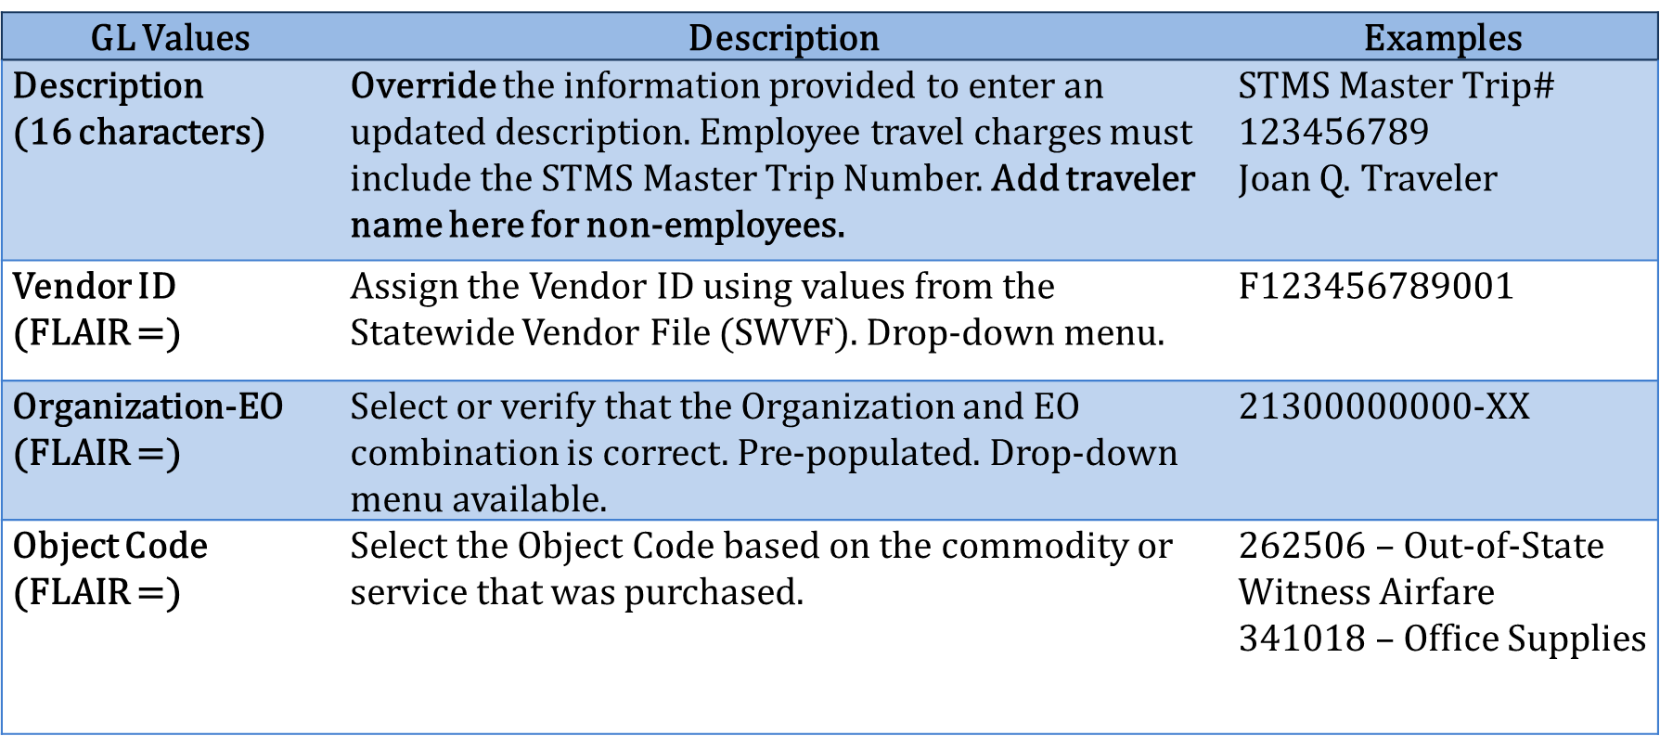
General Ledger Values - Review

Slide 45
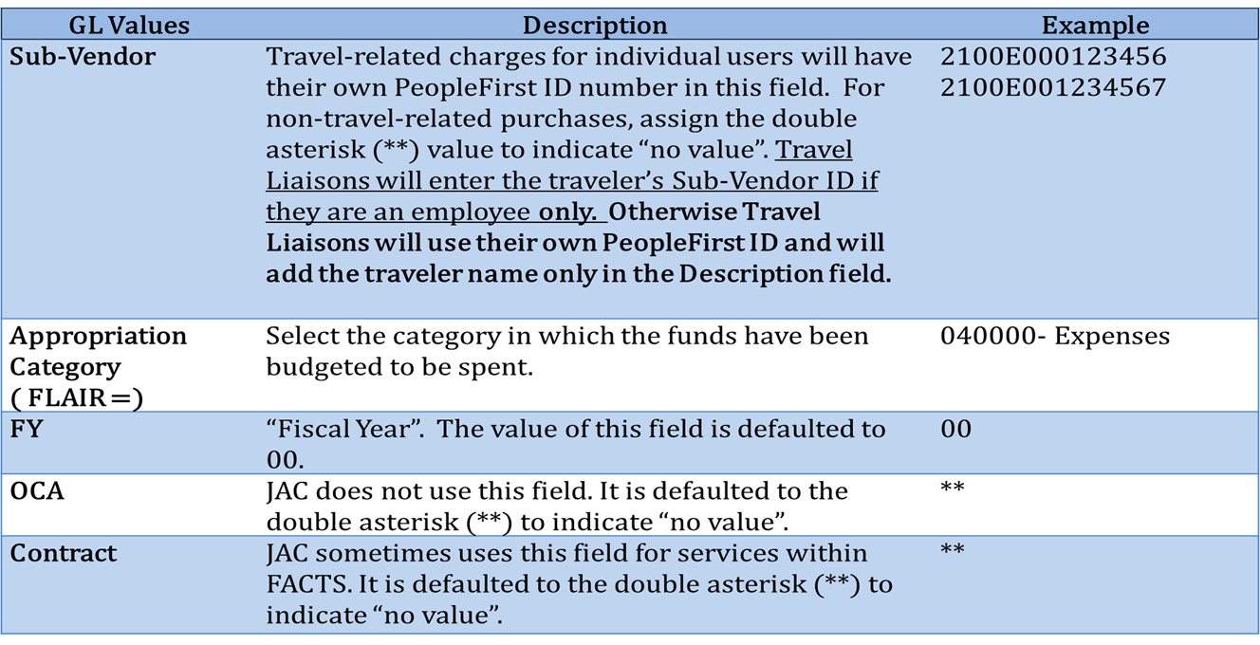
General Ledger Values

Slide 46
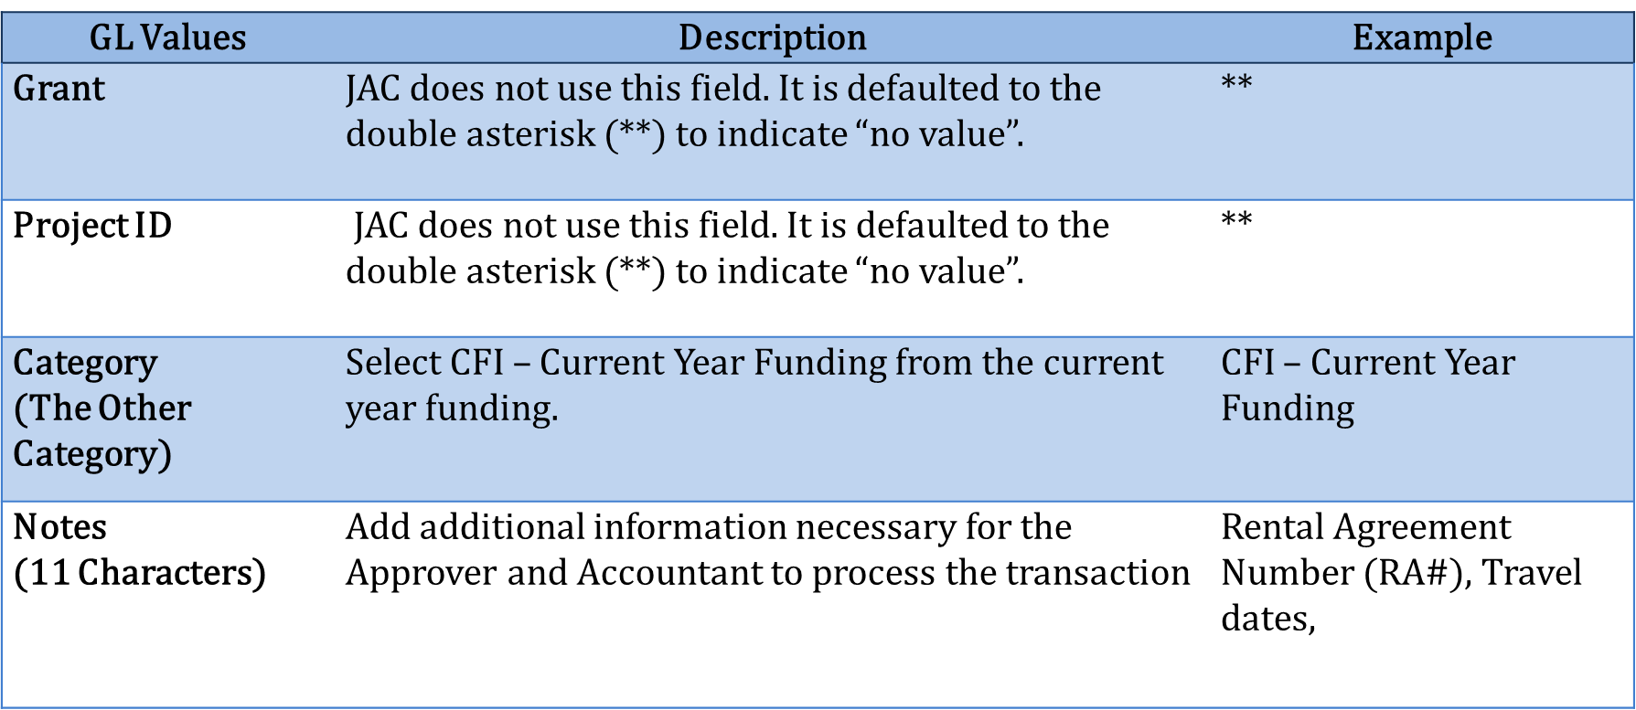
General Ledger Values

Slide 47
Reviewing charges as approvers
Are we ready to process a transaction?

Slide 48
Processing Transactions - Approvers
Once an Accountholder signs off on a charge, the transaction appears in the Approver’s Pending Sign Off queue for review.
The Approver must verify all GL values are accurate, all required supporting documentation has been attached to the transaction, and the transaction is ready for the Accountant to review.
If GL values are incorrect or documentation is missing or insufficient, the Approver has the option to correct the data or return it for review.

Slide 49
Reviewing and Amending Transactions for Approvers
The Approver must review the transaction’s GL fields entered by the Accountholder for accuracy.
If the field does not apply to the transaction, the Approver must verify that the Accountholder entered the double asterisk (**)value to indicate “no value”.
The Approver has the option to correct the GL fields or to flag the transaction for the Accountholder to amend the transaction.

Slide 50
Reviewing and Amending Transactions for Approvers
To allocate or edit transaction information:
Click Expenses > Transactions > Approver. The Transactions screen with transactions on the Pending Sign Off Tab displays.
For Flagged transactions, click the Flagged Tab.
Click the TXN number for the transaction. The single-action menu displays.
Click Allocate/Edit. The Allocation Details window displays.

Slide 51
Reviewing and Amending Transactions for Approvers
Confirm that the transaction has only one allocation line. If the transaction has more than one line, please remove the additional lines. Each transaction can have only one line when it goes to FLAIR.
The Accountholder may need assistance with Dividing a Line if they incorrectly used the Copy or Add functions.
Approvers cannot divide lines - only Accountholders and Accountants!

Slide 52
Reviewing and Amending Transactions for Approvers
Review all required information in the GL values.
Remember that the Approver can choose to make the necessary changes or flag the transaction.
Review the Accountholder comments section for additional information.
Click Save to exit the Allocate/Edit.

Slide 53
Raising and Removing a Flag
Flags Replace the Disapproval Codes in old FLAIR
An Approver or Accountant can flag a transaction to alert other users within the approval flow there is an issue with the transaction.
Flagging a transaction is useful if the transaction requires corrections or additional information from another user within the workflow.

Slide 54
Raising and Removing a Flag
Transactions will not appear on the Accountant’s Flagged queue unless the Accountant raises the flag, or the transaction is returned by FLAIR.
If the Accountant raises the flag, the transaction will appear in the Accountholder’s and Approver’s Flagged queue.
If the Accountant raises a flag, they will work with the JRO (Accountholder or Approver) to resolve, as needed. Approvers cannot amend any changes after initial approval.

Slide 55
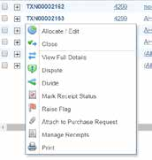
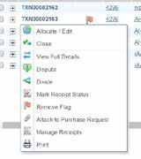
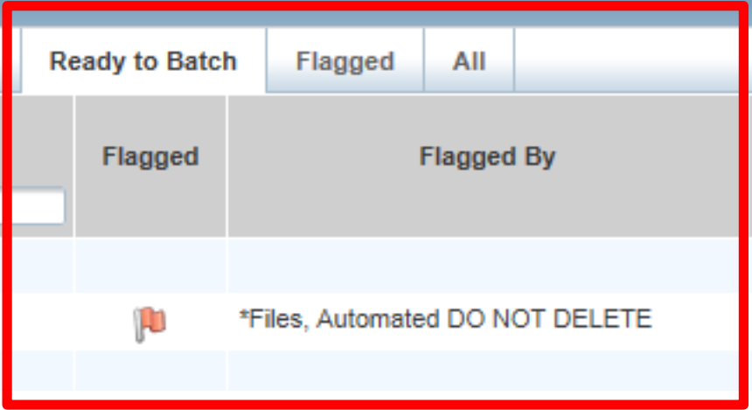
Raising and Removing a Flag

Slide 56
Raising and Removing a Flag
To flag a transaction or remove a flag
Expenses>Transactions>Approver/Accountant. The Transactions screen with the Pending Sign Off Tab displays.
Select the check box for each desired transaction.
Click Flag.
Select Raise Flag or Remove Flag. The Confirm Flag window displays.

Slide 57
Raising and Removing a Flag
Select Remove Flag to remove a flag. All correction(s) must be made prior to removing the flag.
Enter Comments. Comments are required.
Click OK. A confirmation message displays.

Slide 58
Correcting Errors on Lines in Works
Expenses > Transactions > Accountholder/ Accountant
The State of Florida is not using the Add, Duplicate, or Copy to Allocation functions in Works.
If these functions are used, Works will generate more than one line for the transaction. This may cause the transaction to be returned by FLAIR or, may result in duplicate payment transaction.
If the transaction needs to be split into various GL values, the user must use the Divide function.

Slide 59
Correcting Errors - Add or Duplicate

Slide 60
Correcting Errors on Lines in Works
When lines have been added to the transaction, using the Add or Duplicate function, the additional lines must be removed prior to processing the transaction.
If a user uses the Copy to Allocation function, Works will create additional line items, as well as a credit, which will need to be removed.

Slide 61
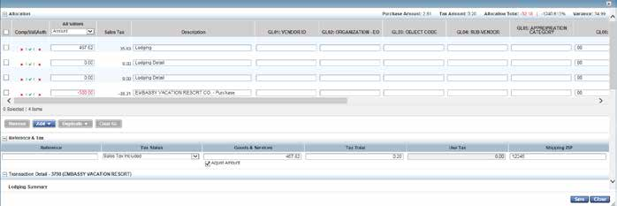
Correcting Errors – Copy to Allocate

Slide 62
Correcting Errors – Copy to Allocate

Slide 63
Line Correction in Works
To remove the additional lines, click the box to the left of each line, then click the Remove button. Once the lines have been removed, click Save.
There must be at least one line of the transaction left to process, and the amount of that line should equal the purchase amount of the original transaction.
Once the transaction has been corrected and has one line item, the user can continue to process the transaction.

Slide 64
Correcting Errors – Deleting Lines

Slide 65
What should be there to sign off or close the charge?
What about the documentation on transactions?

Slide 66
DFS Documentation Policy
One of the new changes to the PCard process is that receipts and supporting documentation be provided on the front end of the process.
This is now a statewide policy that all users attach all receipts and supporting documentation to each transaction.
The types of required documentation is not changing. The only that is changing is when the documentation is being required.
Yes, there is a form for lost receipts!

Slide 67
Supporting Documentation In Works
Documentation can be attached at any point prior to the transaction being closed by the Accountant.
Any user within the approval flow can upload documentation, but Accountholders must add supporting documentation before they can sign off on the transaction.

Slide 68
Approvers want to know
How do I sign-off on a charge?

Slide 69
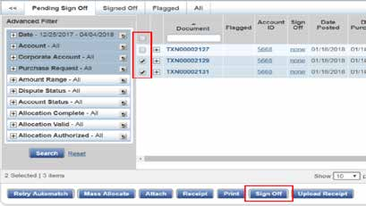
Sign Off on a Transaction

Slide 70
Sign Off on a Transaction
Sign off on the charge to send it to the Accountant level.
Click Expenses > Transactions> Approver. The Transaction screen will display.
Click the check box for the charge to sign off.
Click Sign Off.
Click OK. A confirmation message displays.
Once the Approver has signed off on a transaction, it will appear on the Approver’s Signed Off Tab, and on the Accountant’s Pending Sign Off Tab for review.

Slide 71
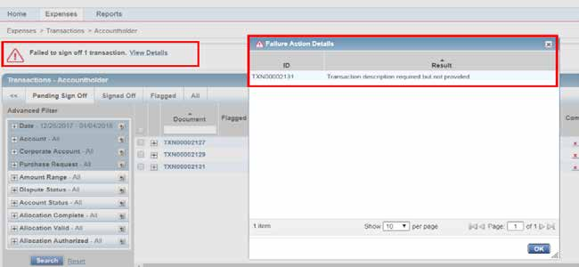
Error Message for a Sign Off Transaction

Slide 72
Error Message for a Sign Off Transaction
Common errors include:
GL Values left blank
Description Field not updated
No supporting documentation attached
There is a hyperlink for View Details for each transaction that has an error.
If an error message appears, the user must resolve the errors before they can attempt to sign off on the transaction again.

Slide 73
Final Notes for Approvers
Once an Approver signs off on a charge, they will not be able to correct any errors.
If there are flags from the Accountant on a charge, the Approver and the Accountholder will have the transaction pop-up in their Flagged queue. For Approvers, it is view only.
The Accountant can correct the charge or send it back to the Accountholder for correction.
Once the Flag is removed from the charge by the Accountant, it will drop off the Flagged queue.

Slide 74
Final Notes for Approvers
Approvers do not have the ability to run reports.
We have granted all Approvers status as an Auditor for this reason.
Approvers should be able to generate and print reports for all of the accounts that are associated with their assigned User Groups.
This is an individual agency policy decision on the types of reports and information that your agency would like to produce for documentation.

Slide 75
Preparing to close a transaction
What do Accountants do?

Slide 76
Processing a Transaction - WARNING
Accountants will follow the same steps as the Approver to verify that GL values are correct, that supporting documentation is valid, and that any flagged transactions have been corrected.
Accountants will see the option to “Sweep” transactions on their Expense menu.
The State of Florida will not use this function. The Statewide PCard Administrator’s Office (SPCA) monitors for the use of this function. Please do not use this function!

Slide 77
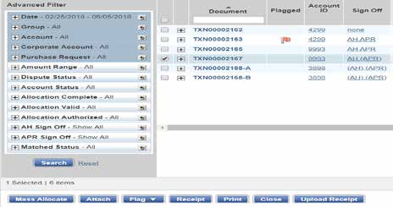
Closing a Transaction

Slide 78
Closing a Transaction
Expenses > Transactions > Accountant
Unlike the Accountholder and the Approver, the Accountant will close a transaction instead of signing off on a transaction.
The Accountant reviews the transaction and removes any flags before closing the transaction to submit to FLAIR for payment.
Accountants can make changes to a transaction through the Ready to Batch queue for a limited time until the transactions are sent to FLAIR for nightly processing.

Slide 79
Closing a Transaction
Click Expenses > Transactions > Accountant. The Transactions screen with Pending Sign Off transactions displays.
Click the box to the left of each transaction that should be closed.
Click Close.
Add any additional comments.
Click OK. A confirmation message displays.
If an error message appears, the Accountant will need to go back and resolve the errors before the Accountant receives a confirmation message.

Slide 80
Flagged FLAIR Transactions

Slide 81
Flagged FLAIR Transactions
Transactions that do not clear FLAIR edits are returned to Works for additional processing.
Accountants should check the Flagged or the Ready to Batch Tabs daily for returned transactions from FLAIR.
Accountants have the responsibility to correct these errors. The Accountholder and Approver may not need to address flagged items that were returned by FLAIR; therefore, these transactions will be reviewed initially by the Accountant.

Slide 82
Flagged FLAIR Transactions
Transactions returned by FLAIR will appear in the Flagged and Ready to Batch queues.
The Flagged queue contains flagged transactions that are in the approval process and the transactions returned by FLAIR.
The Ready to Batch queue shows all transactions that have been closed and are ready to process for payment.
Transactions returned by FLAIR are indicated with “Flagging, Automated DO NOT DELETE” in the “Flagged By” column.

Slide 83
FLAIR Errors
The Accountant must open the transaction and review the comments to determine the reason for the error.
The FLAIR error code and description is included in the Comments section. For example, the object code and category combination may not have been selected correctly.
The Accountant must correct the transaction information and remove the flag.

Slide 84
FLAIR Errors
Once the flag is removed on a transaction that was rejected by FLAIR, the transaction will remain in the Ready to Batch queue to be processed for payment again.
It is important to review the transaction again ensure that all errors and all supporting documentation are correct before removing the flag.

Slide 85
References
(2019) Welcome to Works for Change Champions. Florida Department of Financial Services. Limited Access PowerPoint Presentation.
(2019) Works® User Manual. Florida Department of Financial Services. Access available at https://myfloridacfo.com/Division/AA/WorksTrainingMaterials.htm
(2019) Works for Scoped Administrators. Florida Department of Financial Services. Limited Access PowerPoint Presentation.

Slide 86
850-488-2415 PCARD@justiceadmin.org
Questions?

