Slide 1
Guide to Obtain Vendor Payment Information
How vendors can easily obtain invoice payment information

Slide 2
Introduction:
This guide is intended to assist court-appointed attorneys, due process vendors and vendors hired by the Judicial Related Offices (JROs) in obtaining payment information from Florida Department of Financial Services (DFS) Vendor Payment History website.
Once JAC approves an invoice from an attorney or due process vendor for payment, the invoice is transmitted to the DFS for payment.
JAC does not actually pay invoices. Upon transmission of an invoice to DFS, DFS reviews the invoice and then issues payment on behalf of the State of Florida.

Slide 3
Introduction Continued:
For Court-Appointed payments - once JAC’s Online Billing System indicates an invoice has been Approved for Payment, this means that the invoice has been transmitted to DFS.
Pursuant to s. 215.422(2), F.S., DFS has up to 10 days to review an invoice approved by JAC for payment.
Invoices transmitted to DFS are recorded in the DFS Vendor Payment History website and will show pending status until approved for payment.

Slide 4
Vendor Payment History Website:
DFS’s Vendor Payment History website may be used by vendors to obtain information about pending and paid invoices submitted to DFS for payment:
http://flair.dbf.state.fl.us/dispub2/cvnhphst.htm
The information in the Vendor Payment History website is updated each evening for current day payments.
In order to obtain information, registration is not required. The vendor simply needs their tax identification number (or social security number) used for payment of the invoice(s) submitted to JAC.

Slide 5
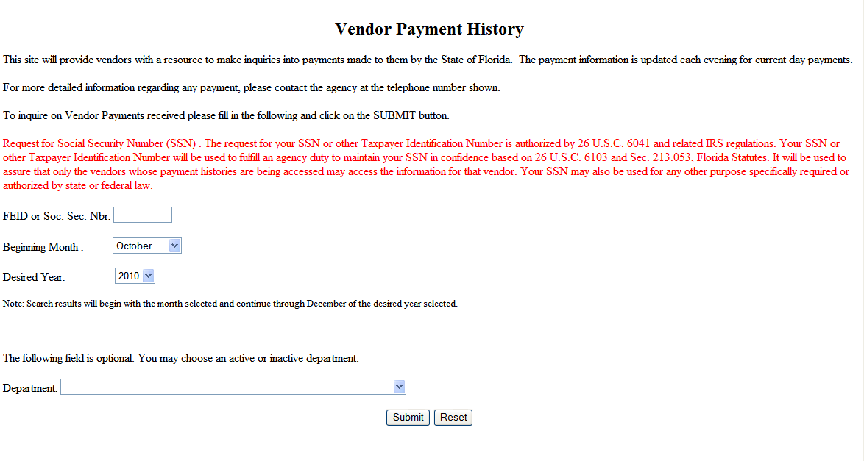
Accessing the Vendor Payment History Website:
The vendor enters their tax ID number in the FEID or Soc. Sec. Nbr. field.
Select the Beginning Month and Desired Year if you want to narrow payment history.
To limit your search to JAC invoice payments, select 210000 Justice Administrative Commission in the dropdown for Department.

Slide 6
Vendor Payment History Screen:
Click here for Pending Payments
PAGE: 1 VENDOR PAYMENT HISTORY RECORDS FOR FEID / SSN: 000000000
PAYMENT PAYMENT PAYEE NAME PAYMENT TYPE AGENCY INVOICE INVOICE AMOUNT
DATE NUMBER DOC.NBR. NUMBER
---------- ------- -------------------------- ------------- -------- ------- ----------
2010/07/12 0000004 JOHN DOE P.A. REGULAR EFT V000001 10-001 5000.00
FOR ADDITIONAL INFORMATION PLEASE CONTACT: JUSTICE ADMINISTRATION AT (850) 488-2415
***************************************************************************************************
2010/07/12 0000006 JOHN DOE P.A. REGULAR EFT V000008 10-003 10,000.00
FOR ADDITIONAL INFORMATION PLEASE CONTACT: JUSTICE ADMINISTRATION AT (850) 488-2415
***************************************************************************************************
This screen reflects invoices that have been paid by DFS. Click on the link for Pending Payments for invoices that are still being reviewed by DFS.
Payment Date: This reflects the date payment was issued by DFS. For a warrant (check), the payment date is the date the check was issued by DFS. For Electronic Funds Transfer (EFT), the payment date is the date the electronic payment was transmitted to the person’s bank account.

Slide 7
Vendor Payment History Screen – Continued:
Click here for Pending Payments
PAGE: 1 VENDOR PAYMENT HISTORY RECORDS FOR FEID / SSN: 000000000
PAYMENT PAYMENT PAYEE NAME PAYMENT TYPE AGENCY INVOICE INVOICE AMOUNT
DATE NUMBER DOC.NBR. NUMBER
---------- ------- -------------------------- ------------- -------- ------- ----------
2010/07/12 0000004 JOHN DOE P.A. REGULAR EFT V000001 10-001 5000.00
FOR ADDITIONAL INFORMATION PLEASE CONTACT: JUSTICE ADMINISTRATION AT (850) 488-2415
***************************************************************************************************
2010/07/12 0000006 JOHN DOE P.A. REGULAR EFT V000008 10-003 10,000.00
FOR ADDITIONAL INFORMATION PLEASE CONTACT: JUSTICE ADMINISTRATION AT (850) 488-2415
***************************************************************************************************
Payment Number: This is a number generated by DFS to designate a particular check or EFT number. This is also referred to as the warrant number. (The warrant number on a written check will include this number plus additional digits.)
Payee Name: This is the person or entity to whom the check or EFT payment is made.

Slide 8
Vendor Payment History Screen - Continued:
Click here for Pending Payments
PAGE: 1 VENDOR PAYMENT HISTORY RECORDS FOR FEID / SSN: 000000000
PAYMENT PAYMENT PAYEE NAME PAYMENT TYPE AGENCY INVOICE INVOICE AMOUNT
DATE NUMBER DOC.NBR. NUMBER
---------- ------- -------------------------- ------------- -------- ------- ----------
2010/07/12 0000004 JOHN DOE P.A. REGULAR EFT V000001 10-001 5000.00
FOR ADDITIONAL INFORMATION PLEASE CONTACT: JUSTICE ADMINISTRATION AT (850) 488-2415
***************************************************************************************************
2010/07/12 0000006 JOHN DOE P.A. REGULAR EFT V000008 10-003 10,000.00
FOR ADDITIONAL INFORMATION PLEASE CONTACT: JUSTICE ADMINISTRATION AT (850) 488-2415
***************************************************************************************************
Payment Type: This reflects the method of payment. If this line reads Regular Warrant then payment is made through written check. If this line reads Regular EFT then payment is made through electronic funds transfer.
Agency Doc. Nbr.: This is number generated by DFS which may include multiple payments involving several vendors. This is often referred to as the voucher number.

Slide 9
Vendor Payment History Screen - Continued:
Click here for Pending Payments
PAGE: 1 VENDOR PAYMENT HISTORY RECORDS FOR FEID / SSN: 000000000
PAYMENT PAYMENT PAYEE NAME PAYMENT TYPE AGENCY INVOICE INVOICE AMOUNT
DATE NUMBER DOC.NBR. NUMBER
---------- ------- -------------------------- ------------- -------- ------- ----------
2010/07/12 0000004 JOHN DOE P.A. REGULAR EFT V000001 10-001 5000.00
FOR ADDITIONAL INFORMATION PLEASE CONTACT: JUSTICE ADMINISTRATION AT (850) 488-2415
***************************************************************************************************
2010/07/12 0000006 JOHN DOE P.A. REGULAR EFT V000008 10-003 10,000.00
FOR ADDITIONAL INFORMATION PLEASE CONTACT: JUSTICE ADMINISTRATION AT (850) 488-2415
***************************************************************************************************
Invoice Number: This reflects the vendor’s invoice number if the vendor provided an invoice number. Generally, JAC will record the exact invoice number used by the vendor as long as the number is nine digits or less. If the number is longer, JAC will adjust the number to make it nine digits or less.
Invoice Amount: This is the amount paid for an individual invoice.

Slide 10
Vendor Payment Pending Screen:
VENDOR PAYMENT PENDING RECORDS FOR FEID/SSN: 000000000
AGENCY VOUCHER INVOICE
PAYEE NAME PAYMENT TYPE DOC.NBR. DATE NUMBER INVOICE AMOUNT
---------- ------------ -------- ------- ------- --------------
JOHN DOE P.A. V000003 2010/10/08 10-002 2,500.00
JOHN DOE P.A. V000003 2010/10/08 10-002 10,000.00
*PAYMENT TOTAL: 12,500.00
FOR ADDITIONAL INFORMATION PLEASE CONTACT: JUSTICE ADMINISTRATION AT (850) 488-2415
***************************************************************************************************
This screen is accessed by clicking on the pending payment link on the Vendor Payment History Records page. Invoices listed on this page have been received by DFS but have not been approved by DFS for payment.
The terms on this screen are the same as the terms on the Payment History Screen. The Payment Type will remain blank until DFS approves the invoice for payment. DFS has up to 10 days to review an invoice after JAC has approved it for payment and transmitted it to DFS.

Slide 11
Vendor Payment Detail Records Screen:
VENDOR PAYMENT DETAIL RECORDS FOR FEID/SSN: 000000000
AGENCY VO: V000001 PAYMENT NUMBER: 0000008 DUPLICATE: NO
SWDN ACCOUNT CODE OBJECT AMOUNT POSTING DATE PYMT STATUS PAID DATE PAYMENT TYPE
---- ------------ ------ ------ ------------ ----------- --------- ----------
D1000000000 XXXXXXXXXXXXXXX 131600 500.00 2010/08/13 PAID 2010/08/31 WARRANT
This page is accessed by clicking on the Payment Number or the Invoice Amount on the Payment History Records page. The terms used on the Payment History Screen have the same meanings on this screen. Other useful information is as follows:
Posting Date: This is the date that the invoice was entered in the FLAIR system. This is not necessarily the payment date.
Payment Status: This reflects whether a written check has cleared the bank used by the State of Florida. If a check has not cleared, this will list as OUTSTANDING.
Paid Date: This reflects the date a written check cleared the bank used by the State of Florida. The actual date of deposit should be prior to this date.
Other information on the page is generally not relevant to attorneys or vendors.

Slide 12
Conclusion:
Through DFS’s Vendor Payment History website, a vendor can obtain information regarding invoices after JAC has approved the invoice for payment. The site for the DFS’s Vendor Payment History website is:
http://flair.dbf.state.fl.us/dispub2/cvnhphst.htm
Effective January 1, 2011, absent an exemption, all payments to court-appointed attorneys and due process vendors must be through electronic funds transfers (EFT). The Vendor Payment History website can assist vendors in tracking invoices paid electronically.

Slide 13
Conclusion Continued:
All vendors are encouraged to enroll for EFT payments in order to speed up receipt of payments.
Information and the forms necessary to enroll in EFT are available at:
http://www.myfloridacfo.com/aadir/direct_deposit_web/index.htm
Once completed, the form should be sent to:
Department of Financial Services
Direct Deposit Section
200 E. Gaines Street
Tallahassee, Florida 32399‐0359
Please do not send the EFT enrollment forms to JAC. JAC cannot process or review these forms.

