Slide 1
Overview of the
Justice Administrative Commission Fiscal Year 2023-24
Alton L. “Rip” Colvin, Jr.
Executive Director

Slide 2
JAC Overview – Objectives
Provide an overview of JAC and its mission
Describe the history of JAC
Define JAC’s role in Justice Administration
Outline JAC sections’ responsibilities

Slide 3
JAC is . . . .
authorized by s. 43.16, F.S., to maintain:
a central state office for administrative services and assistance when possible to and on behalf of the state attorneys and public defenders of Florida, the capital collateral regional counsel of Florida, the criminal conflict and civil regional counsel, and the Guardian Ad Litem Program
a liaison between the offices it serves and the Governor’s Office, Legislature, Department of Financial Services, Department of Management Services, and others

Slide 4
The Commission
The “Justice Administrative Commission” is led by two State Attorneys, appointed by the Florida Prosecuting Attorneys Association, and two Public Defenders, appointed by the Florida Public Defender Association.
Honorable Diamond Litty, Chair Honorable Kathleen Smith
Public Defender, 19th Circuit Public Defender, 20th Circuit
Honorable Brian Haas Honorable Jack Campbell
State Attorney, 10th Circuit State Attorney, 2nd Circuit
The Commission meets regularly with the Executive Director along with other JAC staff to provide guidance and direction on a myriad of issues.

Slide 5
Justice Administrative Commission (JAC)
JAC’s Vision: To be the model of exemplary state government.
JAC’s Mission: To support the entities we serve and Florida’s judicial system with fiscal controls, best practices, and exemplary service.
JAC's Core Values: We take great pride in exemplary service, adaptability, honesty, integrity, and diversity, as well as respectful and ethical conduct.
JAC's Core Competencies: Administrative Service, Communication and Collaboration, Prompt-Payment, Fiscal Accountability, and Continuous Improvement and Innovation.

Slide 6
History
The Justice Administrative Commission (JAC) was created in 1965, shortly after the U.S. Supreme Court’s decision in Gideon vs. Wainwright (1963).
Early on, JAC provided administrative services to the state courts, state attorneys, public defenders, and court reporters.
In 1984, services provided to the state courts were transferred to the Office of the State Courts Administrator (OSCA). That same year, JAC began providing services to the Capital Collateral Representative, which later became the Offices of Capital Collateral Regional Counsel.
In 2003, services for Statewide Guardian ad Litem Office were transferred from OSCA to JAC.
In 2004, JAC began contracting and processing payments for private court-appointed counsel and related vendors, consolidating this function from 67 counties to one state agency.
In 2007, JAC began providing administrative services to the newly created Offices of Criminal Conflict and Civil Regional Counsel.

Slide 7
Justice Administration
Base Budget 2019-20 $955.46 Million

Slide 8
Justice Administration
Base Budget 2020-21 $982.65 Million
Amounts above reflect millions of dollars.

Slide 9
Justice Administration
Base Budget 2021-22 $1.07 Billion
Amounts above reflect millions of dollars.

Slide 10
Justice Administration
Base Budget 2022-23 $1.19 Billion
Amounts above reflect millions of dollars.

Slide 11
Justice Administration
Base Budget 2023-24 $1.28 Billion
Amounts above reflect millions of dollars.

Slide 12
“Two Sides of the House” at JAC
Administratively serves 49 Judicial-Related Offices (JROs)
Provides compliance and financial review of billings for services provided by private court-appointed attorneys representing indigent persons and associated due process vendors

Slide 13
Judicial-Related Offices (JROs) Administratively Served by JAC
20 Offices of State Attorney
20 Offices of Public Defender
5 Offices of Criminal Conflict & Civil Regional Counsel
3 Offices of Capital Collateral Regional Counsel
Statewide Guardian ad Litem Program
Accounting
Budget
Financial Services
Human Resources

Slide 14
JAC Responsibilities for
Court-Appointed Counsel
Contract with 1,690+ Registry & IFC Attorneys, and 660+ Vendors
Audit 59,600+ Billings for Attorney Fees and Costs
Participate in 870+ Hearings when Objecting to Fees or Costs
Report on Various Aspects of this Program
Respond to 14,400+ Legal Motions
Monitor Budgetary Needs for Court-Appointed-Counsel Appropriations

Slide 15
Three-Tiered Indigent Criminal
Defense Model
Public Defender
Regional Counsel
Court-Appointed Counsel

Slide 16
Two-Tiered Indigent Civil Representation Model
Regional Counsel
Court-Appointed Counsel

Slide 17
Civil Representation Model
Children with Special Needs
Court-Appointed Counsel

Slide 18
JAC Accomplishments –
Fiscal Year 2022-23
Processed 320,000+ accounting transactions and 59,600+ court-appointed attorney and due process vendor invoices
Percent of invoices processed within prompt payment requirements = 98.16%, our best performance ever (Legislative performance standard is 95%)
Processed more than 73,000+ payroll and human resources transactions

Slide 19
JAC Accomplishments –
Fiscal Year 2022-23 – Continued
Performed 11,000+ budgetary transactions
Fulfilled more than 520+ public records requests
Responded to 15,900+ JAC Online Support inquiries

Slide 20
JAC accomplishes
all this and more with
93 staff!
Notes:
80 FTE (2 are part time) so actually it’s 79 FTEs
4 OPS (2 full time/2 part time) so actually it’s 3 FTEs
79 + 3 = 82

Slide 21
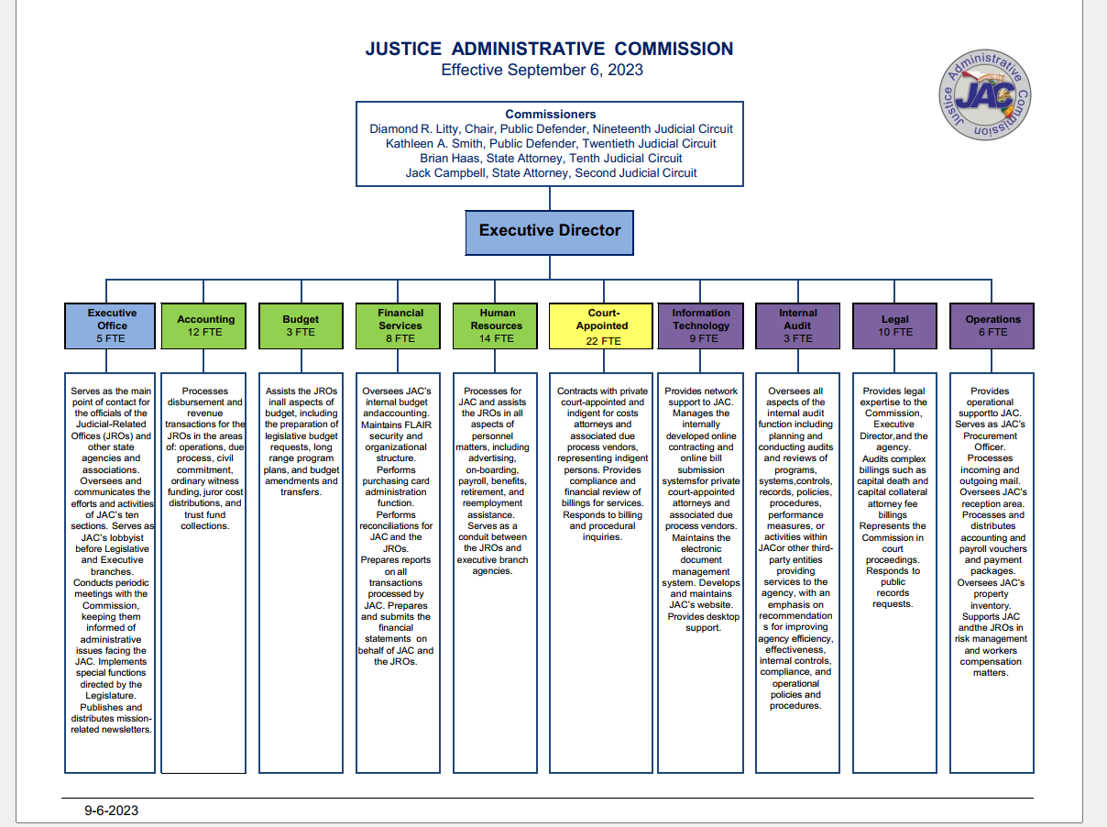

Slide 22
JAC at a Glance
Executive
Budget
Financial Services
Internal Audit
Legal
Human Resources
Accounting
Information Technology
Court-Appointed
Operations

Slide 23
Executive
Oversees agency Operations, Strategic Planning, and robust Internal Controls
Serves as Agency Lobbyist before Executive and Legislative branches
Monitors key legislative developments
Responds to Legislative Bill Analyses Requests
Processes Capitol ID Badge Applications for Justice Administration Agencies
Coordinating JAC’s journey from FLAIR to Florida PALM

Slide 24
Executive
Serves as Public Records Custodian and Records Management Coordinator
Coordinates Year-End Workshop and JAC Conference activities
Promotes and facilitates emergency management best practices
Publishes and distributes mission-related newsletters and surveys
Coordinates juror costs distributions to the Clerks of Court and Comptrollers in Florida’s 67 counties
Coordinates the Online Legal Research contract with the JROs
Explores and promotes cost-savings measures

Slide 25
Accounting
JAC is the 3rd largest processor of invoices, in terms of volume, among all state agencies
Processes operations and due process/case-related vendor invoices
  Review for compliance with the Department of Financial Services standards and Florida Statutes
  Enter transactions into the state’s accounting system for payment
Reallocates expenditures between funds (journal transfers)
Provides fund balances
Provides final review of Purchasing Card charges and process charges for payment
General accounting services and cancelling and reissuing of warrants (checks) as needed

Slide 26
Accounting
Receives and processes receipts
  Verify collections in trust funds submitted through the Department of Revenue
  Process refunds
  Process revenues received in grants and donations trust funds for particular programs
  Work with the Treasury to validate deposits
  Record receipts in the state’s accounting system
Voucher Processing (overseen by Operations)
  Receive and process warrants (checks) and EFT/direct deposit remittance advices
  Match with supporting documentation in the document management system

Slide 27
Budget
Processes budgetary documents on behalf of 55 budget entities within Justice Administration (50 agencies, plus 5 Public Defender Appellate Offices)
Facilitates and Processes:
  Legislative Budget Requests
  Long Range Program Plans
  Budget Amendments
Liaison between the Governor’s Office of Policy & Budget (OPB) and the 50 agencies for the distribution of LASPBS reports, OPB Memorandums, Budget Instructions, etc.
Generates and distributes ad hoc budget analysis and reports

Slide 28
Financial Services
Coordinates and prepares financial reports on a multitude of issues, both those required by law and those requested by the JROs, as well as through public records requests
Monitors budgetary needs of the JAC, State Attorney and Public Defender Due Process Costs, and Court-Appointed Counsel appropriation categories
Prepares Financial Statements after receiving information from the JROs
Administers P-Card Works Program for Justice Administration

Slide 29
Financial Services
Manages JAC’s internal accounting and payment function using BOMS
Performs monthly and annual reconciliations
Distributes FLAIR financial and payroll reports
Coordinates and facilitates FLAIR services with the JROs
Serves as Department of Financial Services’ Liaison for Justice Administration on FACTS, Substitute W-9, EFT, and other items

Slide 30
Human Resources
Processes monthly payroll for the 50 state entities of Justice Administration, with more than 11,000 employees (Payroll by Exception)
  Monthly payroll
  Supplemental payrolls
  Payroll warrants on-demand
Processes retirement and benefit transactions on behalf of the entities of Justice Administration
Serves as the liaison between Justice Administration entities and other state agencies, such as DMS (i.e., Div. of State Group Insurance, People First) and DFS (Bureau of State Payrolls)

Slide 31
Human Resources
Monitors salary rate for the entities of Justice Administration
Processes Personnel Action Requests for new hires, terminations, salary adjustments, position reclassifications, and other transactions
Provides oversight for reemployment assistance
Advertises vacancies for positions of the entities of Justice Administration

Slide 32
Information Technology
Supports and provides email for JAC staff members
Provides Citrix access to JAC staff members for telework purposes
Hosts the Business Office Management System (BOMS) infrastructure for three Offices of Criminal Conflict and Civil Regional Counsel through Citrix
Maintains and supports 40+ servers and the Hybrid Cloud Infrastructure (HCI) and manages environmental and security controls to JAC telecommunications and server equipment
Supports the Court-Appointed Attorney Tracking System (CAATS), a custom written application used by JAC to process payments to court-appointed counsel and due process vendors

Slide 33
Information Technology
Provides support for all computer equipment and applications including BOMS; CAATS; Laserfiche; Citrix; SQL Support; and JAC’s website, including online court-appointed contracts system, and JACOBS, JAC’s Online Bill Submission system
Researches software updates and hardware replacement needs, as well as test updates for functionality and applicability for 90+ desktop computers
Supports, monitors, and manages agency firewall intrusion detection, protected web browsing, and anti-virus software
Supports network file share and print services
Backs up all network data on a frequent basis for offsite storage
Coordinates repairs to JAC equipment

Slide 34
Internal Audit
Oversees all aspects of the internal audit function.
Plans and conducts audits and reviews of programs, systems, controls, records, policies, procedures, performance measures or activities within JAC or related third party vendors.
Emphasizes recommendations for improving agency efficiency, effectiveness, internal controls, compliance, and operational policies and procedures.

Slide 35
Legal
Provides legal expertise to the Commission, Executive Director, and the agency
Audits complex billings, such as capital death and capital collateral attorney fee billings
Represents the Commission in court proceedings

Slide 36
Operations
Provides administrative support to JAC employees related to office equipment (other than computers) and facilities
Supervises JAC Reception, Voucher Room, and Mail Room
Oversees risk management, agency insurance, and workers compensation
Coordinates WEX Fuel Cards and FLEET Management System
Serves as Department of Management Services’ Liaison for JAC Communications (e.g., GoToMeeting/Training, Audio Conferencing, and Virtual Private Network)
Serves as JAC Purchasing Agent
Coordinates JAC inventory

Slide 37
JAC Responsibilities for
Court-Appointed Counsel
Contract with 1,690+ Registry & IFC Attorneys, and 660+ Vendors
Audit 59,600+ Billings for Attorney Fees and Costs
Participate in 870+ Hearings when Objecting to Fees or Costs
Report on Various Aspects of this Program
Respond to 14,400+ Legal Motions
Monitor Budgetary Needs for Court-Appointed-Counsel Appropriations

Slide 38
Questions?
Contact Info:
Alton L. “Rip” Colvin, Jr.
Executive Director
rip.colvin@justiceadmin.org
(850) 488-2415
JAC Website: www.justiceadmin.org

