Slide 1
Statewide Financial Statements
Fiscal Year Ending June 30, 2018
Presented By Michael Mauterer
& Nona McCall
June 7, 2018
Justice Administrative Commission (850) 488-2415
227 N. Bronough Street, Suite 2100 www.justiceadmin.org
Tallahassee, FL 32301

Slide 2
Workshop Objectives
CAFR Introduction
Information Required
Capital Asset Fundamentals
Leave Liability Reporting
Agency Representations
Notes:
2
2

Slide 3
Important Dates
7/16/18
Capital Asset Data Due
7/20/18
Receivables Worksheet Due New
7/23/18
Compensated Absences Data Due
7/11/18
7/2/18
Consideration of Fraud Form Due
JRO Information Request Forms Due

Slide 4


Reconciliation – BOMS to FLAIR
Reconciling BOMS to FLAIR through June 30th ensures:
The financial statement process is as smooth as possible
Corrections for errors are identified before closing
BOMS
FLAIR

Slide 5
Comprehensive Annual Financial Report (CAFR)
Pursuant to s. 216.102, F.S.
The Department of Financial Services requires certain information and agency representations in order to prepare the State’s Comprehensive Annual Financial Report
Notes:
5
5
The Information is also reviewed by the Auditor General’s Office

Slide 6
CAFR, continued
CAFR is a detailed presentation of the state's financial condition. It reports on the state's activities and balances for the fiscal year.
CAFR required by GASB
CAFR is used to set the State’s bond rating
Notes:
6
6
The Information is also reviewed by the Auditor General’s Office

Slide 7
How is the Data Collected?
JROs provide information using:
  Forms
  BOMS Reports
FLAIR transaction data

Slide 8
What Information is provided?
Obligations for Operating Leases
Revolving Fund(s) information for bank accounts (If Applicable)
Receivables information
Payables information
Capital Assets (Property) information
Leave Liability information

Slide 9
Form P6 – Operating Leases
The form contains contract obligations longer than 1 year
Common Lease Agreements:
  Office Space / Building
  Copiers
  Postage Meters
  Storage
Notes:
Any other equipment you may lease should also be included.
Due

Slide 10
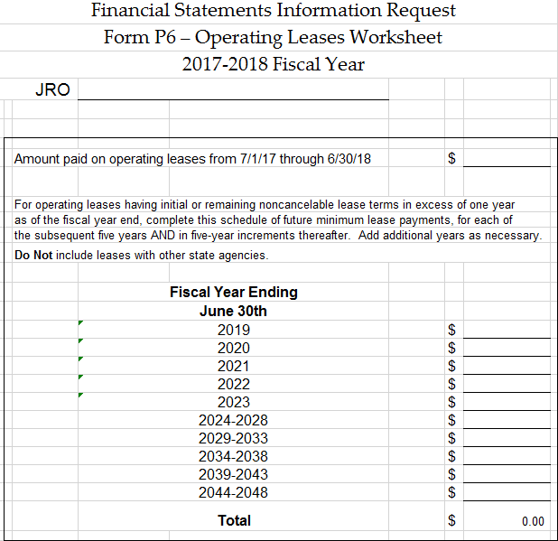
Form P6 – Operating Leases, continued
The form summarizes amounts owed during each year or period
Due 7/11/18

Slide 11
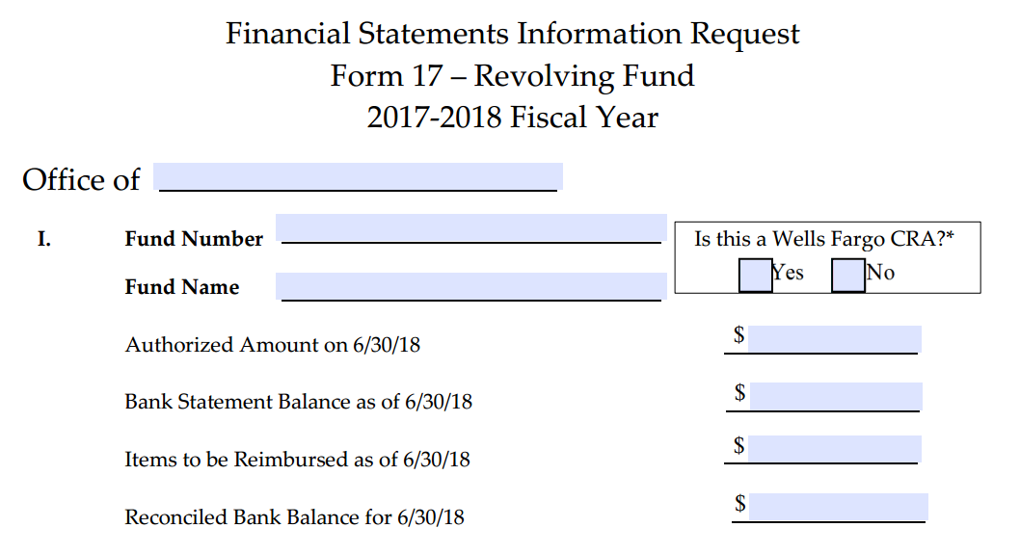
Revolving Funds
The form is only completed if the JRO has revolving funds deposited into a bank
Due 7/11/18
Notes:
Applies to each revolving fund bank account
Authorized Amount
Bank Statement Balance
Reconciled Bank Balance
Please provide copy of June 30th statement

Slide 12
Revolving Funds, continued
Trial Balance entries for Revolving Fund:

Slide 13

Questions

Slide 14
Receivables & Payables
Presented By Nona McCall
Justice Administrative Commission (850) 488-2415
227 N. Bronough Street, Suite 2100 www.justiceadmin.org
Tallahassee, FL 32301

Slide 15
Receivables Worksheet
In prior years:
JROs sent an email summarizing funds owed to their office
  Additional accounting information may have been needed
The information was manually keyed into FLAIR

Slide 16
Receivables Worksheet, continued
For this year:
New form has been created
The form contains fields for all needed information
The worksheet will be uploaded into FLAIR
It is due 7/20/18

Slide 17
Receivables Worksheet, continued
Please include all funds due to your JRO from:
Other State Agencies
Other JAC Entities
County Reimbursements
Refunds due from employees or vendors

Slide 18
Receivables Worksheet, continued
Include all reimbursements due for grants or other agreements
Include refunds not received for deposit by June 30th
Include all refunds that will be deposited to GR Unallocated during July

Slide 19
Receivables Worksheet, continued
No need to include 4th quarter service charge to GR
  JAC will include needed receivables

Slide 20
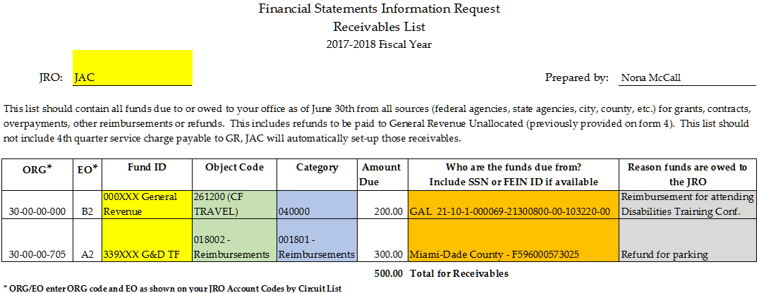
Receivables Worksheet, continued

Slide 21

Receivables
Due From Other Departments
Trial Balance entries to record revenue receivables due from other Departments (state agencies):

Slide 22
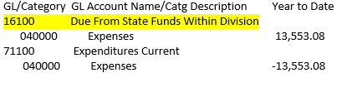
Receivables
Due From Within Your JRO
Trial Balance entries to record certified receivables due from within your JRO:
These entries are often related to charges that need to be moved to G&D TF or Child Support TF and creditedback to Certified category in GR.

Slide 23

Receivables
Due From Another JRO or JAC
Trial Balance entries to record receivables due from another JRO or JAC:

Slide 24
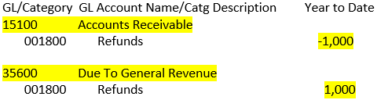


Receivables Worksheet –
Due to GR Unallocated
Trial Balance entries for the amount of other receivables due to your General Revenue from vendors or employees:
Notes:
That is not certified forward or from other agencies.

Slide 25
Payables
Due To Other Departments
State agencies will send JAC a list of funds owed to them
JAC will confirm if a FLAIR entry has already been recorded
JAC will record needed FLAIR entries
Payables must equal other state agencies’ receivables
Notes:
Accounts payable due to other Departments / Agencies are recorded in GL 35300.
Amounts owed are included whether they are certified or non-certified payables.
These payable examples may be non-certified when funds are unavailable or received too late to certify

Slide 26
Payables
Due To Other Departments, continued
Examples:
Unemployment compensation billed by DEO (GL 35300)
Communications billed by DMS
Total Temporary Disability billed by DFS
Criminal History / background screening billed by FDLE
Notes:
Accounts payable due to other Departments / Agencies are recorded in GL 35300.
Amounts owed are included whether they are certified or non-certified payables.
These payable examples may be non-certified when funds are unavailable or received too late to certify

Slide 27

Payables
Due To Other Departments, continued
Trial Balance entries to record payable due to other Departments (state agencies):

Slide 28
Payables
Due Within Your JRO
Example:
Salaries & Benefits payroll costs charged to General Revenue (GR) instead of a Trust Fund (TF).
Solution: Create a payable charging the TF account and due to GR.
Notes:
Accounts payable within your office are recorded in GL 35100.

Slide 29
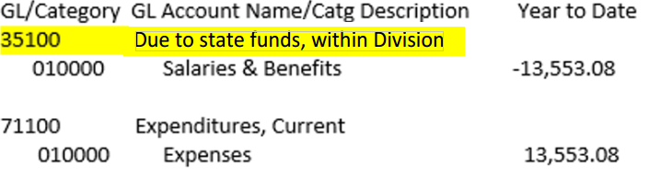
Payables
Due Within Your JRO, continued
Trial Balance entries to record the payable due within your JRO:

Slide 30
Payables
Due To Other JROs or JAC
Example:
A payroll deduction requested by a JRO is received into JAC’s TF and is owed to the JRO’s TF. The funds did not get distributed by June 30th.
Solution: Create a payable charging JAC’s TF and receivable due to the JRO’s TF.
Notes:
Accounts payable due to other JRO’s or JAC are recorded in GL 35200.

Slide 31
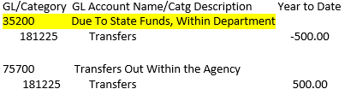

Payables
Due To Other JROs or JAC, continued
Trial Balance entries to record the payable due from another JRO or JAC:

Slide 32
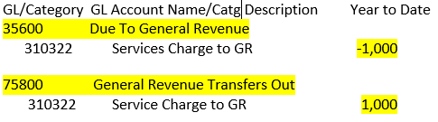
Payables
Due to GR Unallocated
Payables for 4th Quarter Service Charges due to GR will be added by JAC. Trial Balance entries:
Notes:
Upon review JAC will add the 4th quarter services to the receivables worksheet prior to submitting all of the Financial Statements materials to the JRO for final review.

Slide 33

Questions

Slide 34
Capital Assets & Leave Liability
Presented By Lamar Bynum
Justice Administrative Commission (850) 488-2415
227 N. Bronough Street, Suite 2100 www.justiceadmin.org
Tallahassee, FL 32301

Slide 35
Capital Asset Fundamentals
Driven by Ch. 273 (Rule 69I-72.006) – State Owned Tangible Personal Property
  Requires the property custodian to take a physical inventory at least once each fiscal year
  Details what should be tracked on inventory forms
Notes:
The process is driven by statutory requirements under Ch. 273
Requires the property custodian to take physical inventory at least once each fiscal year
Details what should be tracked on inventory forms
Capital asset tracking reports should include…

Slide 36
Capital Asset Fundamentals, continued
State Property Tracking Criteria
  Items $1,000 or more
  Books $250 or more
  Items under $1,000 can be tracked for internal control purposes, but values are not reported
Notes:
Inventory detail does not have to be submitted

Slide 37
Capital Asset Fundamentals, continued
The capital assets summaries provide:
  the original value of the property items
  the accumulated depreciation
  The JRO’s ending value is accepted as reflective of actual balances as of 6/30/18

Slide 38
Capital Asset Fundamentals, continued
Adjustments:
  The calculation of current year inventory must begin with the CFO audited prior year ending balance
  If the beginning balances do not match, an adjustment will be shown

Slide 39
Capital Asset Fundamentals, continued
Property reporting discrepancies may be caused by:
  Items not being posted to inventory in
  the year they were received
  Inclusion of expendable items
  Changes in posting dates
  Adjustments to the duration of useful life
Notes:
FLAIR beaning inventory and accumulated depreciation balances may need to be brought in line

Slide 40
Capital Asset Fundamentals, continued
Accumulated Depreciation:
  Amount of accumulated depreciation cannot exceed total asset value (in other words, the asset cannot be reflected as a negative)
  All inventory reports should show a prior year accumulated depreciation total
Notes:
Depreciation is defined as

Slide 41

Capital Asset Fundamentals, continued
Additions & Deletions
Property Disposition:
  Sold
  Scrapped
  Donated
  Obsolete
Gains & Losses
Notes:
Additions = Total of all OCO items acquired during the fiscal year
Deletions = Total of all items disposed of during the fiscal year
Gains & Losses = Total of any gains or losses resulting from the disposition of assets

Slide 42
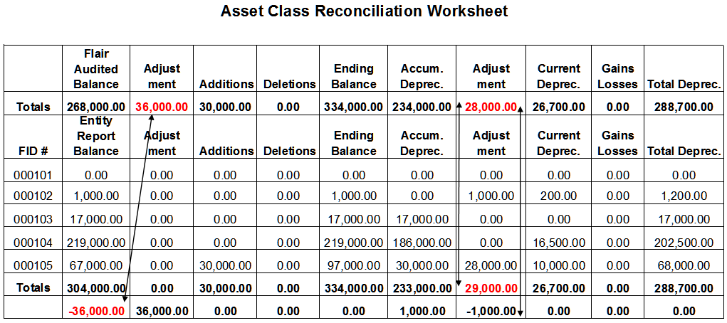
Capital Asset Fundamentals, continued
Form
  Forms BOMS Report & Reconciliation Worksheet
Notes:
Explanation of inventory reporting, see Example #4

Slide 43
Capital Asset Reporting
(BOMS Users)
BOMS Property Reporting Reminders
  Must close out the fiscal year before running the report
  Please review for potential errors prior to submission
Notes:
Review slide and than add…
Although CIP is the main point of contact due to their direct knowledge of BOMS software JAC’s property custodian Wayne Meyer will review how to closeout BOMS and provide some examples of things to be keep in mind in order to prevent reporting errors based on his experience with the software during the yearend meeting.

Slide 44
Capital Asset Information
Information is due on July 16th
The information is used to create a significant number of entries, so your assistance with meeting this deadline is needed and greatly appreciated.

Slide 45

Compensated Absences Leave Liability Reporting
Compensated Absences Leave Liability Reporting – Explained
👍👍👍
Notes:
Discuss reporting criteria slide is for both BOMS and Non-BOMS users
Explain GAFA 10 & GAFA 90

Slide 46
Compensated Absences Leave Liability Reporting, continued
The Leave Liability Report Provides:
  Totals of accumulated compensated leave due to all current employees
  Projected outstanding leave liability
Notes:
Discuss, slide is for both BOMS and Non-BOMS users

Slide 47
Compensated Absences Leave Liability Reporting, continued
GASB requires the obligation to be reported as part of the CAFR so a true picture of the states financial status is shown.
This is an estimated amount that would be owed if the JRO closed on 6/30. Recording this in FLAIR reports the potential future liability owed.
Notes:
Discuss, slide is for both BOMS and Non-BOMS users

Slide 48
Leave Liability Reporting
(BOMS Users)
Leave Payout & Short-Term Factors
Annual Sick and Compensated Leave Payout
Including Short-Term Factors
Entity | TOTAL BEGINNING COMPENSATED ABSENCES | BEGINNING OPERATING BALANCE | BEGINNING LONG TERM BALANCE | FY 2016 SHORT-TERM FACTOR | FY 2017 SHORT-TERM FACTOR
XXXXXXXX | 1,012,391.49 | 48,390.39 | 964,001.10 | 0.42000 | 0.46000
Notes:
Switch to BOMS Users, Handout # 5 and 6.

Slide 49
Leave Liability Reporting
(BOMS Users), continued
Using the incorrect beginning balance will skew:
  Current year short-term factor
  3 year average factor
  Current & long-term liability totals
The report is not representative of actual expenditures incurred
Notes:
BOMS Users

Slide 50
Compensated Absences Leave Liability Reporting (Non BOMS Users)
Demystifying the Compensated Absences Leave Liability (CALLs) workbook which contains:
  The audited CFO beginning balance
  Current fiscal year short-term factor
  Listing of employees by names and rates of pay
Notes:
Switch to Non-BOMS
The Leave Lability Workbook is? (Bring up point any way you like and then go back to the slide)
Intimidating
Complex
Contains Discrepancies

Slide 51
Compensated Absences Leave Liability Reporting (Non BOMS Users), continued
Things to keep in mind:
  Reconcile all employee data with your records
  Input employee leave hours by type
  Include employees in DROP
  Include employees terminating on June 30th

Slide 52
Compensated Absences Leave Liability Reporting (Non BOMS Users), continued
Sick Leave Calculation (s. 110.122, F.S. )
Employees with 10 years of service or more are owed one-quarter (¼) of their accrued sick leave not to exceed the equivalent of 480 work hours, or 1920 x ¼
  Verify data provided
  Only include eligible employees

Slide 53
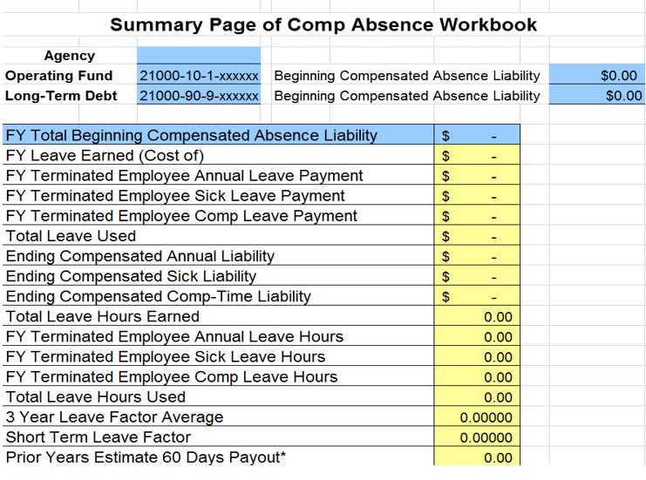
Compensated Absences Leave Liability Reporting (Non BOMS Users), continued
Notes:
Transition to live Workbook demo, see Handout #7.

Slide 54
Compensated Absences Leave Liability Reporting, continued
Information is due on July 23rd
Please note the Leave Liability Reporting due date is different from the Capital Assets information
Adjusting the dates minimizes bottlenecks in processing the necessary entries

Slide 55

Questions

Slide 56
Final Review and Certifications
Presented By Michael Mauterer
Justice Administrative Commission (850) 488-2415
227 N. Bronough Street, Suite 2100 www.justiceadmin.org
Tallahassee, FL 32301

Slide 57

Final Approval
  All financial statements data will be provided to each JRO for final approval

Slide 58
Final Approval, continued
  Each JRO will be provided:
  Form 4 - Due to GR Unallocated
  Form 17 – Revolving Fund Deposits
  Due To and Due From form
  Transfers In and Transfers Out form

Slide 59
Form 4 – Due to GR Unallocated
  Form is created from:
  GR refunds provided on the Receivable Information form
  Receivables for Service Charge Due To GR

Slide 60
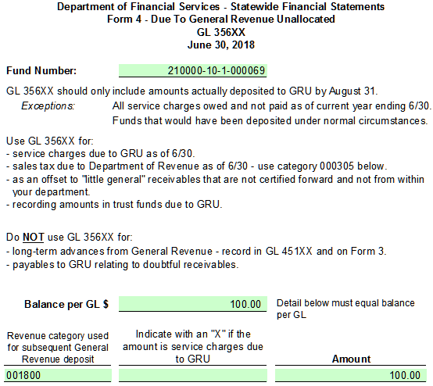
Form 4 – Due to GR Unallocated, continued

Slide 61
Form 17 – Revolving Fund Deposits
  Form is populated from Revolving Fund Information
  This form ties each revolving fund to its FLAIR Fund ID and provides required information showing amounts advanced to these funds

Slide 62
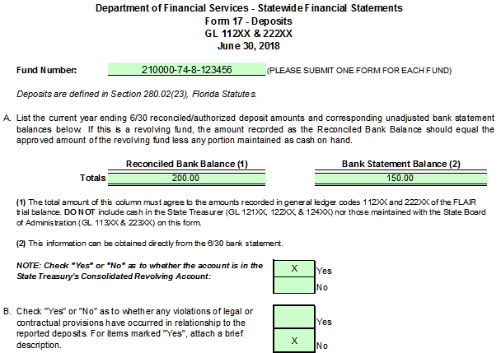
Form 17 – Revolving Fund Deposits, continued

Slide 63
Due To & Due From Information
  Provides all:
  Payables owed to other agencies
  Receivable due from other agencies
  Payables owed or receivables due within a JRO
  Payables owed or receivables due between JROs or JAC
Notes:
Contains all receivables and payables between funds or agencies such as:

Slide 64
Due To & Due From Information, continued
  The payables and receivables must balance between state agencies
  JAC will work with each JRO and associated state agency to ensure the entries balance
Notes:
Contains all receivables and payables between funds or agencies such as:

Slide 65
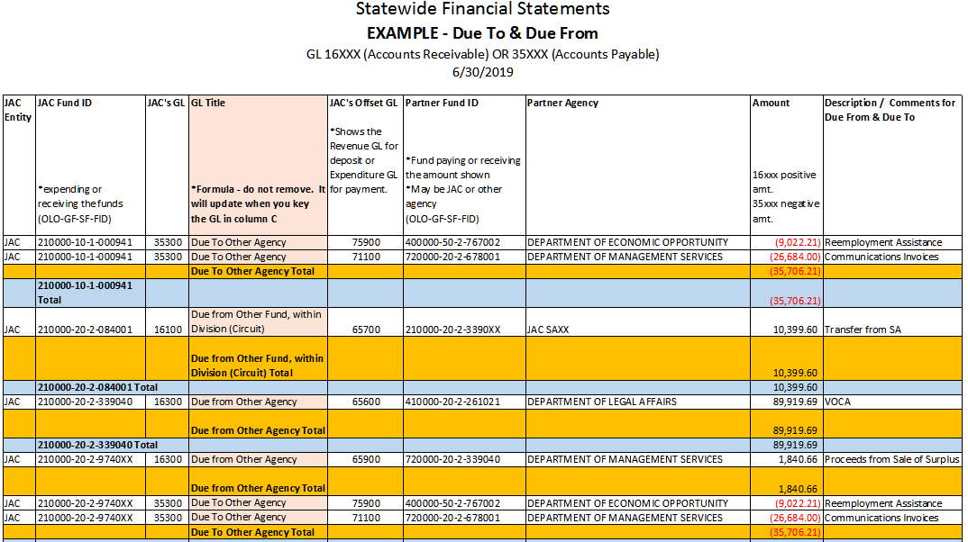
Due To & Due From Information, continued

Slide 66
Transfers In & Out
  A transfer is the movement of cash between funds that is not a payment for goods & services
  General Ledgers for transfers are tied to the object codes used for receipts or expenditures
  All information on the form is based on FLAIR data
Notes:
Contains all transfers between funds or agencies such as:

Slide 67
Transfers In & Out, continued
  Transfers In and Out can be classified as:
  Transfers In or Out from other Departments (agencies)
  Federal Transfers In or Out from other Departments
  Transfers In or Out from within the Department
Notes:
Contains all transfers between funds or agencies such as:

Slide 68
Transfers In & Out, continued
Examples:
Reemployment Assistance to DEO (GL 75900)
General Revenue Service Charge payments (GL 75800)
Payments to the State Personnel System Trust Fund at DMS for People First assessments
Notes:
A transfer is the movement of cash from one fund to another that is not a payment for goods and services.

Slide 69
Transfers In & Out, continued
Examples:
VOCA revenue received from DLA (GL 65600)
Cash transfers from JRO to JAC for payment of People First assessments (GL 65700)
DMS auction proceeds from DMS (GL 65900)
Notes:
A transfer is the movement of cash from one fund to another that is not a payment for goods and services.

Slide 70
What is not a Transfer?
Payments to DMS for services provided such as SUNCOM, building rent, & FLEET system
Payment to the DFS State Risk Management TF for property insurance and casualty insurance
Notes:
Payments for goods or services.

Slide 71
What is not a Transfer? continued
Payments to the Department of State for the Administrative Weekly
Payment to the Department of Legal Affairs for legal services
Notes:
Payments for goods or services.

Slide 72
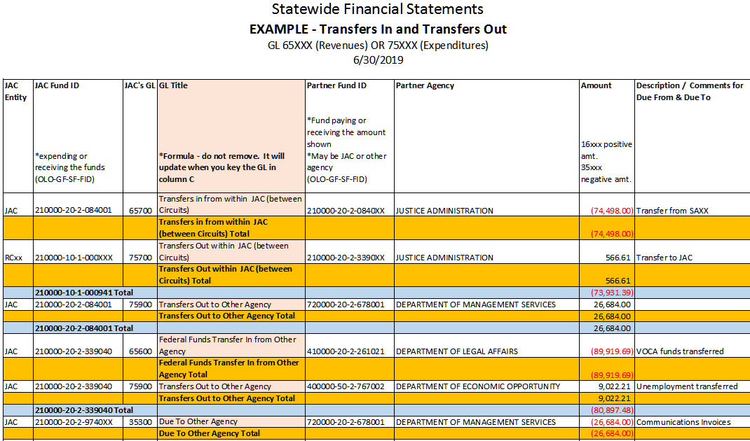
Transfers In & Out

Slide 73
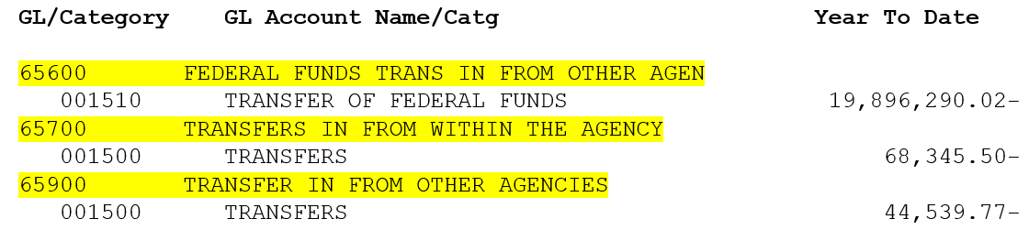
Transfers In
Trial Balance entries recorded for Transfers In from another Agency, JRO or JAC:

Slide 74
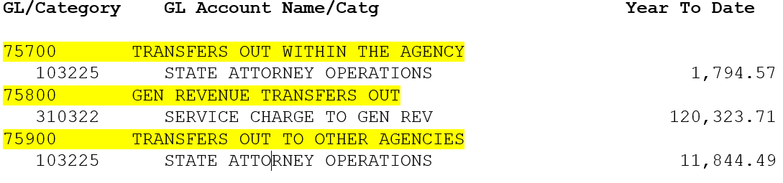
Transfers Out
Trial Balance entries recorded for Transfers Out to another Agency, JRO, or JAC:

Slide 75
Trial Balance Report
Updated report will be available via RDS/EOS on August 1st
Please review the Trial Balance by August 3rd, and look for the following:
  Atypical general ledger account balances
  Missing entries
Ensure all transactions are accurate
Notes:
Notify JAC of any discrepancies

Slide 76
Trial Balance Report, continued
To receive an accurate final Trial Balance, all entries must be completed by August 8th
The final June 30th Trial Balance cannot be updated after closing on August 9th
Adjustments needed after this date will require a DFS post-closing adjustment request

Slide 77

Final Approval Summarized
  Review all the forms provided
  Review the final trial balance
  Notify JAC if any discrepancies are found.

Slide 78
Agency Head Certification
This document is comprised of 5 DFS forms that have to be submitted for the agency as a whole.
It’s encouraged to prepare the certification as provided.
Due 8/3/18
Notes:
These are generic agency wide documents
Violations of Finance-Related Legal and Contractual Provisions P1
Certification of Reconciliation and Capital Assets Accounting P2
Loss Contingencies P3
Construction and Other Significant Commitments P5
Related Party Transactions P7

Slide 79
Subsequent Events Certification
Generally accepted accounting principles (GAAP) require:
Disclosure of any significant event affecting your agency between year-end and the date of the auditor's report.
Due 10/2/18
Notes:
Per this requirement, you should disclose anything that occurred for the period of July 1, 2018 through September 30, 2018.

Slide 80
Subsequent Events Certification, continued
Examples to be considered for disclosure are:
Approval to issue or call bonds
Incurrence of debt
New revenue sources
Initiation or settlement of litigation
Loss of capital assets as a result of a natural disaster

Slide 81

Need Assistance? We’re Here to Help!
Lamar Bynum
Senior Management Analyst
Lamar.Bynum@justiceadmin.org
 | State Property Reporting
 | Leave Liability Reporting
 | Transfers In & Out

Slide 82
Need Assistance? We’re Here to Help!
David Kosinski
Professional Accountant
David.Kosinski@justiceadmin.org
 | Certifications
 | Collection of data & forms
 | FLAIR year-end reports

Slide 83
Need Assistance? We’re Here to Help!
Michael Mauterer
Director, Financial Services
Michael.Mauterer@justiceadmin.org
Nona McCall
Deputy Director, Financial Services
Nona.McCall@justiceadmin.org
General Inquiries | Receivables
Revolving Funds | Payables

Slide 84

Questions

Slide 85
Inventory
Year End Closing
Presented by Wayne Meyer
Operations Director
Wayne.Meyer@justiceadmin.org
Justice Administrative Commission (850) 488-2415
227 N. Bronough Street, Suite 2100 www.justiceadmin.org
Tallahassee, FL 32301

Slide 86
Year End Closing
Please make sure that you have conducted a physical inventory, as required by Rule 69I-72.006, F.A.C., prior to closing your inventory year out.

Slide 87
Year End Closing
Remember that if you notice an error in your Capital Assets report after you close the year, you can “Undo” year end closing and make the necessary adjustments to clear the error.

Slide 88
Year End Closing
Please review your inventory reports for negative depreciation before you finalize and close the year out.

Slide 89
Year End Closing
Please retain a detailed inventory list that supports the amounts sent to JAC in your Capital Assets report for the Auditor General and your records. This does not need to be sent to JAC.

Slide 90
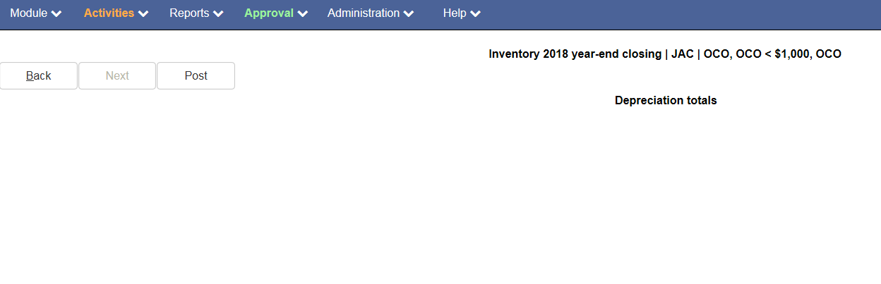
Year End Closing

Slide 91
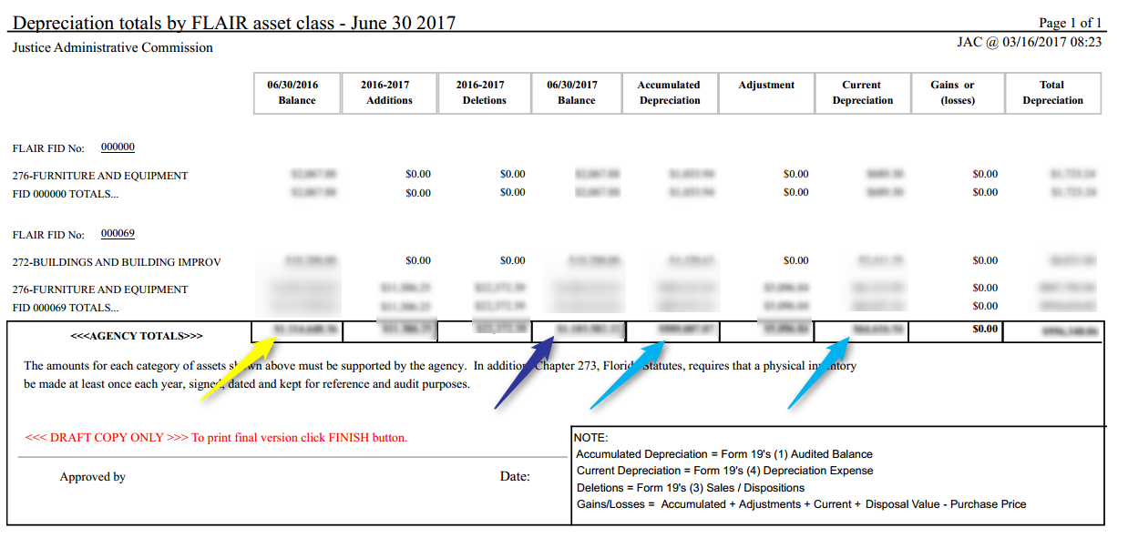
Year End Closing

Slide 92

Year End Closing
Questions??

Slide 93
Year-End Calendar
Fiscal Year 2017-18

Slide 94
May 2018
Sunday | Monday | Tuesday | Wednesday | Thursday | Friday | Saturday
 |  | 1 | 2 | 3 | 6 | 5
6 | 7 | 8 | 9 | 10 | 11 | 12
13 | 14 | 15 | 16 | 17 | 18 | 19
20 | 21 For SAs, PDs, CCRCs, RCs and GAL/9AM | 22 Declaration of Intent Sent to JROs With Notice of Financial Statement Workshop | 23 | 24 | 25 | 26
27 | 28 Memorial Day | 29 | 30 | 31 The Division of Retirement will cease processing retirement credits.
4
Year-End Training
Notes:
94
94

Slide 95

June 2018
Sunday | Monday | Tuesday | Wednesday | Thursday | Friday | Saturday
 |  |  |  |  | 1 Declaration of Intent Due to JAC | 2
3 | 4 | 5 | 6 Financial Statements Workshop reminder Emailed to JROs | 7 | 8 Deadline for Retirement Upgrades for SMS; | 9
10 | 11 Consideration of Fraud & Financial Statement Forms Emailed to JROs | 12 Consideration of Fraud & Financial Statement Forms Emailed to JROs continued | 13 | 14 | 15 | 16
17 | 18 | 19 | 20 Supplemental Pay Transactions Due to JAC from JROs; | 21 Deadline for Processing 5% Budget Amendments; Due to JAC by 2PM ET. Posting of June Monthly Payroll after 3PM ET. | 22 June monthly payroll; Deadline for submitting current year Expense Refunds and submission of Batch Sheets; Includes Revolving Fund Reimbursements; 5PM deadline for submitting Insurance Voucher payments to JAC; | 23
24 | 25 Supplemental Payroll processes; Deadline for submission of Journal Transfers; | 26 | 27 Deadline for submission of Revenue Receipts and Processing of Expense Warrant Cancellations and On-Demand Payments; Negative Salary or OPS release balances must be cleared. | 28 Budget Amendments posted to FLAIR by JAC; 9AM Deadline for processing cancellation of payroll warrants; | 29 Vouchers presented to the Bureau of Auditing by 5PM will be processed as FY 2017-18 disbursements; Payment of Supplemental Payroll; | 30 Salary Rate Deadline
Financial Statements Workshop
Year-End Financial Statements Workshop
Notes:
95
95

Slide 96
July 2018
Sunday | Monday | Tuesday | Wednesday | Thursday | Friday | Saturday
1 | 2 Consideration of Fraud Due to JAC | 3 | 4 Independence Day Holiday | 5 June Monthly FLAIR closing; | 6 June 30 balances and tentative certified releases posted to FLAIR; | 7
8 | 9 Requested Leave Workbooks Emailed to JROs | 10 Requested Leave Workbooks Emailed to JROs | 11 Financial Information Request Forms Due to JAC from JROs | 12 | 13 | 14
15 | 16 Capital Assets Information & Certifications Forward Lump Sum or CF1 Forms Due to JAC from JROs | 17 Run date for Final Certifications Forward listing | 18 | 19 Certified Forward Report Due to the EOG | 20 Accounts Receivable Information Due to JAC from JROs | 21
22 | 23 Compensated Absences Data Due to JAC from JROs | 24 | 25 | 26 | 27 JAC Sends Out Completed FS materials to JROs for Review | 28
29 | 30 | 31
Compensated Absences Spreadsheets Out to JROs/Short Term Factors & Leave Payouts for BOMS Users
Notes:
96
96

Slide 97
August 2018
Sunday | Monday | Tuesday | Wednesday | Thursday | Friday | Saturday
 |  |  | 1 Updated Trial Balance Report available in RDS/EOS | 2 | 3 Trial Balance Review Deadline Form 20A & Agency Head Certification Due to JAC | 4
5 | 6 | 7 | 8 Completion of all final Trial Balance Entries | 9 Agency FLAIR Fiscal Year Closing Date Any changes received after closing require a DFS post-closing adjustment request | 10 Final Year-End Trial Balance Report available in RDS/EOS | 11
12 | 13 | 14 | 15 | 16 | 17 | 18
19 | 20 | 21 | 22 | 23 | 24 | 25
26 | 27 | 28 | 29 | 30 | 31
Notes:
97
97

Slide 98
October 2018
Sunday | Monday | Tuesday | Wednesday | Thursday | Friday | Saturday
 | 1 | 2 Subsequent Events Certification Due to JAC | 3 | 4 | 5 | 6
7 | 8 | 9 | 10 | 11 | 12 | 13
14 | 15 | 16 | 17 | 18 | 19 | 20
21 | 22 | 23 | 24 | 25 | 26 | 27
28 | 29 | 30 | 31
Notes:
98
98

Slide 99
Frequently Asked Questions
Compensated Absences &
Leave Liability Related FAQs

Slide 100
Frequently Asked Questions, continued
Q1. Why is our agency’s beginning balance for compensated absences liability and capital assets different than JAC’s balances?
A1. Per SFRS guidelines, JAC must use the prior audited ending balance as the beginning balance of the current reporting year.

Slide 101
Frequently Asked Questions, continued
Q2. When calculating leave liability for annual, sick, and comp time, which employees should be included?
A2. For financial reporting, the total of all annual and comp time hours earned should be included (no cap on hours).
For sick leave include only employees that are vested (10+ years of service) and limit to ¼ of the total hours up to the 480 hours cap
(per s. 110.122, F.S.).

Slide 102
Frequently Asked Questions, continued
Q3. After completing the input columns during my review while comparing the calculations with last year’s data, I noticed the sick and annual leave payout numbers are incorrect for both the hours and dollars. The numbers came directly off the payroll tabs and registers, so they are correct. How do I proceed since the "blue" cells are not supposed to be changed?

Slide 103
Frequently Asked Questions, continued
A3. Compensated Absences Leave Liability Spreadsheet (CALLS) users can make changes to data in any cells except for white cells with formulas. However, If changes are needed, please highlight the adjusted columns and email the updated worksheet along with an explanation back to JAC.

Slide 104
Frequently Asked Questions, continued
Q4. I have a leave liability report question regarding a person that terminated on June 30th and their leave will be paid in July from certified forward funds. This person is not included within the list that was sent to me for our JRO. Should they be listed in the leave payout list for Fiscal Year 2017-18?

Slide 105
Frequently Asked Questions, continued
A4. To ensure that this employee does not get included in two Year-End Reports, you should check your BOMS report to be sure this employee is not included in your BOMS current employees’ list. Because the individual terminated on June 30th, he or she was still an active employee as of June 30th. If the individual is included within your BOMS current list, he or she should not be added to the terminated leave payout list. If not, you can add them to the payout list and send an updated copy to JAC.

Slide 106
Frequently Asked Questions, continued
Q5. Does JAC include the FICA and Retirement for annual and comp time leave and FICA for sick leave?
A5. For Year End Financial Reports, all costs are included in determining leave liability (sick limited to 10+years of service).

Slide 107
Frequently Asked Questions, continued
Q6. I am getting ready to run the Leave Liability Part 1 Report. Do I get my Fiscal Year Terminated Employee Payments from JAC?
A6. After People First closes out the year, JAC will send each JRO an Excel spreadsheet with your annual, sick, comp time leave payouts, your prior year short-term factors, and your beginning compensation liability total.

Slide 108
Frequently Asked Questions, continued
Q7. The cost of sick leave used changes from one version of BOMS to the next. Is this right?
A7. Yes, if all sick leave pay was used, the 3 year average factor would be skewed. Therefore, the intent is to determine a reasonable amount of liability to be booked by the entity—not the actual expense incurred.

Slide 109
Frequently Asked Questions, continued
Q8. How is the Prior Years’ estimate 60-day payout calculated?
A8. The 60-day payout totals from the past two years comp leave reports are added. This is necessary to attain the 3 year moving average required by DFS.

Slide 110
Frequently Asked Questions
Capital Assets & Inventory
Related FAQs

Slide 111
Frequently Asked Questions, continued
Q10. The Capital Assets form has a line for furniture and equipment. Is that furniture and equipment of any purchase amount? I’ve heard the number is anything over $1,000.
A10. The capitalization threshold for furniture & equipment is $1,000; books and other reference material not circulated to students or general public is $250.00.

Slide 112
Frequently Asked Questions, continued
Q11. I noticed the Asset Class Reconciliation worksheet is blank. Is this correct?
A11. Yes, it can be blank. This spreadsheet is only used when there are multipliable FLAIR classes, BOMS worksheets, or adjustments are needed.

Slide 113
Frequently Asked Questions
Other Related FAQs

Slide 114
Frequently Asked Questions, continued
Q13. We sent over a refund for discoveries that was credited back to GR – Operations that we didn’t receive until after the cutoff date. Does this amount need to go on the new Receivable Form as unallocated?
A13. Yes, this item should be listed on new Form.

Slide 115
Frequently Asked Questions, continued
Q14. I am expecting a check from the county for reimbursement of my June IT payroll which will be deposited into my GDTF cash. Do I put that somewhere?
A14. Yes, list it on the new Receivables form so an Accounts Receivable entry can be recorded.

Slide 116
Frequently Asked Questions, continued
Q15. Where is the amount owed for Unemployment Compensation shown?
A15. It’s shown on the Due To & Due From Form.

Slide 117
Definitions
3 Year Leave Factor Average: A percentage factor used to determine the average short term portion of compensated liability that will be reported for the fiscal year (cumulative leave factor/3).
60 Day Leave Payout: The short term portion of compensated liability estimated to be paid out within 60 days after the end of fiscal year (total short term compensated liability/12 x 2).

Slide 118
Definitions, continued
Amount Due Within One Year: The remaining short term compensated liability (61 days to one year after fiscal year)(total short term compensated liability – 60 day payout).
Beginning Compensated Absences Liability: The audited Prior Year ending balance (must agree with the Bureau of Accounting reported balance).

Slide 119
Definitions, continued
Cumulative Leave Factors: Total of the short term factors for the prior two fiscal years + the current reported fiscal year (used to determine the 3 year leave average factor).
Ending Compensated Annual Liability: Total accumulated annual leave due to all employees for the fiscal year (PY leave + FY leave earned – FY leave used).

Slide 120
Definitions, continued
Ending Compensated Comp-Time Liability: Total accumulated comp-time leave due to all employees for the fiscal year (PY leave + FY leave earned – FY leave used).
Ending Compensated Sick Liability: Total accumulated sick leave due to all vested employees for the fiscal year (PY leave + FY leave earned – FY leave used).

Slide 121
Definitions, continued
Leave Earned: The total leave earned by all activity of employees for the reported fiscal year (calculated: annual + sick + comp time hours earned X hourly rate of pay).
Short Term Compensated Liability: The short term portion of compensated liability estimated to be paid out within one year of the fiscal year (total compensated liability 3 year average factor).

Slide 122
Definitions, continued
Short Term Factor: A percentage factor used to determine the short term portion of compensated liability (calculated: FY leave used/FY leave available).
Terminated Employee Annual Leave Hours: Total accumulated annual leave hours for all employees that terminated during the report fiscal year.

Slide 123
Definitions, continued
Terminated Employee Comp-Time Leave Hours: Total accumulated comp-time leave hours for all employees that terminated during the report fiscal year.
Terminated Employee Sick Leave Hours: Total accumulated sick leave hours for all vested employees that terminated during the report fiscal year.

Slide 124
Definitions, continued
Terminated Employee Annual Leave Payout: Total annual leave payment to all employees that terminated during the report fiscal year.
Terminated Employee Comp-time Leave Payout: Total comp-time leave payment to all employees that terminated during the report fiscal year.

Slide 125
Definitions, continued
Terminated Employee Sick Leave Payout: Total sick leave payment to all vested employees that terminated during the report fiscal year.
Total Leave Deletions: Total of all leave payments for the fiscal year + all terminated leave payout.
Total Leave Hours Used: Total accumulated leave hours used during the fiscal year for all employees (sick limited to vested employees).

Slide 126
Definitions, continued
Total Leave Hours Earned: Total accumulated leave hours earned during the fiscal year for all employees (sick limited to vested employees).
Total of Prior 2 Year 60 Days Payout: Total of the prior 2 year estimated 60 day payout added together.

