Slide 1
2021-22
Fiscal Year End Training
May 19, 2022
Justice Administrative Commission
227 N. Bronough Street, Suite 2100
Tallahassee, FL 32301
(850) 488-2415
www.justiceadmin.org

Slide 2
The Commission
The “Justice Administrative Commission” is led by two State Attorneys, appointed by the President of the Florida Prosecuting Attorneys Association, and two Public Defenders, appointed by the President of the Florida Public Defender Association.
Honorable Diamond Litty, Chair Honorable Kathleen Smith
Public Defender, 19th Circuit Public Defender, 20th Circuit
Honorable Brian Haas Honorable Jack Campbell
State Attorney, 10th Circuit State Attorney, 2nd Circuit
Alton L. “Rip” Colvin, Jr.
Executive Director

Slide 3
JAC’s Vision, Mission & Core Values
JAC’s Vision: To be the model of exemplary state government.
JAC’s Mission: To support the entities we serve and Florida’s judicial system with fiscal controls, best practices, and exemplary service.
JAC’s Core Values: We take great pride in exemplary service, adaptability, honesty, integrity, and diversity, as well as respectful and ethical conduct.
Notes:
3
3

Slide 4
Accounting Overview –
Disbursements and Revenue
Notes:
4
4

Slide 5
State of Florida Fiscal Year
The State of Florida’s fiscal year runs from July 1 through June 30
Florida governmental accounting is mostly a year-to-year process – “spend it or lose it”
The State of Florida allows state obligations incurred but not paid prior to June 30 to be paid after June 30
  In effect, extending the fiscal year to September 30

Slide 6
Fiscal Year End – June Information and Reminders
Volume of batches/invoices increases as everyone works to get all FY 21-22 obligations paid in June
JAC encourages offices to submit invoices for payment as early as possible in June
  Both due process/case-related and operations
Batches – JAC Accounting staff will pay all batches/invoices received by JAC on or before June 22 as fiscal year 21-22 batches
Journal Transfers (JTs) – transferring expenditures between funds to cover shortfalls and maximize general revenue expenses – JAC JT deadline on or before June 23

Slide 7
Journal Transfers - Overview
JTs generally post overnight in FLAIR; however, delays can occur at year-end because of high volume
When expenditures are moved, the budget is restored (increased), and
When expenditures are posted to the other fund, the budget is decreased accordingly

Slide 8
Journal Transfers – Challenges at Year-End
JTs and payroll – many offices utilize JTs to expend all or most of their General Revenue during the last week of June
  JAC Accounting staff process JTs to “zero-out” General Revenue Salaries and Benefits (or OPS)
Meanwhile HR staff send requests for on-demand or supplemental payroll after JTs have been processed – payroll posting causes negatives
  JAC is scrambling to cover negatives
  If negatives aren’t covered in a timely fashion, DFS will “take” the budget from any JAC fund

Slide 9
Journal Transfers – Challenges at Year-End
JAC runs reports to monitor payroll activities and account balances frequently
JAC’s Accounting and HR staff coordinate to try to “catch” negatives
How can your office help JAC?
  If any unexpected or “extra” payrolls are processed the last week of June, please be sure there is enough budget to cover that payroll
  When sending JTs reducing General Revenue balances, please factor in any payrolls that may run during the last week of June

Slide 10
Journal Transfers – Deadlines and Considerations
JAC will contact offices regarding negative balances to determine the funding source to clear negatives
Please consider any payroll activities occurring during the last week of June when submitting JT requests
Thursday, June 23 is the deadline for submitting JT requests to the JAC Accounting Office
JTs must be entered by JAC staff in FLAIR (to clear negatives) no later than Tuesday June 28

Slide 11
Statewide Travel Management System (STMS) – June Deadlines
For the few offices utilizing the STMS:
The deadline for JAC’s final approval of travel in the STMS for processing in FY 21-22 is 2:00 pm Thursday, June 23
  Travel not approved for FLAIR upload in the STMS by JAC Accounting on or before 2:00 pm, June 23, will be processed in July (fiscal year 2022-23)
  Continue to process travel in the STMS as needed; after June 23, JAC Accounting will wait until July to approve the travel for upload to FLAIR

Slide 12
Purchasing Card (PCard) – June Activities
PCards are not “turned off” at any time during year end activities
Charges approved by JAC Accounting staff on or before Monday, June 27 in Works will be paid from FY 21-22 funds
Charges approved after June 27 will be paid from FY 22-23 funds
Items ordered via a PCard in June, but not approved in June, may be charged to certified funds (via a JT) after a payable is established
5/19/2022
12

Slide 13
JAC Revenue - Current Year Refunds
Current year expense refunds are checks (employee or vendor) presented to the state for overpayment of an expense in the current fiscal year (2021-2022)
Information submitted with expense refunds should include original warrant information (warrant number & warrant date) to identify the expense being refunded
Once posted by DFS, current year expense refunds will restore budget and reduce expenditures by the amount of the refund
Restored budget may be certified
Deadline for submitting current year expense refunds to JAC is Wednesday, June 22
5/19/2022
13

Slide 14
JAC Accounting - More Deadlines
  Last day to request warrant cancellations for restoration to FY 21-22 is Friday, June 24
  Last day to submit revenue deposits to JAC for processing in the FY 21-22 is Tuesday, June 28
  Last day to make deposits into Wells Fargo (Treasury) for FY 21-22 is Wednesday, June 29
5/19/2022
14

Slide 15
July – September: Certifications Forward Budgets
Certifications forward is the terminology used to describe the process for identifying budgets to be set aside (certified) for obligations to be paid after June 30
All or part of the June 30 release balances may be marked “certified” for use after June 30
Any release balance not marked with a “C” (certified) automatically reverts back to the state
  July 5-12 timeframe to certify budgets – submit certification forms to JAC

Slide 16
Certifications Forward – Release Balances and Categories to Certify
General Revenue and Trust Funds
Any appropriation category: salaries and benefits, OPS, operations, contracted services, expenses, acquisition of motor vehicles, due process, case related costs, etc.
Certifying release balances ensures the budget is available for known and unknown prior year obligations
Note: Cash in trust funds on June 30 “roll over” automatically to the next fiscal year

Slide 17
Certifications Forward – All Funds and Categories - Reminders
Certified funds may be used to pay obligations incurred prior to June 30, but not paid until after July 1
There must be documentation to show the funds were obligated prior to June 30 to pay from certified funds
  DFS will need something to validate that the invoice is payment of a FY 21-22 obligation
  Authorizations issued to vendors on or before June 30 will satisfy DFS*
  Authorizations must be included with batch when processing payments utilizing certified funds
*Normally Authorizations are not required for due process/case costs; however, to demonstrate the obligation occurred on or before June 30, it is recommended for all obligations

Slide 18
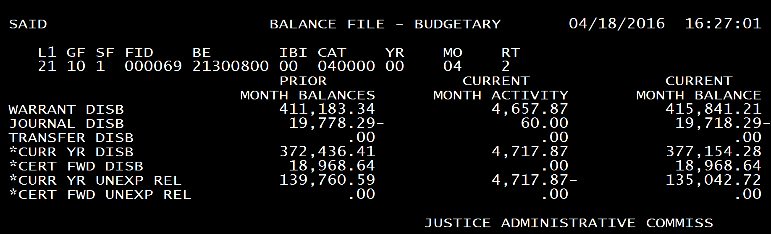
6/30/22 FLAIR Balance
The State Accounts (SA) – Balance File will reflect the amount eligible for certification when FLAIR “opens” in early July
The current year unexpended release balance for June is the total amount available for certifying (to pay for FY 21-22 obligations)
6/30/2020
06
Notes:
18
18
If B.O.M.S. or any other internal system being used has a different balance than State Accounts, it is critical that you use the State Accounts Balances for Certification Forward. Internal systems must be reconciled to the FLAIR State Accounts Balances.

Slide 19
Obligations – Identified by Classes
Class A
Class B
Class C
Accounts Payable – Goods or services received on or before June 30, but not yet paid
Encumbrances – Goods or services ordered but not received by June 30
Accounts Receivable – Cash refunds owed to the state for payments made prior to June 30*
*Only applicable for general revenue refunds needed to pay obligations
Notes:
19
19
Goods/ Services received on or before June 30 should be classified as A items. For class B items, if you have not received the goods/services, estimate the receipt date. If the date received on a class B item is prior to July 1, then it would not be a class B and should be listed as class A.

Slide 20
Public Defender and State Attorney Due Process - Balances
There will be a large surplus for SA and PD due process this year
June 30th the funds will revert back to the state
In July the funds will be returned to the current year budget (pending the Governor's approval)
There will be no payables set up for due process this year
FY 21-22 obligations will be paid with 22-23 funds.

Slide 21
Sexually Violent Predator Funds (SVP)
There is also a surplus expected in this fund
If your office has 21-22 obligations send us a lump sum form to set up your payable
JAC sets up a payable with the amount left for our Court Appointed section’s obligations
If JAC Accounting sees invoices with a date prior to June 30th we will use the payable set up for with the excess amount

Slide 22
Acquisition for Motor Vehicles Appropriation - Reminder
Revert and appropriate was not picked up.
If you ordered a vehicle this year and do not receive it by June 30th you will have to certify those funds.

Slide 23
Certified Items and Budgets
When obligations (e.g., payables or encumbrances) are entered in FLAIR with a “C” in the CF field
  A certified budget is created
  The certified budget is in effect for the period of July 2–September 28 only
  The certified budget is used to pay prior year obligations (only)
  The certified budget does not affect the current year budget

Slide 24
“Lump Sum” Certified Budget - Overview
Certify all or part of the June 30 unexpended release balance in FLAIR (Operations)
Generally one payable is set up for each fund and category (BOMS fund) – no long lists
For example, JAC has a June balance in general revenue operations category (103230) of $35,042.72
  A payable (e.g., PJAC001) is added to FLAIR with a total of $35,042.72 – this payable establishes the certified budget for general revenue expenses

Slide 25
Lump Sum Certified
Follow these four steps:
  Determine June unexpended release balance –
  SA Function in FLAIR or report from JAC
  Fill out lump sum form identifying amounts to certify (per fund and category)
  Determine if any receivables are needed
  JAC Accounting staff will assist with assigning payable numbers (and receivables) for each office
    Each payable will be assigned one vendor and one object code

Slide 26
JAC Lump Sum Certified Form
JAC has created a form to identify the amount to lump-sum certify in each fund and category
Receivables may be added to form if needed
The Lump Sum Form will assist JAC with setting up the budgets (payables) in FLAIR
The form is available on JAC’s website
JAC will email a copy to your office, if desired

Slide 27
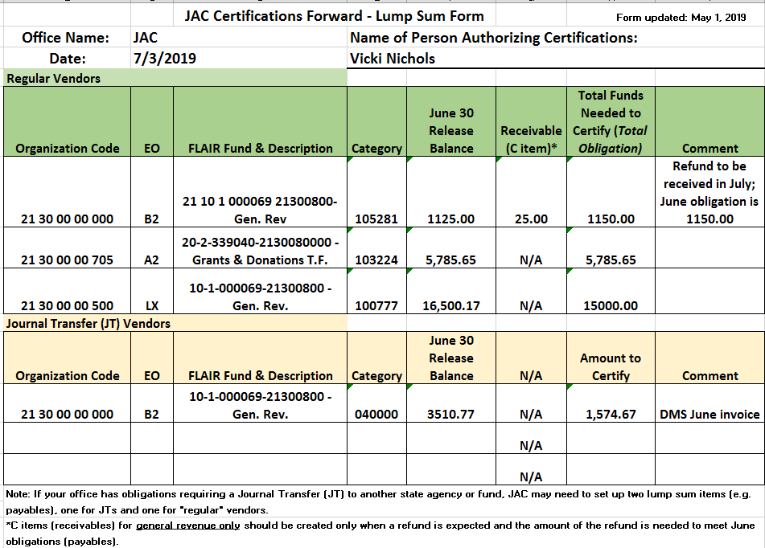
JAC Lump Sum Form - Sample
7/5/2022

Slide 28
Lump Sum Certified (cont.)
The JAC Accounting Section will enter payables (and receivables) in FLAIR, establishing the certified budget, and send a FLAIR report for each office to review
As soon as lump sum items are set up in FLAIR – send batches/invoices to JAC with the assigned payable number
Lump sum payable (budget) is reduced in FLAIR with each invoice
  JAC Accounting staff enters vendor number and appropriate object code when paying the invoice
No CF1 or CF2 forms needed when using lump sum

Slide 29
Certifications Forward – Detailed Option (CF1 Form)
Complete CF1 form for each FLAIR fund and category (BOMS fund)
Submit CF1 forms to JAC’s Accounting Section during the period July 5 – July 12
JAC’s Accounting Section will process individual items in FLAIR and work with each office to ensure the FLAIR entries are correct
Submit batches/invoices to JAC paying obligations with individual payable numbers
No CF2 Form is required – JAC will verify that the certified total does not exceed 6/30 release balances or cash if it’s a trust fund.
Notes:
29
29
This presentation is an overview of the forms used as source documents by JAC to enter the appropriate FLAIR information for your particular office and how to complete these forms.

Slide 30
Certified Forward Batch Sheets
For any invoices submitted for payment
(via batch sheets) using certified funds, please include:
  Payable or encumbrance number (with “C”), or
  Something evident on the batch that it is a certified payment (can be hand-written)
  Back-up, such as: authorization, goods received date, or other documentation clearly showing the invoice should be paid from prior year funds (clearly a prior year obligation)
Notes:
30
30
The payable number and class of the item can be handwritten on the batch sheet. In order to maintain clear communication and a clean audit trail, JAC will not process certification forward vouchers , until a Certified forward batch sheet is received.

Slide 31
Target Dates and Deadlines – June Recap
June 24: Last day for current year expense Warrant Cancellations to be processed
June 22: Last day for Batch Sheets to be submitted
June 2021
S
M
T
W
Th
F
S
June 22: Last day for submitting Current Year (FY 21-22) Expense Refunds
1
7
2
3
4
5
6
7
8
9
10
11
12
June 23: Last day for Journal Transfers to be submitted
13
14
15
16
17
18
19
June 23: Last day for JAC to approve travel in the STMS for payment in FY 21-22
20
21
22
23
24
25
26
27
28
29
30
June 28: Last day for Revenue Receipts to be submitted
June 29: Last day to make deposits into Wells Fargo (Treasury) for processing in (FY 21-22)
5/19/2022
31
Notes:
31
31
Please keep in mind the following important date related to Year-End processing and to the Certified Forward process. Your observance of these dates will give JAC sufficient time to enter the information into FLAIR and allow for last minute items or correcting entries, if necessary. These dates also allow sufficient time for the Department of Financial Services to process all items by the close of business June 30th.
Please note that JAC will not process certifications forward transactions of any type until the proper forms have been received from your office. Again this reduces the chances of miscommunication and maintain a clean audit trail.

Slide 32
Deadline and Target Dates – July
July 5: Tentative Certified Forward Releases will become available
July 2021
S
M
T
W
Th
F
S
July 5-12: Certifications Forward Forms submitted to JAC; deadline July 13
1
2
3
4
5
6
7
8
9
10
July 5: Begin submitting CF and current year batches to JAC for processing
11
12
13
14
15
16
17
18
19
20
21
22
23
24
July 13: Run date for the Final Certifications Forward listings
25
26
27
28
29
30
31
29
July 14: Certifications Forward Report is due per instructions provided by the Executive Office of the Governor (EOG)*
*JAC will request the electronic transfer of this data through the FLAIR Help Desk, as instructed by the EOG.
5/19/2022
32
Notes:
32
32
CF1 and CF2 forms can be received earlier than July 18 if you have them ready. This deadline allows JAC time to enter the forms into FLAIR and make any corrections necessary. If you do have changes on the last day, these can be called in to your accountant an the adjustments made however; you must follow up immediately with a hard copy of the change.

Slide 33
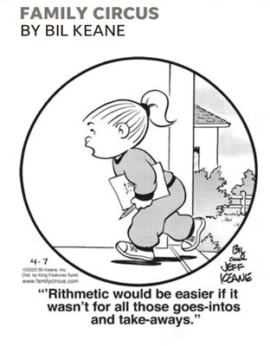
Budget Office Overview -
Budget Amendments
Notes:
33
33

Slide 34
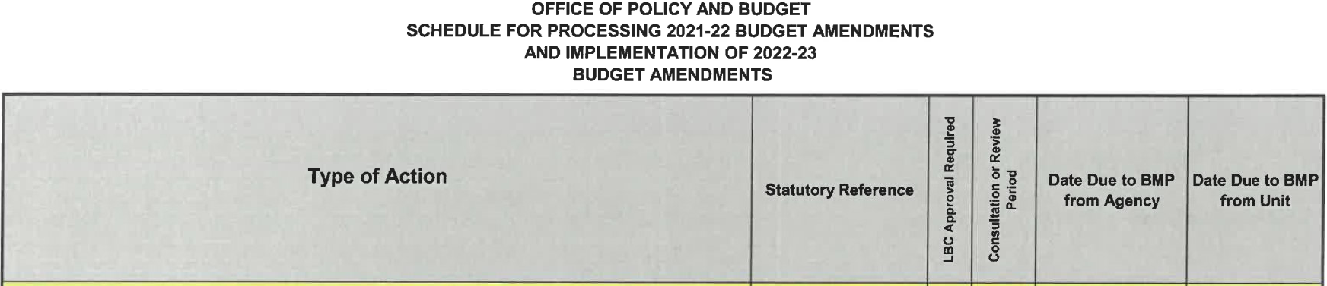
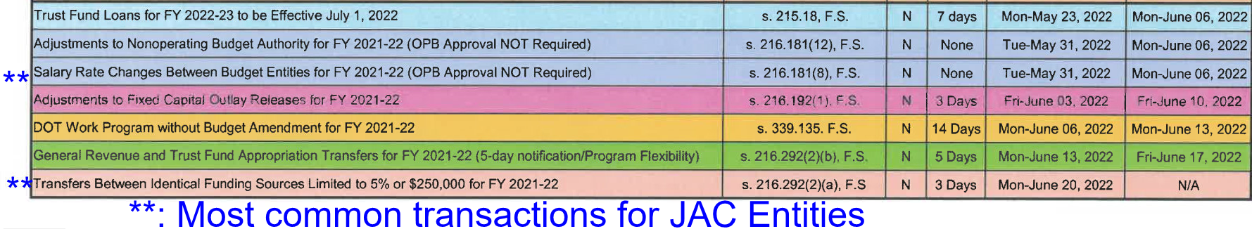
EOG Memo 22-043 Remaining Deadlines
Notes:
34
34

Slide 35

EOG Memo 22-043 Remaining Deadlines
Submit to the JAC Budget Section by:
Thursday, May 26, 2022: Salary Rate Changes between Budget Entities
Thursday, June 9, 2022: 5 Day Notification / Program Flexibility
Thursday, June 16, 2022:
  Budget authority movement between Budget Entities
  Budget authority movement within a Budget Entity
Notes:
35
35

Slide 36
5% or $250,000 (whichever is greater) Budget Amendments
Two types of 5% Budget Amendments for the Movement of Budget Authority: [See. s. 216.292(2)(a)1.–2., F.S.]
  1. Within a Budget Entity:
    Between appropriation categories
    Within identical funds
  2. Between Budget Entities:
    Within identical appropriation categories
    Within identical funds.
The Governor’s Office of Policy and Budget (OPB) has a 3-day review period for all agency 5% or $250,000 Budget Amendments. [See s. 216.292(2)(a)4., F.S.]
Notes:
36
36

Slide 37
Appropriation Modification versus Expenditure Journal Transfer
The Budget Office cannot move budget authority between funds with a Budget Amendment. This requires a Journal Transfer.
Budget Transfers and Amendments modify approved spending authority in Appropriation categories, before authority is spent.
Journal Transfers (JT) of expenditures ‘restores’ or ‘reduces’ available spending authority. JT’s occur after authority is spent.
For assistance with journal transfers please contact: Accounting@justiceadmin.org.

Slide 38

Procedures for Completing the 5%/$250K Budget Amendment Form
When a JRO determines that a movement of budget authority is necessary:
Verify there is sufficient unexpended released budget authority available that can be transferred as requested.
Consider all invoices that have been sent to the JAC Accounting Section that have not been processed for payment.

Slide 39
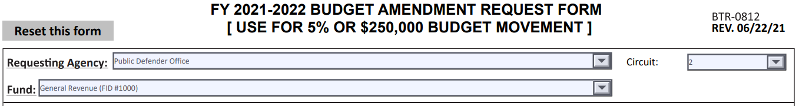
Procedures for Completing the 5%/$250K Budget Amendment Form
Access the electronic form through the JAC Budget Section’s website: https://www.justiceadmin.org/sa/budget/5percentForm.pdf
Step 1. Begin by selecting your agency and circuit/region (as applicable) from the drop-down boxes.
Step 2. Select the appropriate fund (Example: General Revenue, Grants and Donations Trust Fund, etc.)

Slide 40
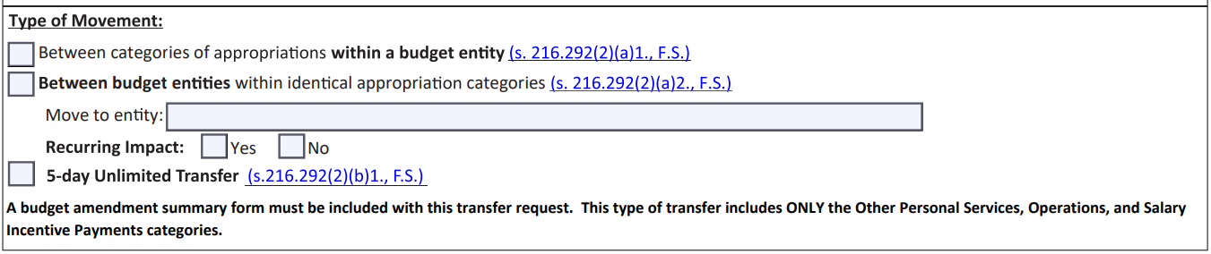
Procedures for Completing the 5%/$250K Budget Amendment Form
Step 3. Select the type of budget movement you are requesting:
between different appropriation categories within the same budget entity and fund
between budget entities within the same appropriation category and fund
If you are initiating budget movement between budget entities then the budget entity you are moving funds to must be listed under the section entitled “Move to Entity.”
A
B
C
See Step 4.
See Step 5.

Slide 41
Procedures for Completing the 5%/$250K Budget Amendment Form
Step 4. Determine the impact [recurring or non-recurring]. Budget amendments are only good for the current fiscal year, therefore if you would like the exact amount of the budget transfer to be recurring in subsequent years then mark “Yes” in the Recurring Impact section of the Budget Amendment Request Form. Otherwise mark “No”.
Step 5. If you are requesting a 5-Day Unlimited Transfer, a budget amendment summary form must be completed with full justification for the budget action. Section 216.292 (2) (b) 1. Florida Statutes limits the appropriation categories that can be utilized in this type of transfer. [Deadline: Monday June 13, 2022]
https://www.justiceadmin.org/ClientAgencies/Budget%20Deficit%20Procedures/Budget-Amendment-Summary-Form.pdf

Slide 42
Procedures for Completing the 5%/$250K Budget Amendment Form
Step 6. Type “GR” in the Revenue Source column if the transfer is for General Revenue. If the transfer is for a trust fund, the source of funds must be listed (i.e., Article V-Traffic Fines, Cost of Prosecution, County Information Technology, VAWA, etc.). A numeric organizational code and EO from your account code listing may also be noted to further identify the desired cost center to post to in FLAIR.
Step 7. Enter the amounts “from” and “to” onto the form on the desired appropriation category or categories lines. Enter whole dollars only. PLEASE DO NOT enter cents or use any type of punctuation marks. The form will automatically convert the amount “from” to a negative number and the amount “to” will automatically show as a positive number. Therefore, do not insert plus or minus signs in front of the dollar amounts.

Slide 43
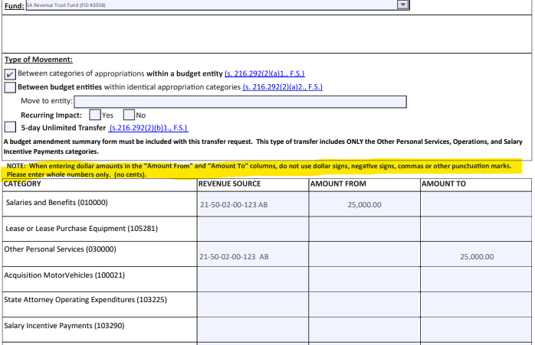
Procedures for Completing the 5%/$250K Budget Amendment Form

Slide 44
Procedures for Completing the 5%/$250K Budget Amendment Form
Step 8. Provide a brief reason why the budget amendment is being requested.
Example Statement: The ___ Office in the __ Judicial Circuit does not have sufficient budget authority in the Other Personal Services (OPS) category to meet this fiscal year’s remaining obligations.
Step 9. Date and sign the completed form. An employee who is authorized to sign budget transaction requests may type their name in the authorized signature field without having to print and sign the form.
Step 10. Transmit the form electronically to the JAC budget Office using the following email address: Budget@justiceadmin.org

Slide 45
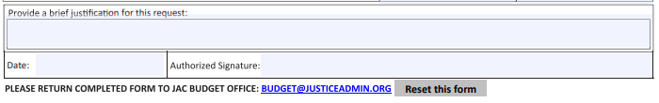


Procedures for Completing the 5%/$250K Budget Amendment Form
SPECIAL NOTE REGARDING 5% or $250K BUDGET AMENDMENTS
When there is a consistent need to request the same transfer of budget authority between the same categories every fiscal year; please consider a realignment of budget authority in your LBR or Amended LBR using Issue Code numbers 2000100 [Add] and 2000200 [Deduct]. This action will help to ensure that your operating budget is properly aligned where best and most needed to accommodate expenditures. Additionally, it will decrease the number of requests made to OPB during the fiscal year.

Slide 46

IN TIME for LBR & LRPP FY2023-24 Preparation ....
Implementing the use of shared Budget folders between the Budget Office and the JRO’s to minimize emailing numerous attachments back and forth as necessary to assemble the LBR and LRPP.
Fewer than a dozen JRO’s are not set up.
More information to come in the next several weeks
Notes:
46
46

Slide 47

Budget Office Contact Information
Email Addresses: budget@justiceadmin.org *
Mailea Adams: mailea.adams@justiceadmin.org
Kelly Jeffries: kelly.jeffries@justiceadmin.org
Adams Preisser: adam.preisser@justiceadmin.org
Telephone #: (850) 488-2415
* Preferred address for submissions that are to be processed.
Notes:
47
47

Slide 48


Human Resources
How it started. How it ended.
Notes:
48
48

Slide 49
Payroll Discussion—
Early Submission: Please submit payroll actions as soon as you know about them.
On-Demand Payments:
Deadline for processing in
FY 21-22 is
Tuesday, 06/28/2022 at 2:00 p.m.
No guarantee that On-Demand requests entered after 06/28/2022 2:00 p.m. will be processed from FY 21-22 budget, but can be certified forward as a FY 21-22 payable if funds are available. Please coordinate with your JAC Accountant.
Supplemental Pay Transactions:
Due Thursday, 06/16/2022 to ensure processing from
FY 21-22 budget.
5/19/2022
49
Notes:
49
49

Slide 50
Payroll Discussion
Supplemental Payroll processes Tuesday, June 21st
It will post late afternoon on Tuesday, June 21st
It will pay on Monday, June 27th
Supplemental will be charged to FY 21-22
5/19/2022
50

Slide 51
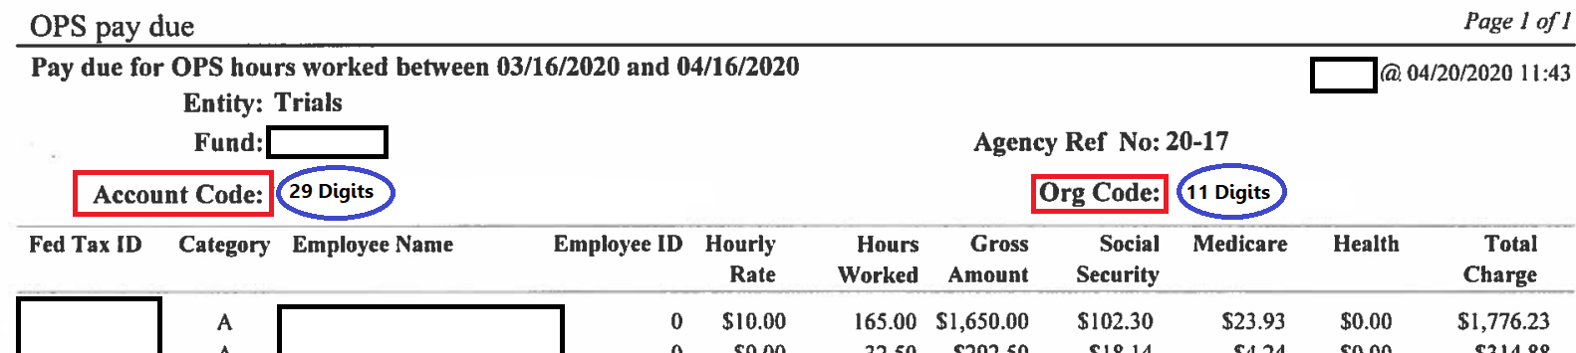
ORG CODES! They do make a difference.
Please do not confuse the Account Code with the Org Code. Both are important to put on the form. Account Codes ensure we have the correct corresponding Org Code.
Account Codes have 29 digits.
Org Codes have 11 digits.
5/19/2022
51

Slide 52
Salary Cancellation Deadlines
Potential Budget Impact
EFT Cancellations
Paper Warrant Cancellations
Monthly payroll EFTs marked for deletion by 10:00 a.m., Tuesday, 06/28/2022 and supplemental payroll EFTs marked for deletion by 9:00 a.m., Thursday, 06/23/2022 will be restored to agency’s accounts in June 2022. Overpayment problems discovered after these deadlines will require a refund from the employee.
Salary cancellations requested in late June which are not timely processed and approved by DFS can result in funds not being restored for
FY 21-22.
Deadline for processing cancellation of payroll warrants dated for June is 9:00 a.m., Wednesday, 06/29/2022 to ensure funds are restored to FY 21-22 accounts.
EFT cancellation reports will not post in RDS until the warrant date of June 30th.
JAC staff will monitor pending cancellations to ensure proper processing for FY 21-22.
5/19/2022
52
Notes:
52
52

Slide 53
Insurance Payments
Health, Life & Disability Voucher Payments (to DMS) deadline for submission to JAC is 5:00 p.m., Thursday June 16, 2022.
JAC will follow the standard operating procedure of coordinating with the JRO prior to processing the voucher.
Insurance premium payments for July coverage that are not paid in June cannot be certified forward and must be paid out of FY 21-22 funds; have employees sign up as soon as possible.
5/19/2022
53
Notes:
53
53

Slide 54
Avoid Negative Balances
The June monthly regular payroll will post in the late afternoon of Thursday, June 23rd.
You can still do a Journal Transfer after payroll posts if you have a negative balance. JT requests must be received by our Accounting Section by close of business on Thursday, June 23rd.
Any negative Salary or OPS release balances created after payroll posts on Thursday, June 23rd must be cleared by Tuesday, June 28th.
5/19/2022
54
Notes:
54
54

Slide 55
Journal Transfers – Transferring Expenditures at Year-End
JAC runs reports to monitor payroll activities and account balances frequently.
Staff in JAC’s Accounting and HR sections coordinate to try to “catch” negatives.
If any unexpected or “extra” payrolls are processed the last week of June, please be sure there is enough budget to cover that payroll.
When sending JTs reducing General Revenue balances, please factor in any payrolls that may run during that last week of June.
5/19/2022
55

Slide 56
Salary Refunds
Code 200 Deductions
For the month of June only, if a salary overpayment refund is due from an employee, please obtain a check or money order in lieu of a Code 200 deduction. Code 200 deductions entered in June, regardless of the month the overpayment occurred, will not be processed until July, too late to restore funds to your account for FY 21-22. Therefore, the refund due must be certified forward.
Pending Benefits Refunds
In the rare event of a total net salary refund, refunds for the overpayment of insurance premiums require approval by DMS, JAC cannot guarantee that all pending refunds will get processed and approved by Thursday, June 16th. Any refunds not processed and approved by that date will go to unallocated.
5/19/2022
56
Notes:
56
56

Slide 57
Benefits Premiums
Benefit premium monies cannot be Certified Forward for premiums due after June 30th. If there is an employee expected to be on LWOP, a voucher will be needed to cover their benefits premium for July coverage. The voucher will need to be processed in June to come out of current year funds. Even though premiums are paid a month in advance, they cannot be Certified Forward for this cost.
5/19/2022
57

Slide 58
Overpayment Strategies
Cancellation vs. Reimbursement
Employee overpaid by EFT on regular payroll:
Option 1
Option 2
EFT Cancellation – Must be processed and approved by 10:00 a.m., Tuesday, June 28th or funds will not be restored to FY 21-22 budget. (Cancellation reports will not show up in RDS until late on the warrant date of June 30th.)
Seek reimbursement from employee for overpayment. Checks received by HR after Wednesday, June 22nd will be deposited into unallocated. (Coordinate certified forward receivables with your JAC Accountant.)
5/19/2022
58

Slide 59
Retirement Credits
If your circuit is due a retirement credit, JAC has no control as to when the Division of Retirement will generate the invoice from the error report.
The Division of Retirement will cease processing credit requests after June 1st, 2022.
5/19/2022
59

Slide 60
Helpful Hints
Check your rate reports daily.
OPS employees are paid for hours actually worked, not hours projected to work.
Please do not use retroactive dates for June payroll actions. People First will not allow a retroactive date if a future dated action has already been processed.
No payroll adjustments that affect an employee’s “prior quarter” tax obligations (withholding, Social Security, Medicare) will be processed between Friday, June 10th and Thursday, June 30th, 2022.
Please adhere to all HR Calendar deadlines.
5/19/2022
60

Slide 61
Human Resources Contacts
Please use these email groups:
payrollgroup@justiceadmin.org
benefits@justiceadmin.org
retirementcoordinator@justiceadmin.org
posttaxbenefits@justiceadmin.org
5/19/2022
61

Slide 62
Salary Rate
Notes:
62
62

Slide 63
Salary Rate
Section 216.292(2)(a)3., F.S., states, “Any agency exceeding salary rate established pursuant to s. 216.181(8), F.S., on June 30th of any fiscal year shall not be authorized to make transfers pursuant to subparagraphs 1. and 2. in the subsequent fiscal year.”
This references the “Agency 5% or $250,000 Transfer Authority” for moving funds within and between budget entities.
If this penalty is imposed, agencies seeking to move funds would have to appear before the Legislative Budget Commission (LBC).
Therefore, on June 30, 2022, the 50 entities that comprise Justice Administration must be at, or under, our authorized rate in order to have Agency 5%/$250,000 Budget Amendment Authority for FY 22-23.
5/19/2022
63
Notes:
63
63

Slide 64
Rate Reports
June Rate Reports
Positions vacant for 180 days or more
  If you have positions that have been vacant for more than 180 days, or very close to that number, you may want to consider reclassifying them to start the clock over from the time that they have been vacant.
  Please note that the clock will start over only if an employee is placed in the vacant position.
5/19/2022
64

Slide 65

Financial Statements
Notes:
65
65

Slide 66

Financial Statements Workshop
Thursday, June 16
Workshop provides procedural
updates and year-end information
Participation is encouraged
Email will be sent to the
JRO contacts today
5/19/2022

Slide 67
Financial Statement Checklist
A checklist is available with deadlines
The checklist and the forms can be found on JAC’s website under Financial Services
5/19/2022

Slide 68
Information JROs Provide
You are a fundamental part of generating successful financial statements
We only have about 2 weeks to complete the bulk of the financial statement work
Receiving JRO information on time is critical
5/19/2022

Slide 69
  Important Information Due Dates
June 1 Declaration of Intent
July 8 Operating Lease Information
July 15 Receivable Information
July 15 Capital Assets Information
July 20 Leave Liability Information
The Revolving Fund Information form is no longer required.
5/19/2022

Slide 70

  Declaration of Intent
Notify JAC of the systems used by the JRO for property, timesheet, and accounting
Select if your JRO or JAC will prepare all of the year-end financial statement entries and documents
  JRO’s selection
  due June 1
5/19/2022

Slide 71
Operating Leases
Due July 8
Includes contracts paid through FLAIR for rent, leased space, copier rentals, & postage machines
Only include if the period is > 1 year
Calculate the total remaining obligation to be paid each fiscal year
5/19/2022

Slide 72

Implementing GASB 87
If DFS implements changes to capture information needed for GASB 87:
The type information needed to complete DFS forms may change and be more detailed.
There may be an interactive form
More information will be provided in DFS’s Workshop June 14.
5/19/2022
72

Slide 73
Receivables Information
Due July 15
Include all funds owed to a JRO and will be deposited into FLAIR
  State agencies
  Other JAC entities
  County reimbursements
  Refunds due from employees or vendors
5/19/2022
73

Slide 74
Receivables Information (Continued)
Include:
  All reimbursements due for grants or other agreements
  Refunds not deposited by June 30th and received during July
5/19/2022

Slide 75
Receivables Information (Continued)
Exclude:
  Public records request payments since services haven’t been provided until payment is received
  4th Quarter Service Charge to GR
  Certified receivable tied to any CF payables (JT) between your funds (These must be sent to Accounting before CF closes)
5/19/2022

Slide 76
Capital Assets Information
Information is due on July 15
All reports will be in Excel Format
Provide either the:
  BOMS Report - NEW rolled up format V12.07
  Non-BOMS Capital Asset Summary form in Excel – JAC will provide the file
The data is used to create a significant number of entries
5/19/2022

Slide 77

Leave Liability Information
Information is due on July 20
This is the last information to be submitted so it is critical to be early or on time
10 days left
5/19/2022

Slide 78
Leave Liability – Short-Term Calculations
Non-BOMS Users
  A workbook will be provided with employee information needed to calculate leave liability payouts
  JROs input employee leave hours by type
  The worksheets will calculate the leave liability based on input
5/19/2022
78

Slide 79
Leave Liability – Short-Term Calculations (Continued)
BOMS Users
  Provide the Annual, Sick and Compensatory Leave Liability report
  Both short-term factors will be entered in BOMS
  Critical to enter provided leave payout information to correctly calculate liability
5/19/2022
79

Slide 80

Revolving Fund Information
All participating offices are using the CRA so this form is no longer needed
5/19/2022
80

Slide 81
Final Review of Financial Statement Information
Information will be provided July 29
Trial Balance will be added to RDS
Compiled forms and information will be emailed
Notification of any discrepancies due by August 3
5/19/2022

Slide 82
Final Review of Financial Statement Information
Review of information for accuracy
  Missing receivable or missing obligations
  Missing payables owed to other agencies
  Missing payables for Service Charge paid to GR
  The form containing items between agencies is not fully generated from information provide by JROs
5/19/2022

Slide 83
Final Trial Balance Report
Final Trial Balance Report will be available via RDS or EOS on August 9
General ledger account balances on the final report are used to finalize the financial statement information due to DFS
5/19/2022

Slide 84
  Certifications Due Dates
July 6 Consideration of Fraud
August 15 Agency Head Certification
October 3 Subsequent Events Certification
November 4 Agency Representations for the Annual Comprehensive Financial Report
November 4 Agency Representations for the Schedule of Expenditures of Federal Awards
5/19/2022

Slide 85
Schedule of Expenditures of Federal Awards (SEFA)
Due September 2
A list will be emailed to JROs
Verify all federal grants or projects are listed
Best practice
  Revenue = Expenditures
  cash received & receivables = paid & payables
  The Auditor General may compare your expenditures to the amount paid to you from other agencies (VOCA, VAWA, & DFS)
5/19/2022

Slide 86
Submission of Financial Statement Information
Please submit all information to:
  financialservices@justiceadmin.org
  Return all Excel forms as Excel documents
  The entire Financial Services team will assist with Financial Statements.
5/19/2022

Slide 87
Subject Matter Experts
  Questions can be sent to the Financial Services mailbox or you can individually reach out to:
  Lorelei Welch – Accounts Receivable
  Brad Fannon – Transfers In & Out, Leave Liability
  Merry Sutton – Capital Assets
  Susie Kalous – Revolving Fund
  Dahlia Flowers – Operating Leases
  Aleah Roddenberry – Due To & Due From
  Nona McCall – Miscellaneous, Assistance & Review
5/19/2022

Slide 88

Financial Statements
Questions

Slide 89
Inventory
Year-End Closing

Slide 90
Year-End Closing
Please make sure that you have conducted a physical inventory, as required by Rule 69I-72.006, F.A.C., prior to closing your inventory year out.

Slide 91
Year-End Closing
Please make sure that you are recording all 16 data elements for your property items that are required by 69I-72.003, F.A.C.

Slide 92
Year-End Closing
Please make sure that you update your local copy of BOMS to the latest version so you can take advantage of the new features for Year-End reports.

Slide 93
Year-End Closing
Questions??

Slide 94
Calendar for Year-End
Fiscal Year 2021-22

Slide 95
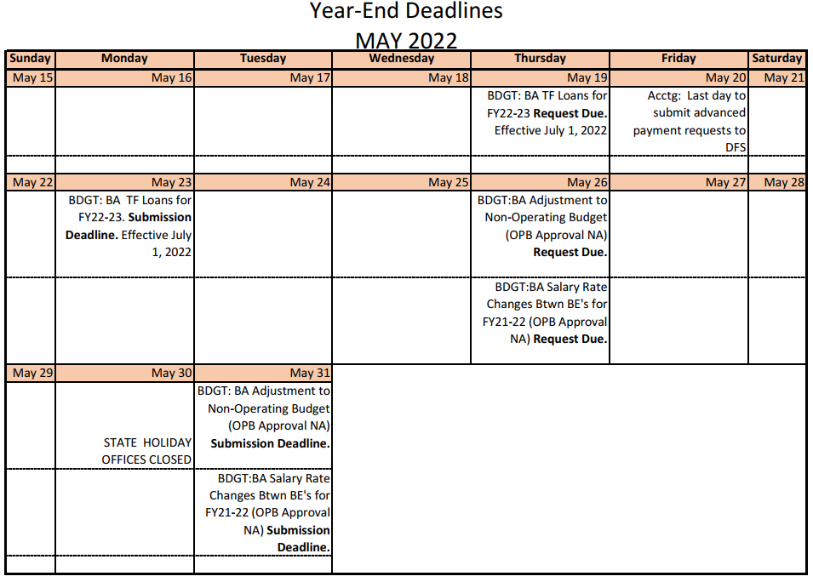
Calendar

Slide 96
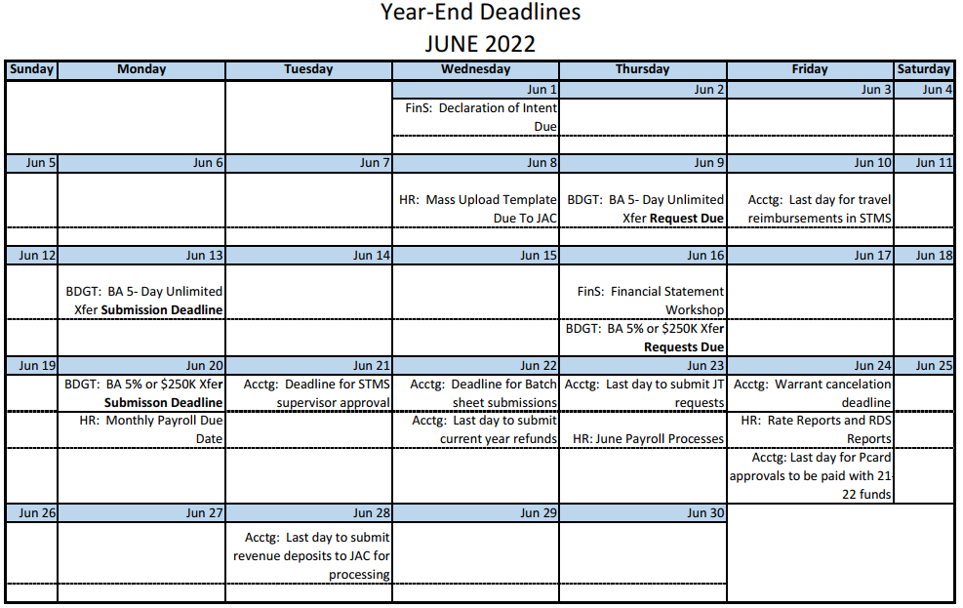
Calendar
96

Slide 97
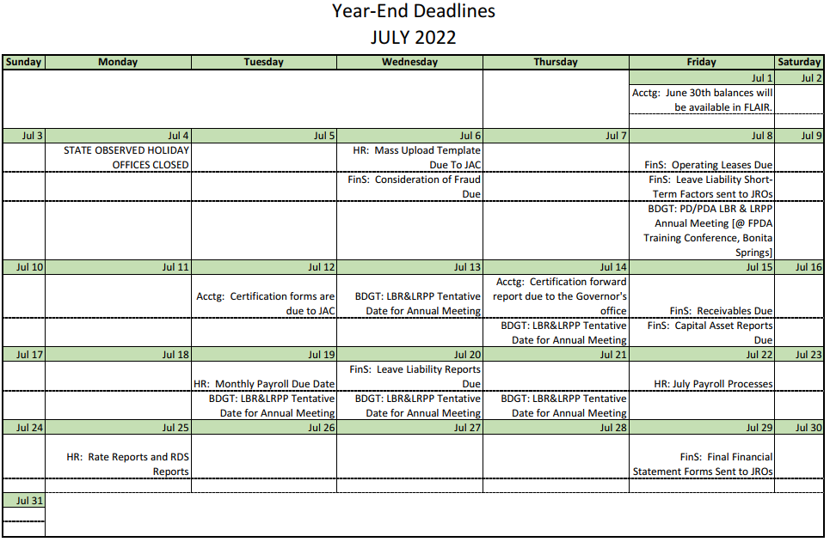
Calendar

Slide 98
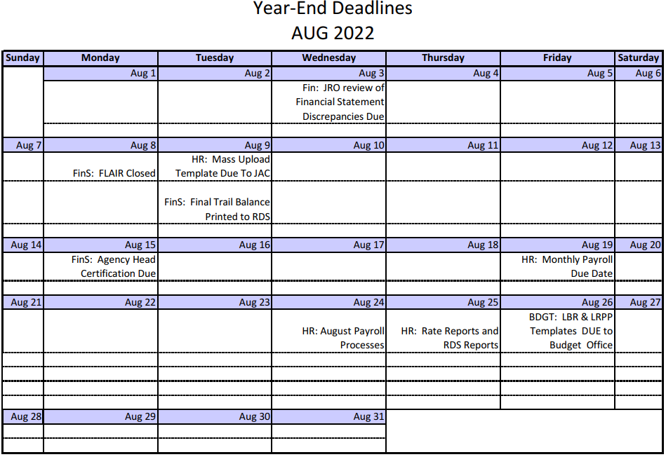
Calendar

Slide 99
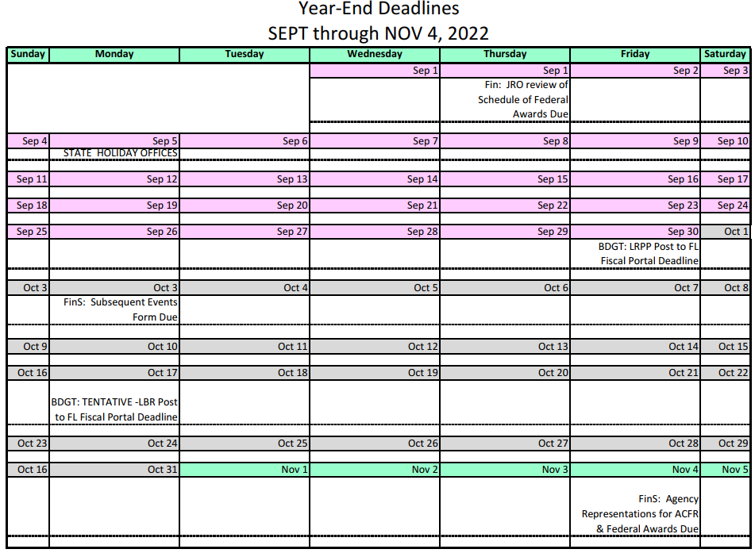
Calendar

Slide 100

Other Business, General Discussion and Questions
Notes:
100
100

